Slide 1

Habeus Hygge
Normalisation and Reintegration : Rethinking Canada’s Justice Path Through a Danish Perspective
This presentation does not reflect the views of the British Columbia Prosecution Service

Slide 2
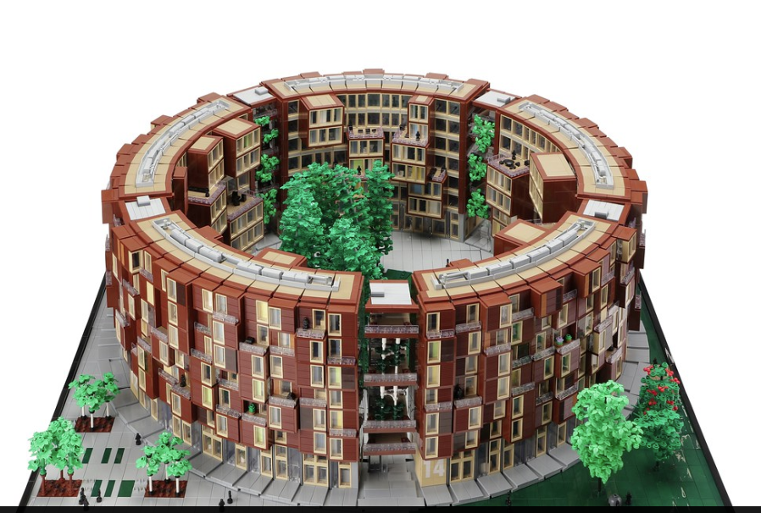
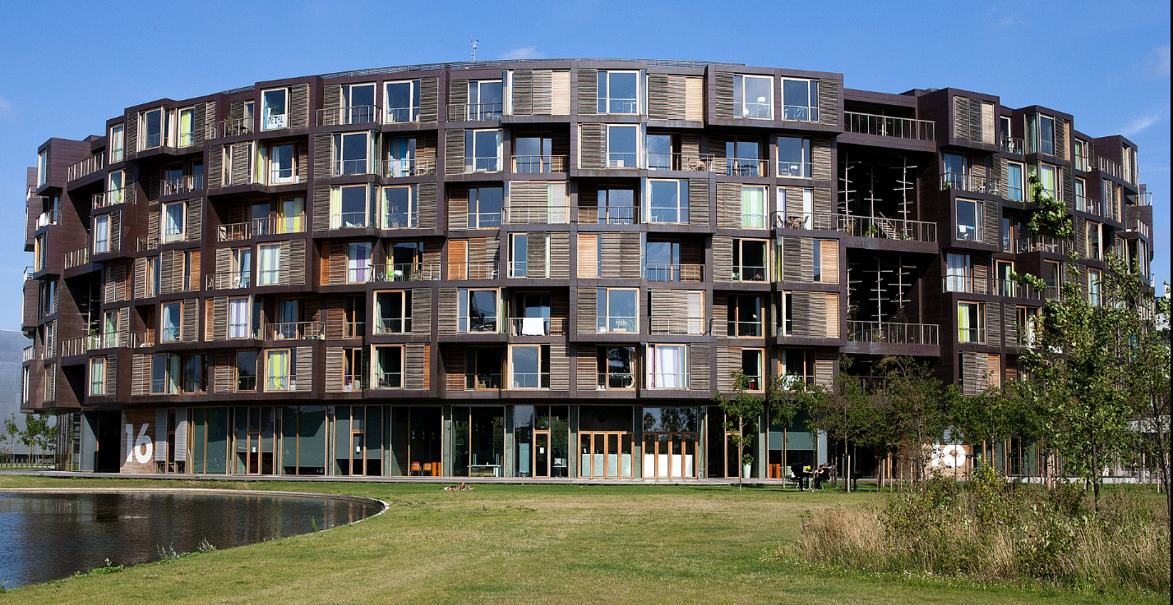
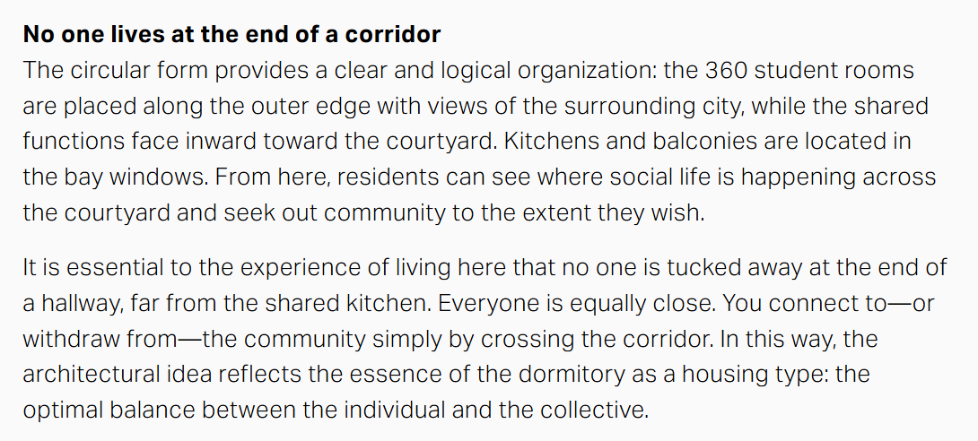
TIETGEN STUDENT RESIDENCE BUILDING
“No one is tucked away at the end of a hallway”
Tietgen Dormitory | Student Housing

Slide 3


Slide 4
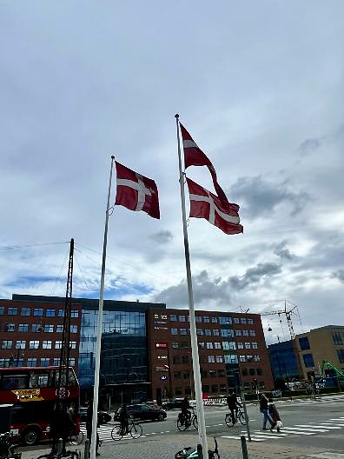
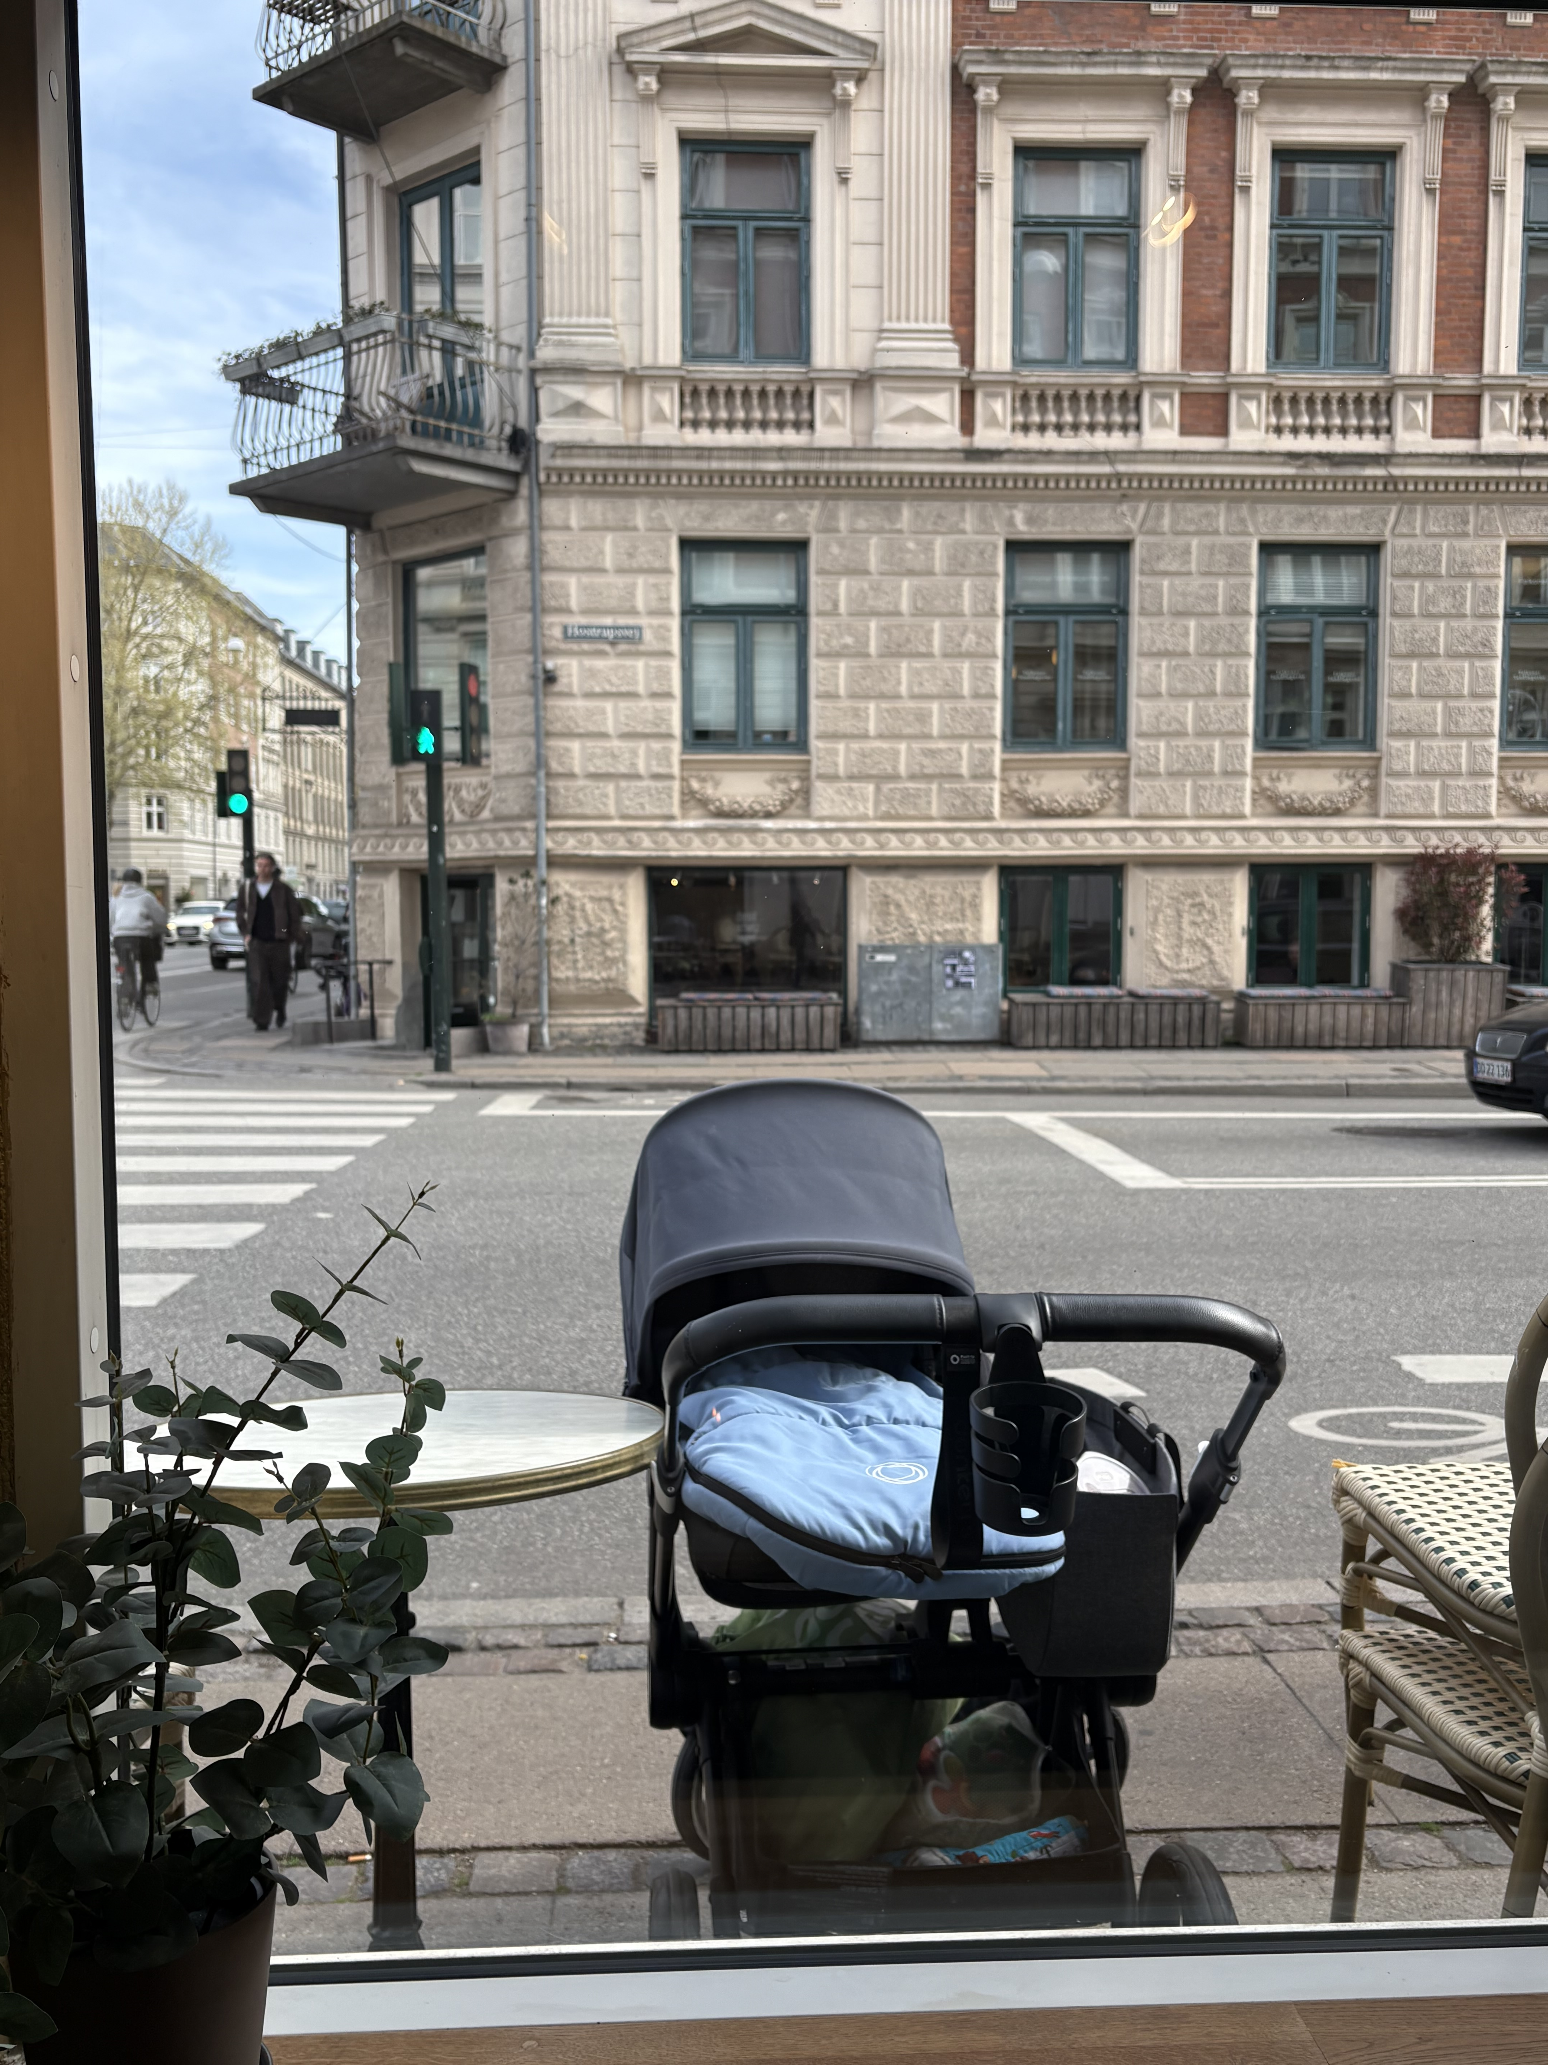
SOCIAL VALUES AS JUSTICE FOUNDATIONS
Hygge & Janteloven
Notes:
Brief explanation of each of these concepts and how you see them connected to each other – you should be about 1.5-2 minutes in at this point

Slide 5
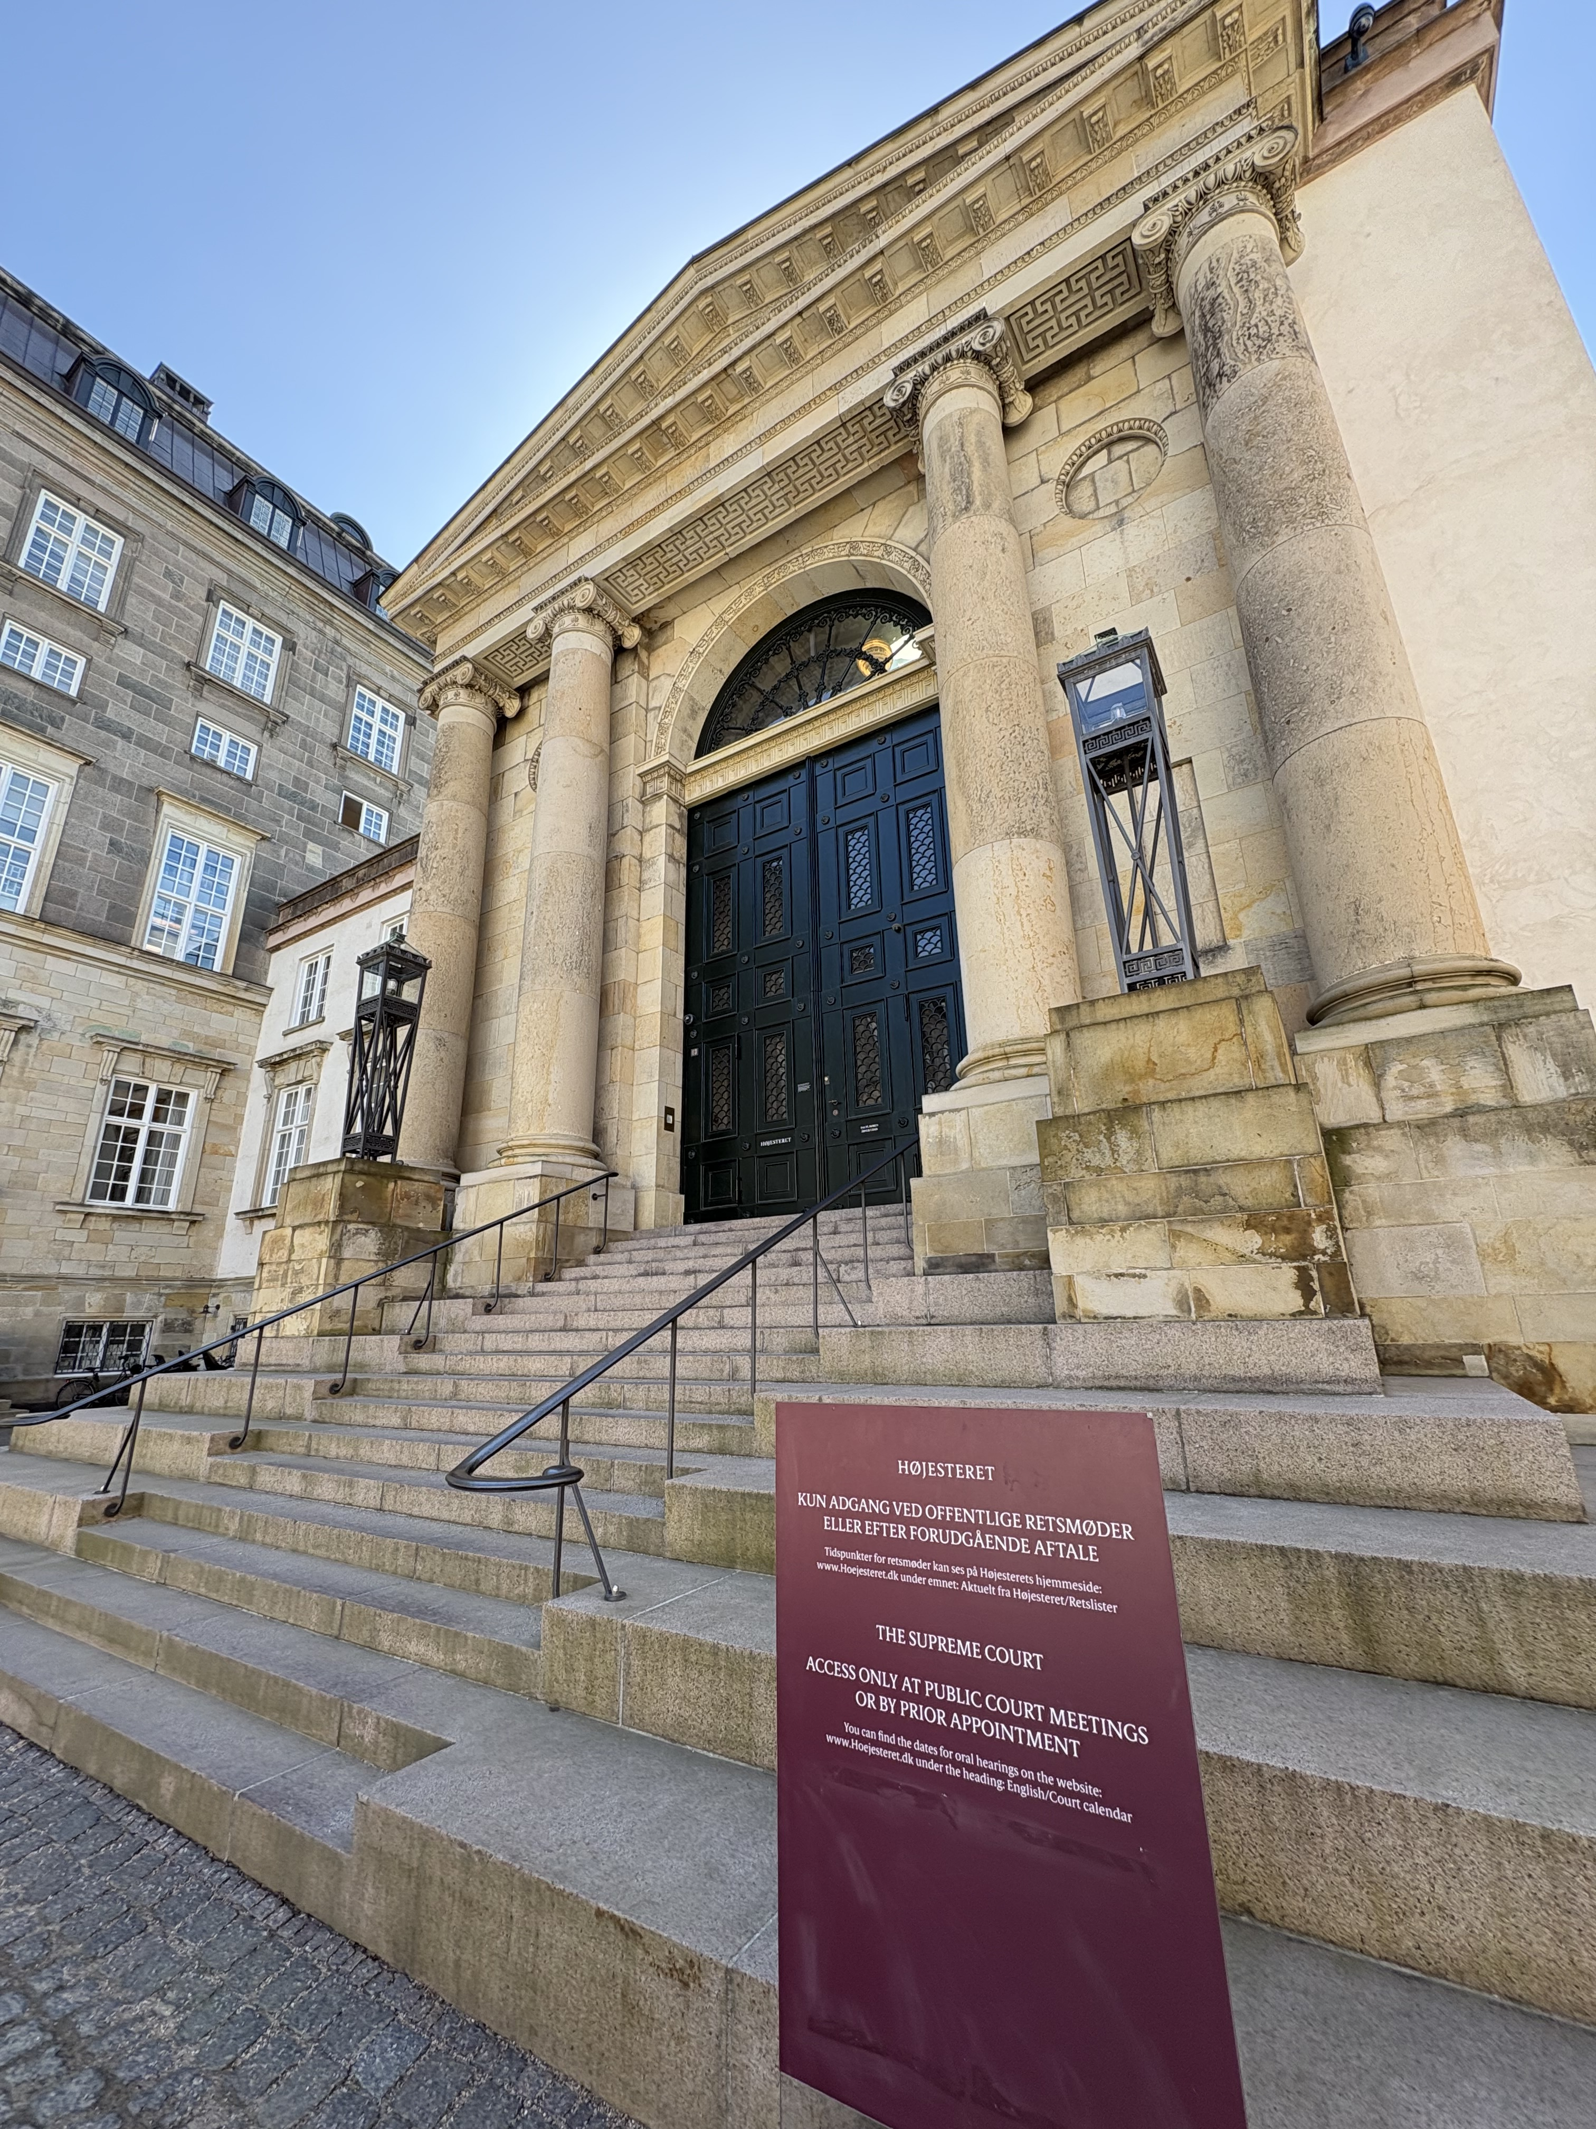
The Danish Prison and Probation Service is guided by six principles:
Normalisation, openness, responsibility, security, the least possible intervention, and the optimum use of resource
NORMALISATION:
    REINTEGRATION
    VICINITY
Supreme Court of Denmark

Slide 6
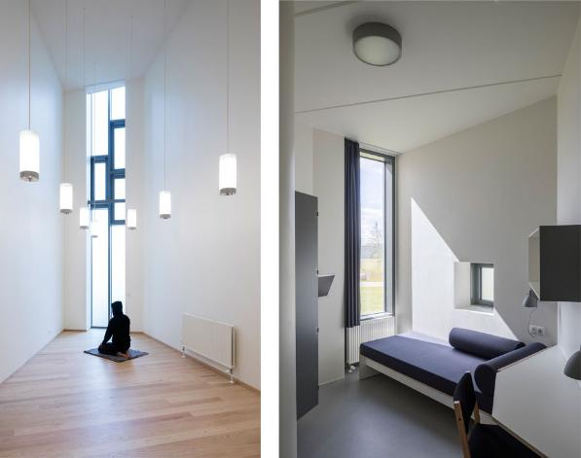
Reintegration: through
Institutional
Design
Storstrøm Prison

Slide 7
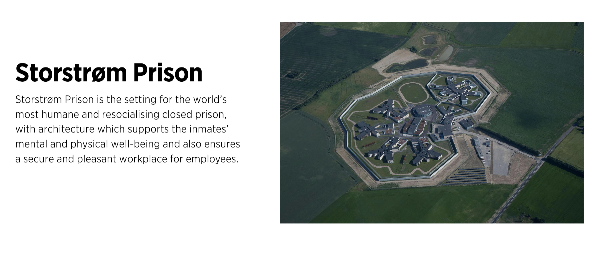
Storstrøm Prison - Projects - C.F. Møller

Slide 8
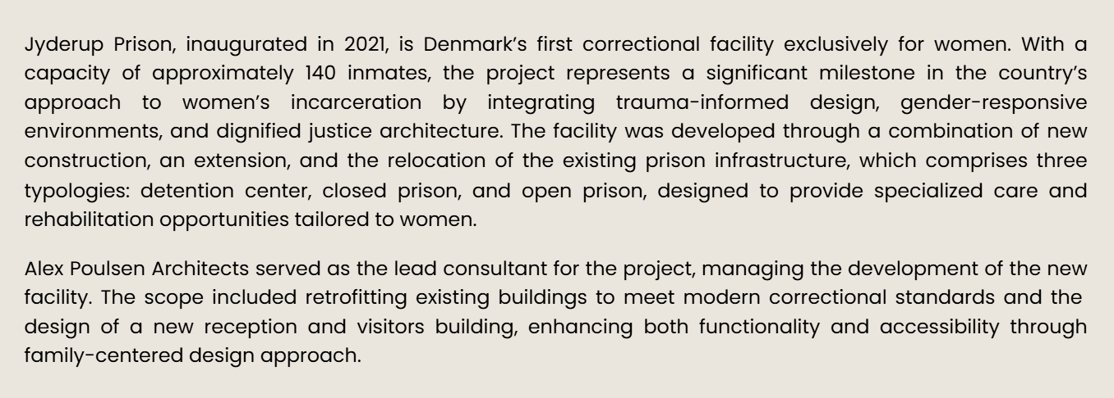
PRINCIPLE OF VICINITY
Jyderup Women’s Prison | Family-Focused Architectural Design — Alex Poulsen Architects

Slide 9
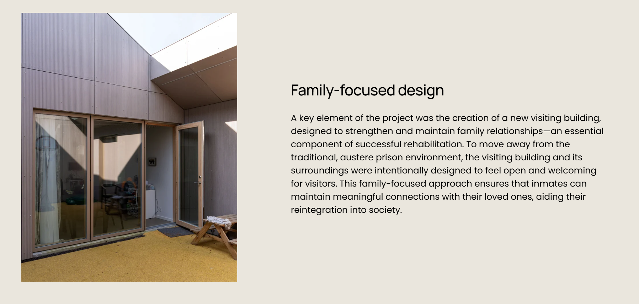
PRINCIPLE OF VICINITY

Slide 10

Institutional Coherence
Criminal justice is one small part of the overall ecosystem
Notes:
These are some suggested bullets, you should add more but none more than one line.

Slide 11
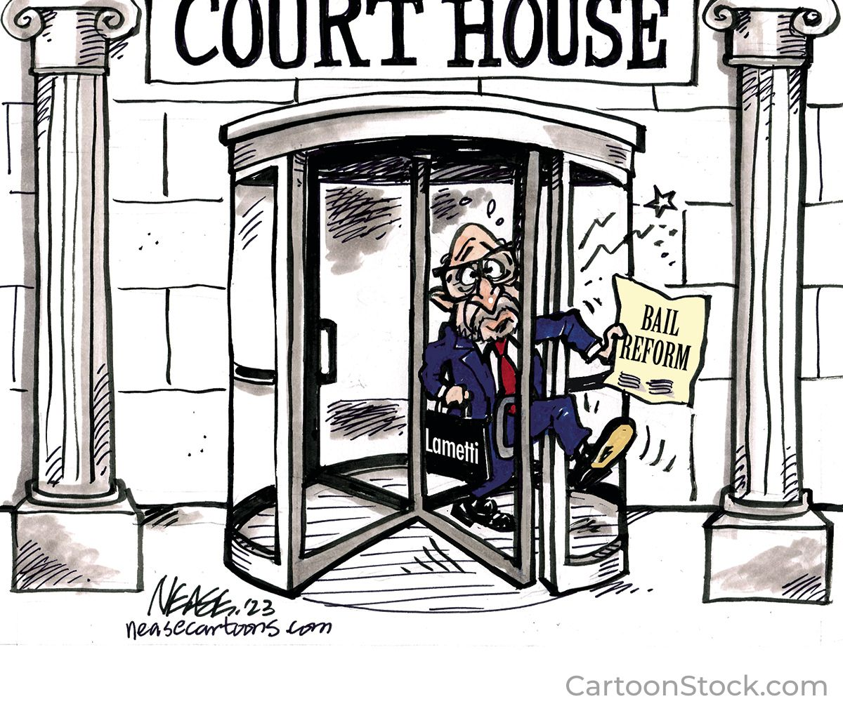
CONTEMPORARY
CANADIAN CONUNDRUM

Slide 12

Looking forward
Notes:
Brief explanation of each of these concepts and how you see them connected to each other – you should be about 1.5-2 minutes in at this point

Slide 13

Any fool can make something complicated.
It takes a genius to make it simple.
Woody Guthrie

