Slide 1






THE MYTH BEHIND BARS
WHY ALTERNATIVES TO IMPRISONMENT
MATTER FOR REDUCING REOFFENDING
thanks
overview
2nd conclusion
rehabilitation
1st conclusion
incapacitation
Maria Falcone Università degli Studi di Milano (Milan, Italy)
Tommaso Trinchera Bocconi University (Milan, Italy)
ISRCL Conference, Montreal 13-16 July 2026

Slide 2
Incapacitation vs. Rehabilitation
Costs:135€ (220CAD) per day
thanks
overview
2nd conclusion
rehabilitation
1st conclusion
incapacitation
Safety: sooner or later prisons open the doors
«Punishment can not consist in inhuman treatments and must aim at the rehabilitation of the offender» (Art. 27 Italian Cost.)

Slide 3
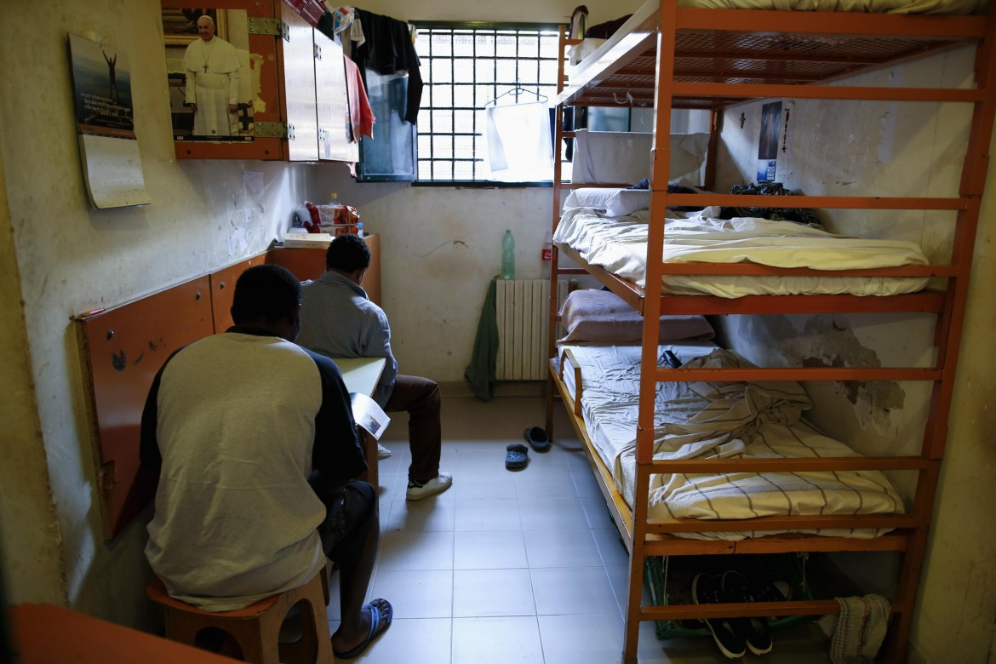
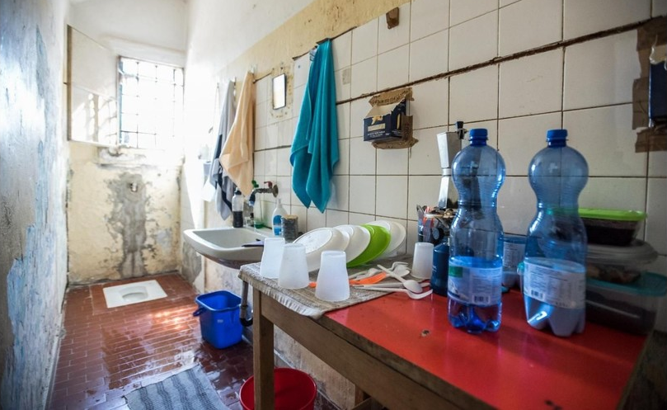
thanks
overview
2nd conclusion
rehabilitation
1st conclusion
incapacitation
ITALIAN PRISON
ITALIAN PRISON

Slide 4
59.2 %
40.8 %
WITH PREVIOUS IMPRISONMENT
WITHOUT PREVIOUS IMPRISONMENT
thanks
overview
2nd conclusion
rehabilitation
1st conclusion
incapacitation
Inmates in Italian prisons on 31 December 2025, by previous imprisonment experience
Sources. Statistical Office of the Italian Department for Administration of Prisons (DAP)
ITALIAN PRISON

Slide 5
59.2 %
40.8 %
WITH PREVIOUS IMPRISONMENT
WITHOUT PREVIOUS IMPRISONMENT
Inmates in Italian prisons on 31 December 2025, by previous imprisonment experience
Sources. Statistical Office of the Italian Department for Administration of Prisons (DAP)
thanks
overview
2nd conclusion
rehabilitation
1st conclusion
incapacitation
68.45 %
RETURNED TO PRISON
31.55 %
DID NOT RETURN
Convicted prisoners released in 1998 and followed until 2005: return to prison with final conviction.
Sources. F. Leonardi (2007), based on DAP Statistical Office data

Slide 6
thanks
overview
2nd conclusion
rehabilitation
1st conclusion
incapacitation
19 %
68.45 %
RECIDIVISTS
RECIDIVISTS
ALTERNATIVE MEASURE (AFFIDAMENTO IN PROVA)
INCAPACITATION-ORIENTED IMPRISOMENT
Recidivism after alternative measure (affidamento in prova) and ordinary imprisonment
Sources. Sources. F. Leonardi (2007), based on DAP Statistical Office data and criminal records data

Slide 7
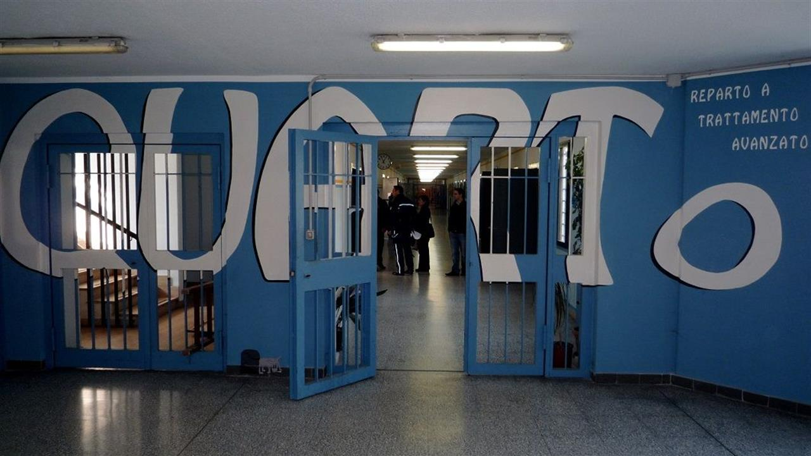
thanks
overview
2nd conclusion
rehabilitation
1st conclusion
incapacitation
19 %
68.45 %
RECIDIVISTS
RECIDIVISTS
ALTERNATIVE MEASURE (AFFIDAMENTO IN PROVA)
INCAPACITATION-ORIENTED IMPRISOMENT
BOLLATE PRISON
Recidivism after alternative measure (affidamento in prova) and ordinary imprisonment
Sources. Sources. F. Leonardi (2007), based on DAP Statistical Office data and criminal records data

Slide 8

68%
Incapacitation-oriented Imprisonment
40%
thanks
overview
2nd conclusion
rehabilitation
1st conclusion
incapacitation
Bollate Prisoners
MASTROBUONI & TERLIZZESE ESTIMATE (2022)
1 additional year in Bollate instead of
an incapacitation-oriented prison
percentage points
recidivism
– 6
BOLLATE PRISON

Slide 9
68%
Incapacitation-oriented Imprisonment
40%
thanks
overview
2nd conclusion
rehabilitation
1st conclusion
incapacitation
Bollate Prisoners
-6%
MASTROBUONI & TERLIZZESE ESTIMATE (2022)
1 additional year in Bollate instead of
an incapacitation-oriented prison
BOLLATE PRISON

Slide 10
Why does rehabilitation-oriented punishment matter?
Rehabilitation requires investment.
Repeated incarceration creates
higher long-term costs.
Safety
Legitimacy
thanks
overview
2nd conclusion
rehabilitation
1st conclusion
incapacitation
Costs
Confinement only postpones risk.
Rehabilitation reduces recidivism over time.
Legitimate punishment preserves the path back to society through rehabilitation.

Slide 11
Recidivism is not only a fact about the offender.
It also reflects missed opportunities for rehabilitation.
ARGUMENT
QUESTION
Can repeat-offender enhancements be justified solely by a prior conviction?
thanks
2nd conclusion
overview
rehabilitation
1st conclusion
incapacitation
PROPOSAL
A harsher punishment is justified only if the previous sentence offered a genuine opportunity for rehabilitation.
Otherwise, recidivism may also reflect the failure of the criminal justice system, not only that of the offender.

Slide 12
Thank You
For Your Attention!
thanks
overview
2nd conclusion
rehabilitation
1st conclusion
incapacitation
m.falcone@unibocconi.it
tommaso.trinchera@unibocconi.it

