Slide 1

The Role and Potential Benefits of Sentencing Guidelines
International Society for the Reform of the Criminal Law,
Montreal, 2026
Julian V. Roberts,
K.C. (Hon.) Ph.D., LLM

Slide 2
Overview
The Potential benefits to the sentencing process and society more generally;
Examples of Guidelines
Illustrating the benefits
Conclusions

Slide 3
Benefits for sentencing
More consistent and proportionate sentences as all courts apply a common methodology – seeking consistency of approach not outcome;
More evidence-based sentencing practices;
Increased victim confidence in courts;
Increased public knowledge of sentencing and confidence in the courts;
Enhanced perceptions of the fairness of punishments;

Slide 4
Good Sentencing Guidelines Should..
Be comprehensive -- covering all aspects of sentencing;
Be flexible and tailored to the specific offence;
Carry a compliance requirement yet allow judicial discretion to permit individualisation;
Be evidence-based and updated to reflect research on the effectiveness of sentencing;
Be subject to ongoing scrutiny to ensure they do not contribute to or exacerbate differential impact on minority defendants

Slide 5
Relationship between Court of Appeal and the Council: both are necessary
CA also issues guidance: supplementing and refining Council guidelines;
CA may propose topics to Council for additional guidance;
The bodies have overlapping membership;
CA can issue guidance more swiftly (eg, R. v. Blackshaw)
CA wholly independent, Council guidance subject to approval of the Lord Chancellor (Sentencing Act 2026).

Slide 6
Examples of guidelines
Approximately 50 common law jurisdictions now operate guidelines

Slide 7
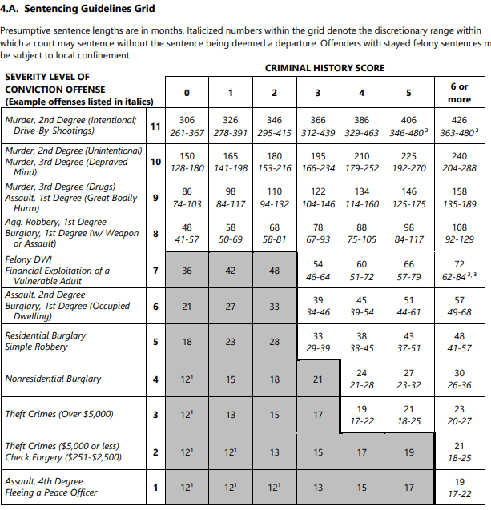

Slide 8
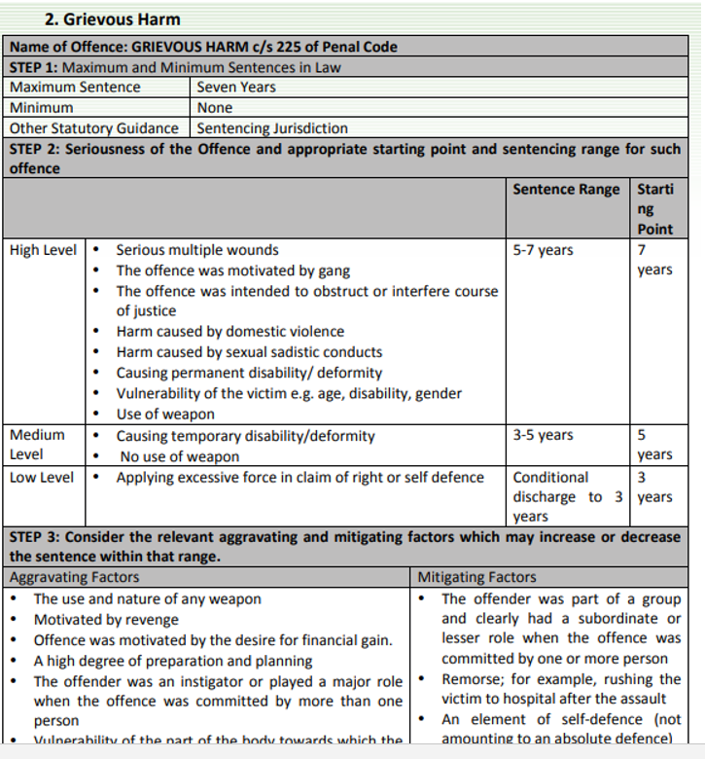
Tanzanian Guideline

Slide 9
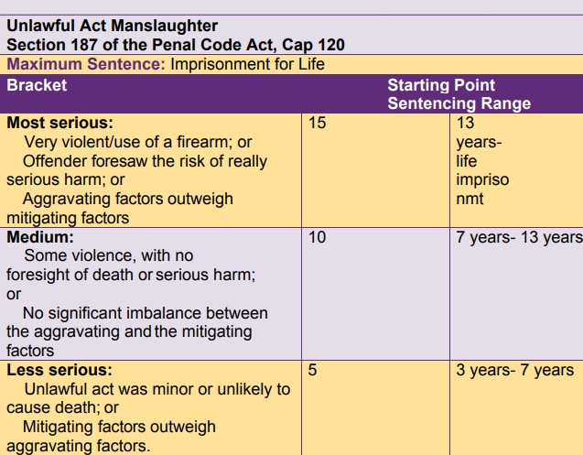
Uganda

Slide 10
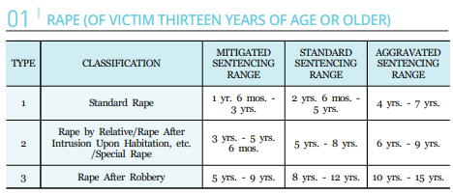
South Korea

Slide 11
Guidelines and sentencing transparency

Slide 12

The UK sentencing guidelines

Slide 13
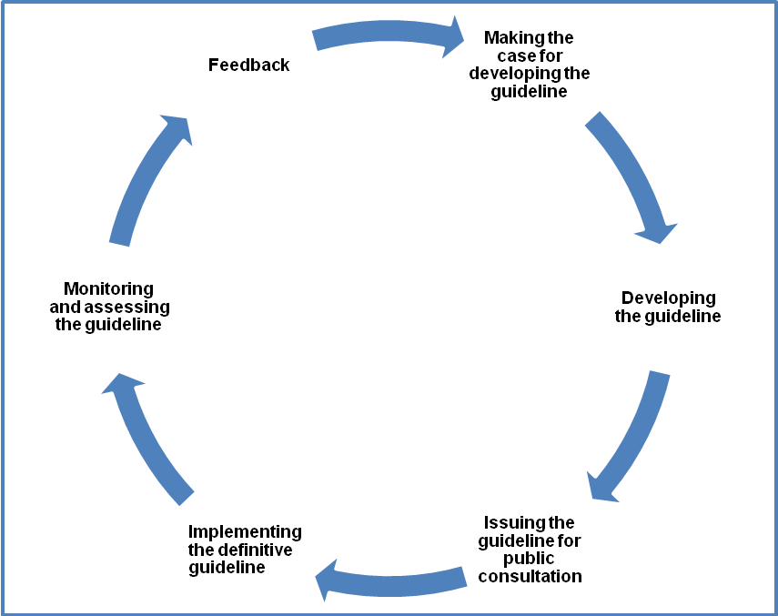
The Evolution of a Guideline

Slide 14
Compliance Requirement in England and Wales
(1) Every court—
(a) must, in sentencing an offender, follow any sentencing guidelines which are relevant to the offender’s case, and
(b) must, in exercising any other function relating to the sentencing of offenders, follow any sentencing guidelines which are relevant to the exercise of the function,
unless the court is satisfied that it would be contrary to the interests of justice to do so.

Slide 15
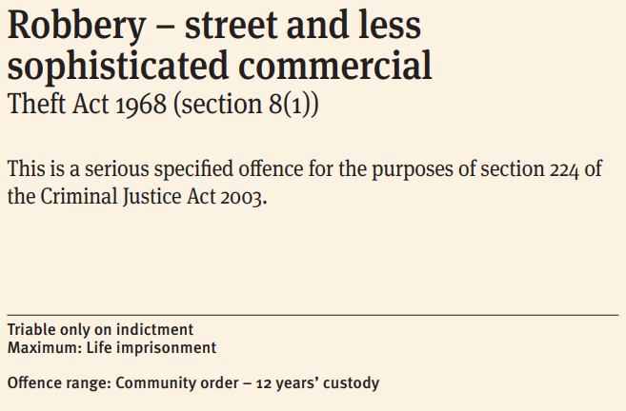

Slide 16
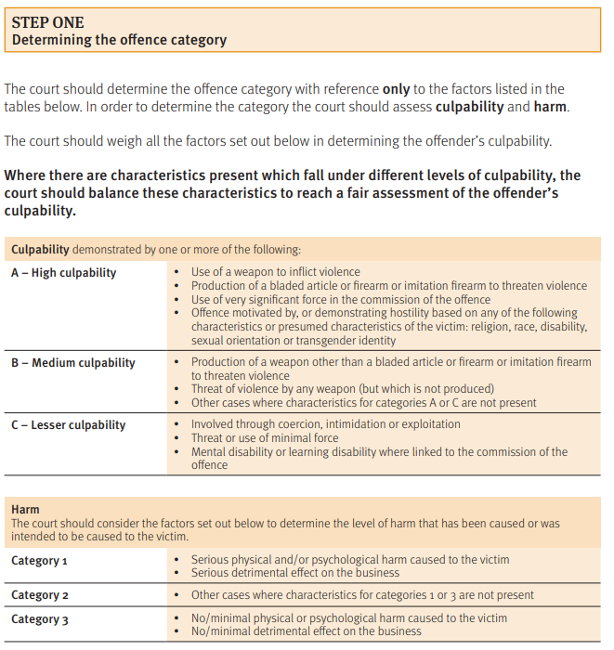

Slide 17
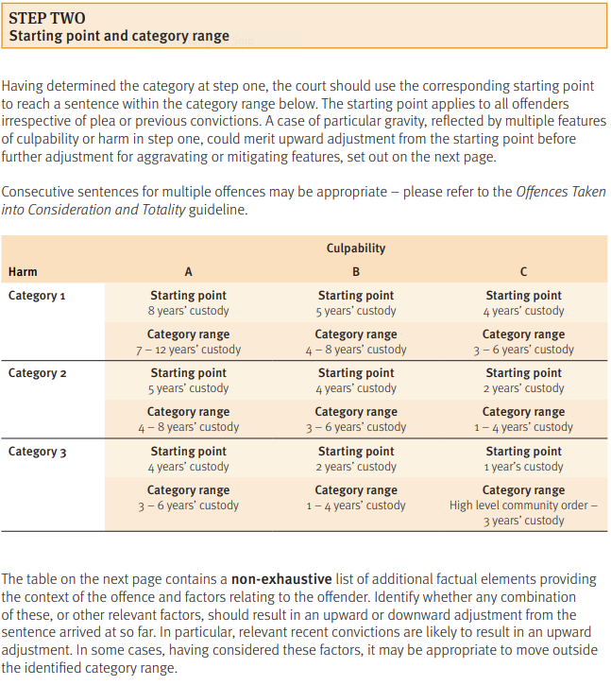

Slide 18
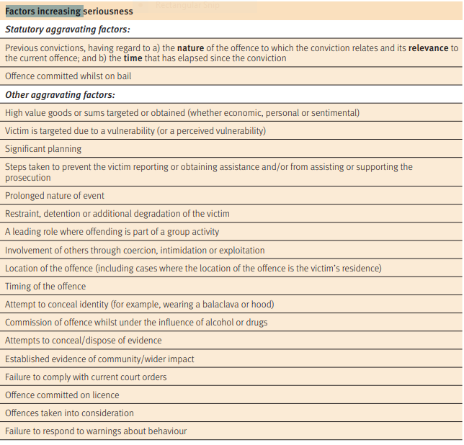

Slide 19
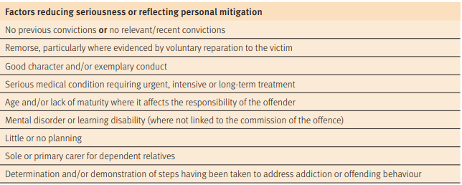

Slide 20
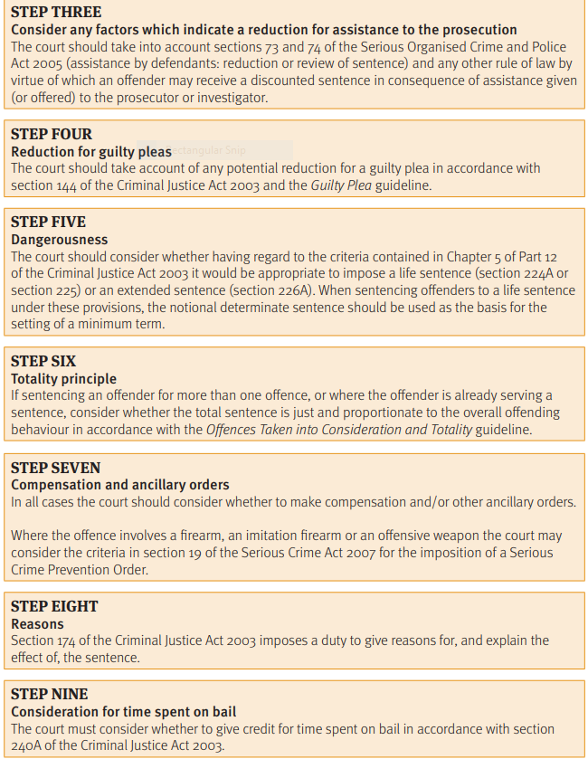

Slide 21
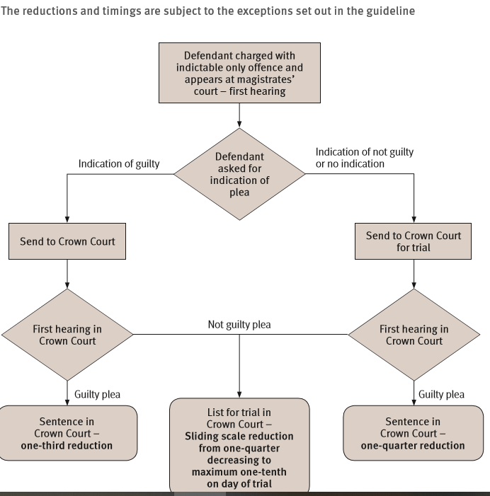

Slide 22
Examples of other Sentencing Issues for which Guidelines Exist
Sentencing children and young people
Sentencing Multiple Counts (Totality)
Use of community and custodial sentences
Domestic abuse: overarching principles
Sentencing offenders with mental disorders, developmental disorders, or neurological impairments

Slide 23
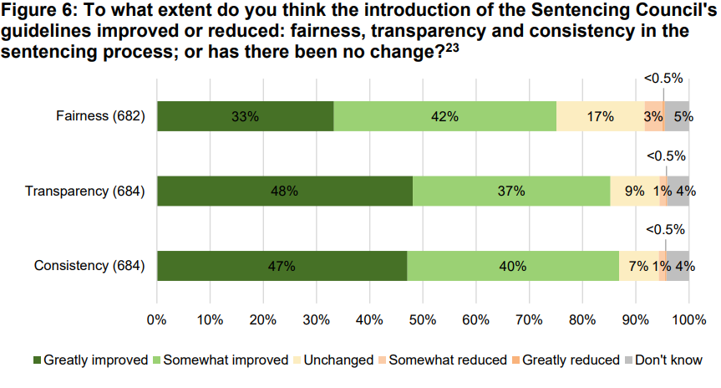
Notes:
Circuit and high court judges more + than magistrates 60% of former but 48% of latter saw great improvement.

Slide 24
Lessons from England and Scotland?
Guidelines acceptable to the judiciary if the Sentencing Council has a judicial majority, and judges largely construct the guidelines – or if the guidelines are issued by a superior court, eg Supreme Court
Guidelines must allow a significant degree of judicial discretion;
Guidance must involve more than just sentence ranges and starting points – courts can benefit from guidance on many other issues;
Guidelines increase transparency of sentencing decisions – people can see more clearly how the sentence was derived.

Slide 25
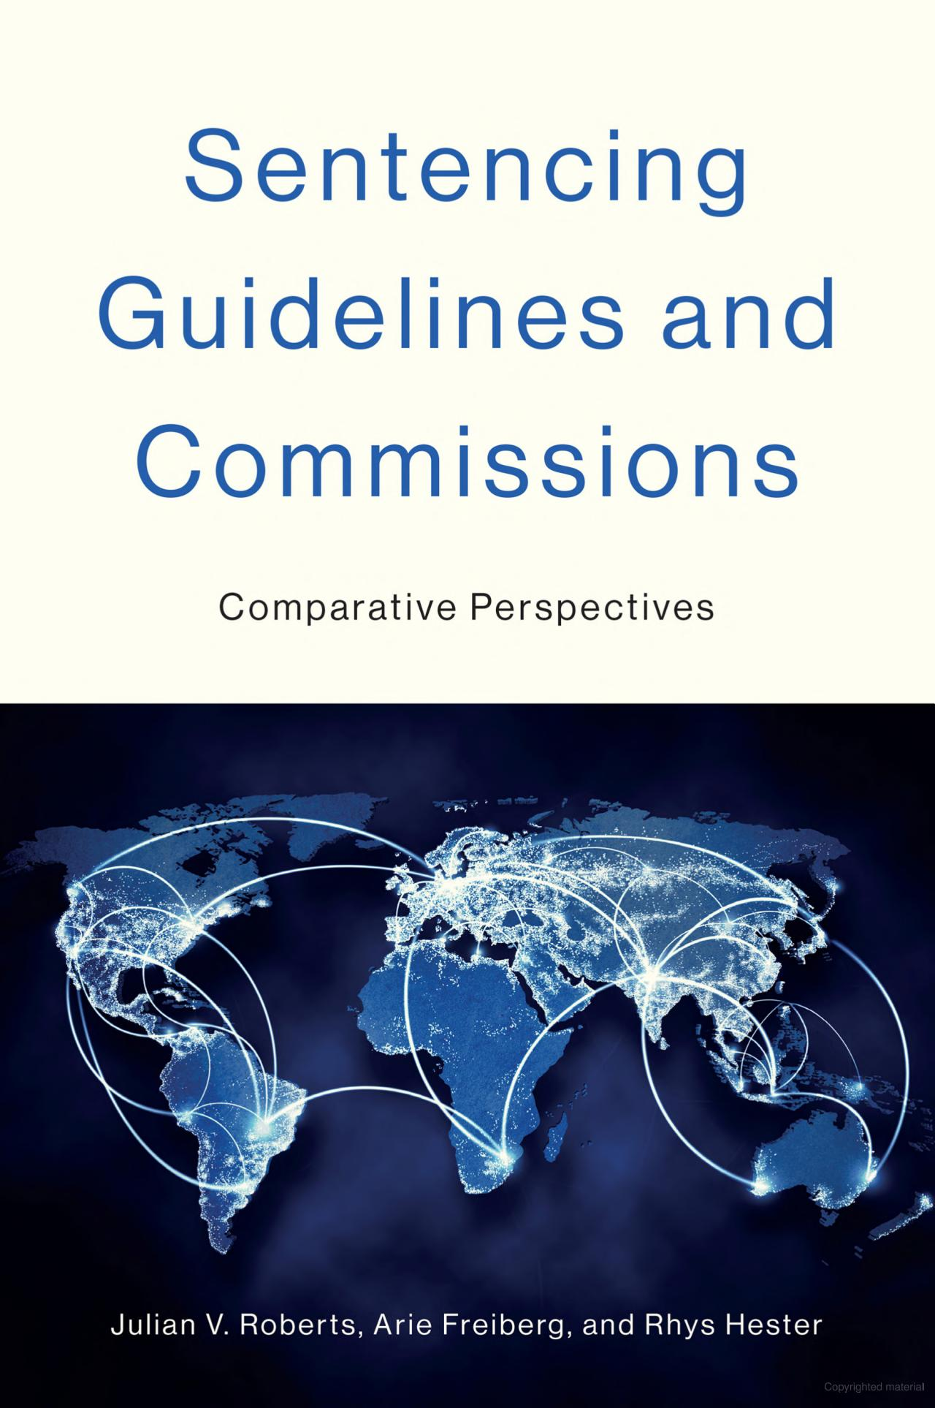
Thank you for your time and attention, and for further information..
julian.roberts@crim.ox.ac.uk

