Slide 1
RESTORING JUSTICE:
Why Victim-Offender-Community Conversations Matter
ISRCL International Conference 2026
Justice Anna Loparco, Alberta Court of King’s Bench
Deputy Chief Justice Joanne Durant, Alberta Court of Justice
Justice Michelle Christopher, Alberta Court of Justice
Matthew Hinshaw, Alberta Crown Prosecution Service
Megan Stephens, Megan Stephens Law, Toronto (Moderator)

Slide 2
Introduction
What do we mean by justice in the criminal context?
Does the current criminal justice system do what it was intended to do?
Why the current system is not responding to the needs of complainants/victims/survivors?

Slide 3
CURRENT LEGISLATION
Canadian law is changing as we speak
S. 718 of the Criminal Code of Canada includes a long-standing reference to restorative justice
NEW Criminal Code provisions – in effect this month, July 2026 – codify RJ principles (s. 715.53) and the application of RJ in Canada (s. 715.54)

Slide 4
RESTORATIVE JUSTICE Benefits
understanding of the root causes of crime
reducing recidivism
increase compliance with conditions
tailored sentencing that is culturally sensitive to community needs
better outcomes for offenders, victims and communities

Slide 5

Myths
Myth: Indigenous Courts only
Myth: Soft on punishment
Myth: A “get out of jail free” card
Myth: Requires victim forgiveness
Myth: Only for minor offences
Myth: Not a justice-system matter
The RJ process remains accountable, voluntary, and participant-centred.

Slide 6
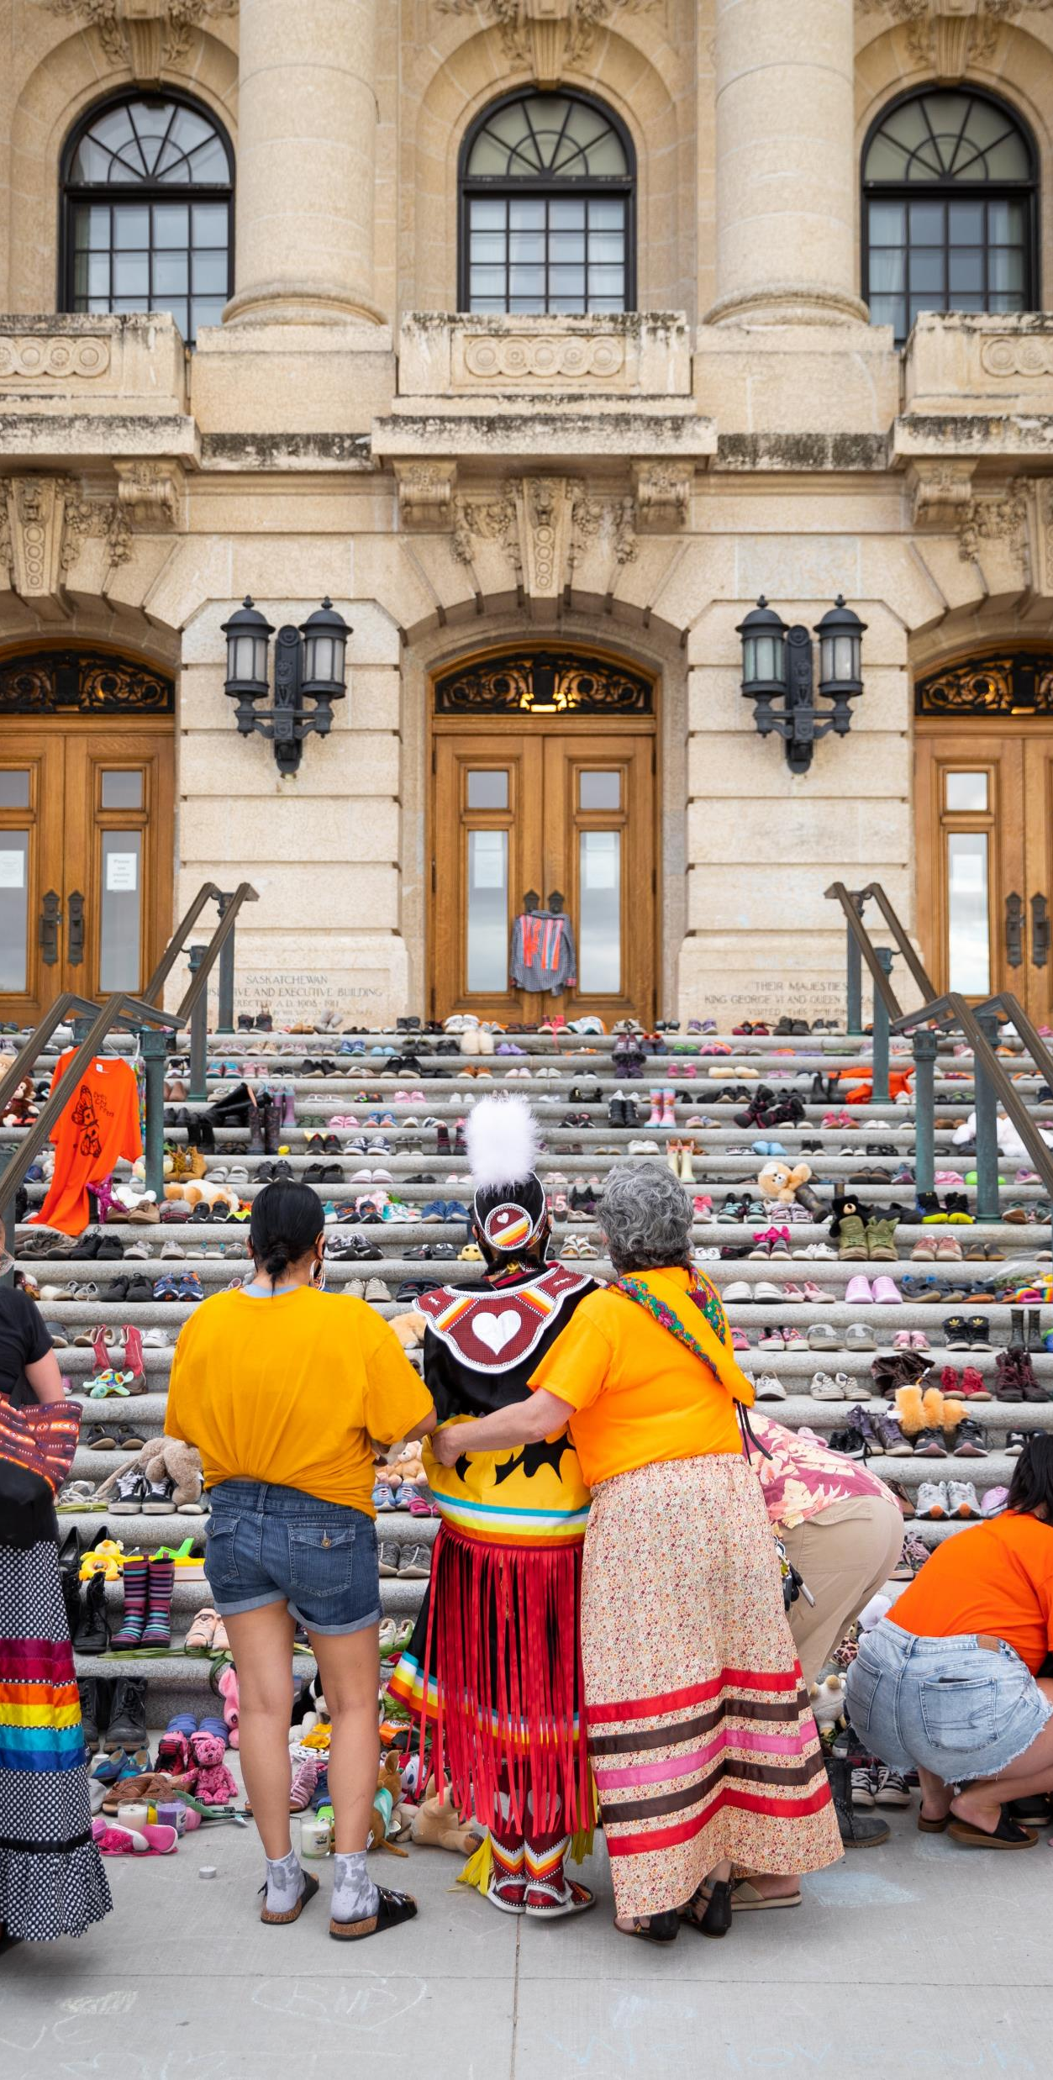
Why DID The Restorative Justice Project Start?
  To redefine what justice means for participants
  To create a framework for the referral of matters to RJ agencies
  To respond to the Truth and Reconciliation Commission Calls to Action
Photo by Tandem X Visuals

Slide 7
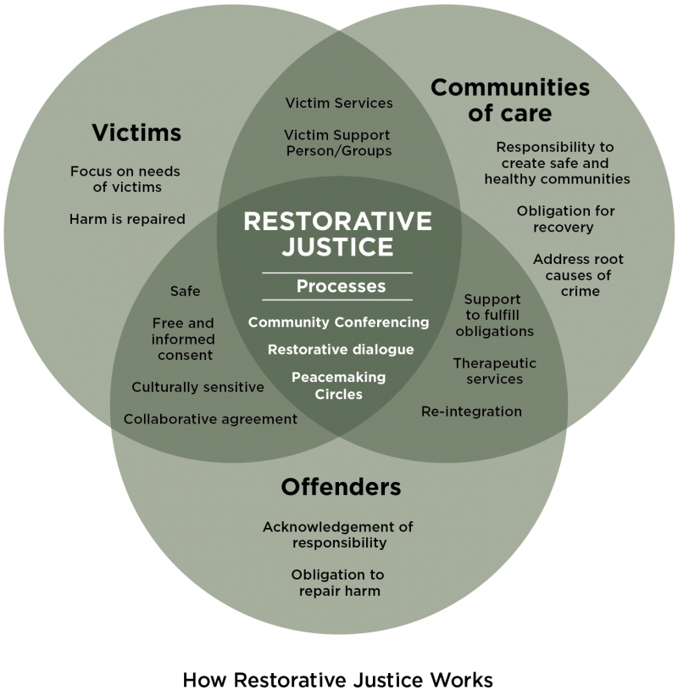

Slide 8
RJ Project
Launched March 2022 as part of a symposium held in the Calgary Courts Centre
Applies to King’s Bench and Alberta Court of Justice province-wide for all criminal matters, subject to conditions in the Referral Guidelines
Public website links to roster agencies and details about project: https://rjalbertacourts.ca/

Slide 9

When will RJ be used?
RJ can occur any point in the justice system
Most likely raised in KB at 3 points:
  Criminal Docket Court
  Pre-trial conference (listed on CC7)
  After conviction or Guilty Plea but pre-sentence

Slide 10
REFERRAL FRAMEWORK
Principled/flexible decision making framework
Goals:
  Consistency
  Transparency
2 distinct referral streams
  Pre-Plea/Diversion
  Post-Plea/Pre-Sentence

Slide 11
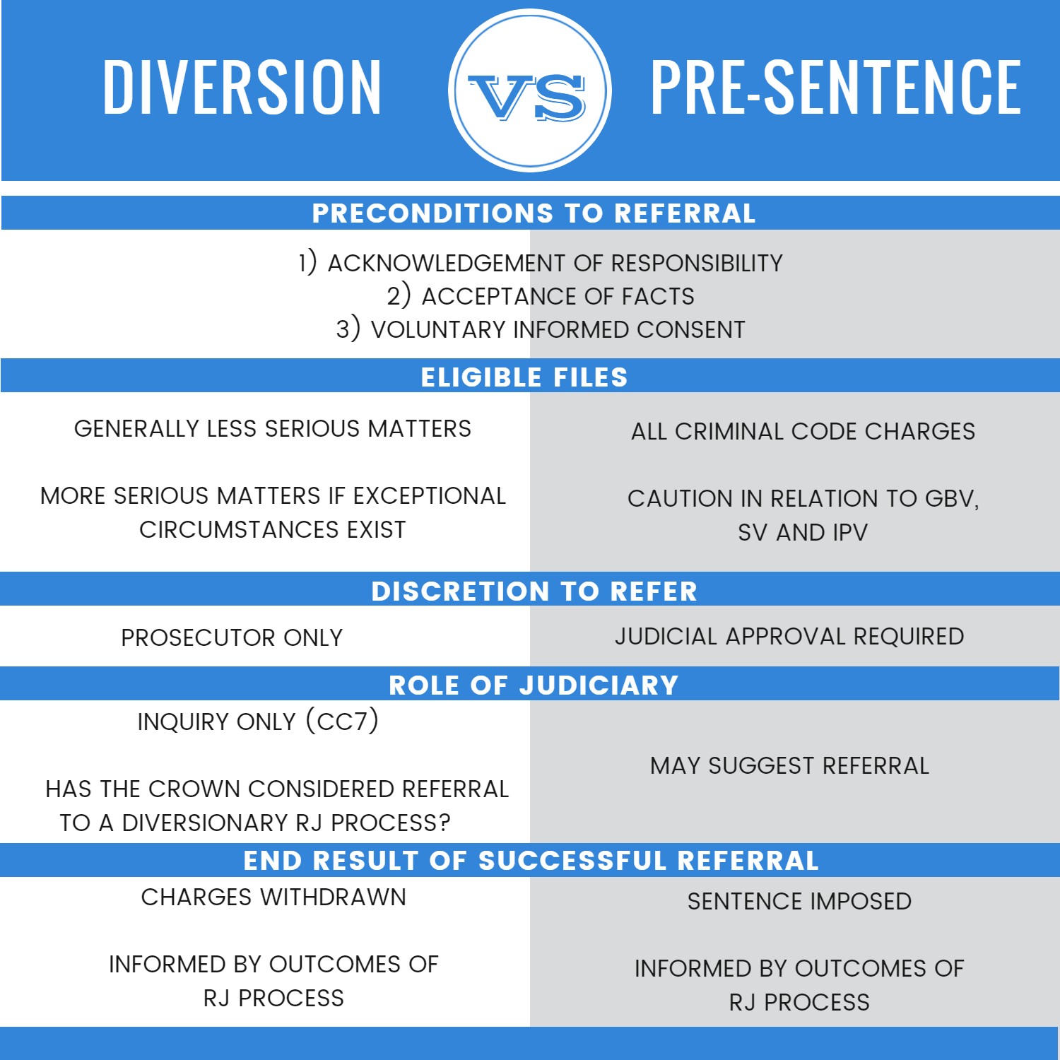

Slide 12
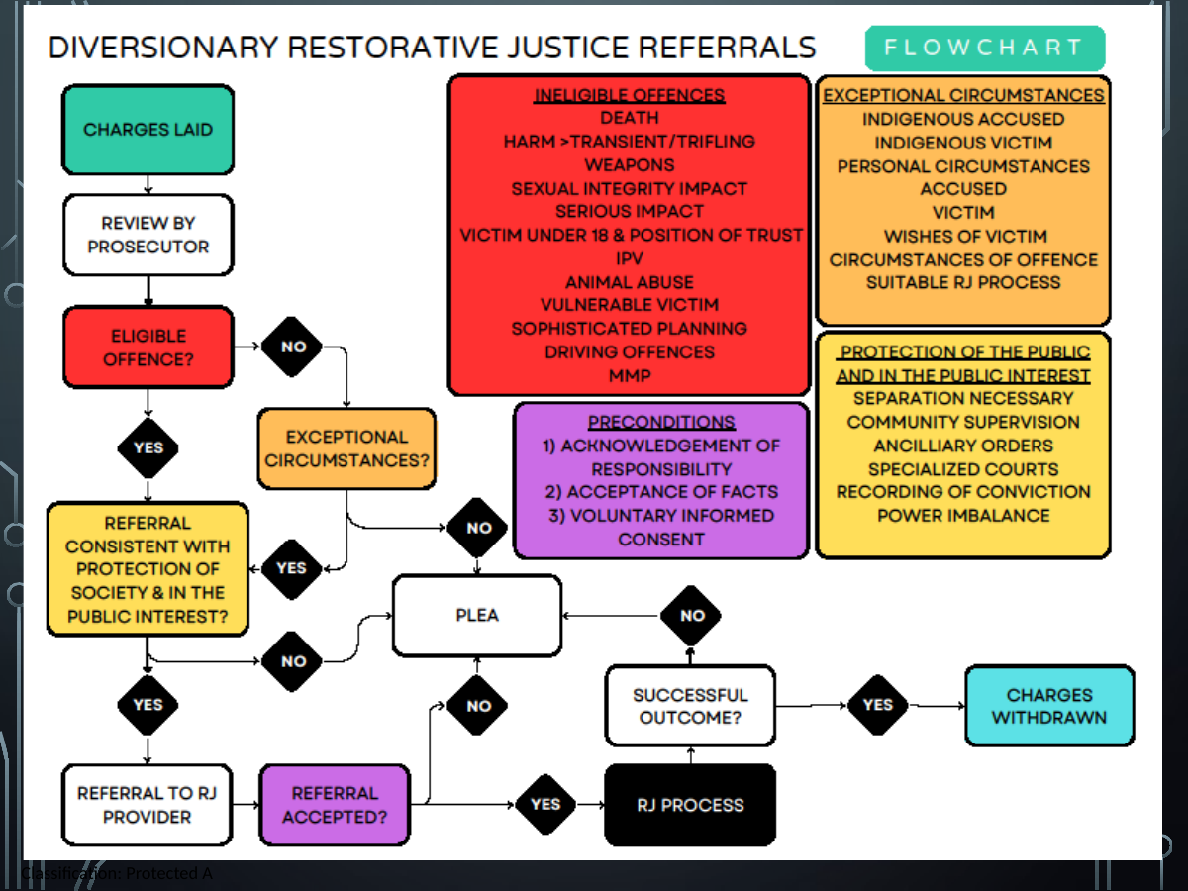

Slide 13
REFERRAL FRAMEWORK
Pre-Plea/Diversion Ineligibility
Offences involving:
  Death
  Violence resulting in bodily harm
  Impact on sexual integrity of victim
  Serious impact (physical, psychological or financial)
  Violence against child by caregiver
  IPV offences
  Infliction of pain, suffering or injury to animal
  Vulnerable victims (children, the elderly, etc…)
  Sophisticated planning
  CC driving offences
  MMPs

Slide 14
REFERRAL FRAMEWORK
Pre-Plea/Diversion
Chief Prosecutor can approve referral of ineligible matters if exceptional circumstances exist:
  Indigenous identity of accused or victim
  Personal circumstances of accused
  Personal circumstances of victim
    Victim’s desired to engage in RJ process
    Degree of harm done
  Circumstances of offending behaviour
  Suitable RJ process

Slide 15
REFERRAL FRAMEWORK
Pre-Plea/Diversion
Consistent with protection of society and in the public interest
Considerations
  Separation of offender necessary
  Long-term supervision/treatment/no-contact
  Ancillary orders (DNA, SOIRA, etc…)
  Specialized courts
  Importance of recording of a conviction
  Power imbalance/meaningful victim participation

Slide 16
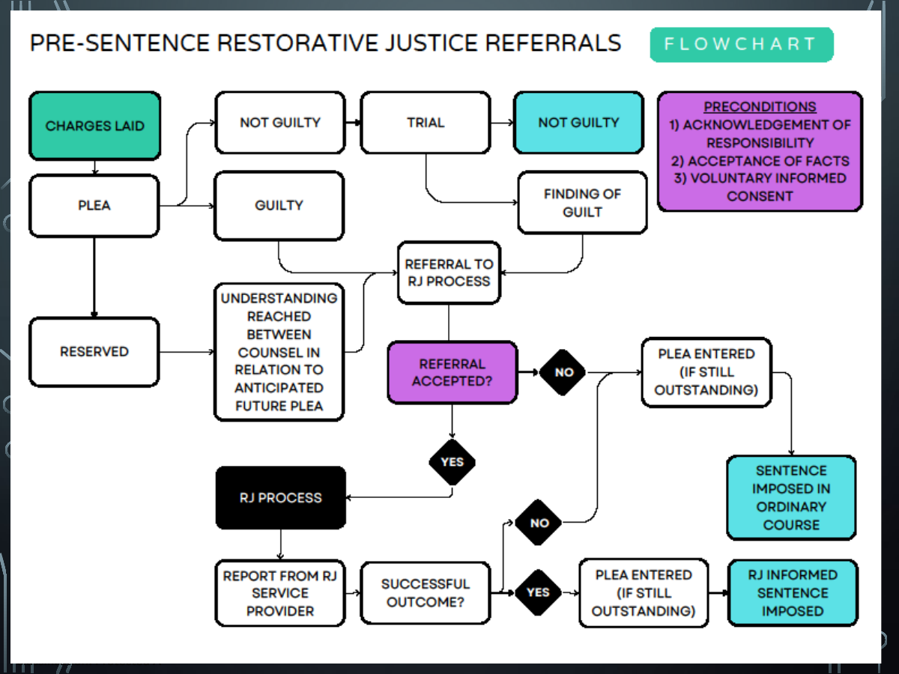

Slide 17
REFERRAL FRAMEWORK
Post-Plea/Pre-Sentence
Wide range of cases
May be suggested by any party
  Requires informed consent of all participants
Generally following entry of GP or finding of guilt
May proceed prior to GP if clear understanding reached between counsel as to pleas expected following RJ process

Slide 18
Outcomes
If RJ is successful
  Withdrawal (Diversionary)
  Sentencing (Pre-sentence)
Pre-sentence referrals
  Report from RJ agency
A sentencing judge is not bound by any RJ recommendations
Report may be useful to determining an appropriate sentence

Slide 19
Outcomes
1
2
3
Referral accepted
RJ agency begins dialogue and preparation
RJ process
Participants explore harm, accountability, and repair
Report to court
Outcome informs diversion or sentencing pathway

Slide 20
REFERRAL FRAMEWORK
Caution with some types of files
  Sexual violence
  Gender based violence
  Intimate partner violence
Require specialty training
Referrals must be carefully considered

Slide 21
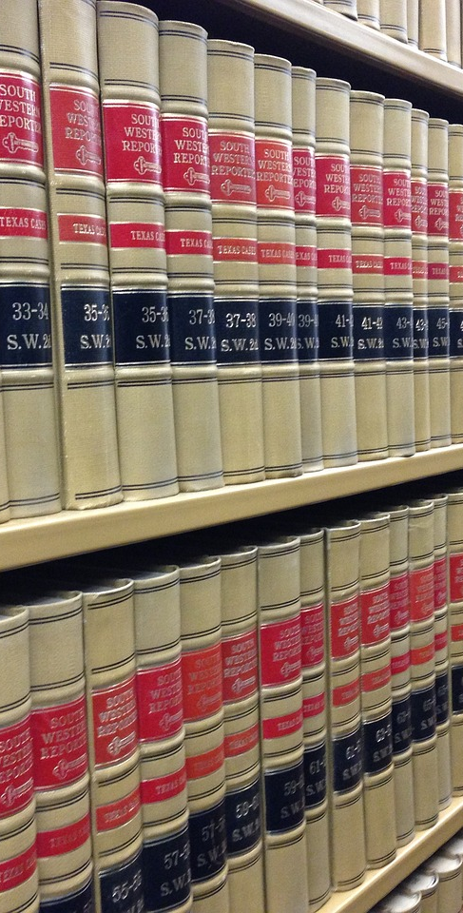
Use of RJ in Alberta Courts
2021 ABQB 432 (CanLII) | R v Lariviere | CanLII
2023 ABKB 706 (CanLII) | R v Rabbit | CanLII
2024 ABKB 642 (CanLII) | R v SH | CanLII

Slide 22
Recent successes in RJ and other Specialized, Indigenous and Therapeutic approaches to justice
Prior to the pilot launch, while it had been used at various times, it certainly was not the norm
RJ had been used in our Indigenous Courts (CIC; Tsuut’ina) as well as by certain Judges/Justices more familiar with the practice.

Slide 23
Specialized and Therapeutic Courts
Drug Treatment Courts, Mental Health Courts, Domestic Conflict Courts, Community Courts
All programs address the root/cause of offending
All are generally lengthy programs and involve connection with social support agencies
All have a restorative approach-personal, victim/ offender, community

Slide 24
Drug Treatment Courts
Seven courts across Alberta
DTCs provide a community alternative to incarceration for individuals facing significant custodial time for criminal charges associated with drug addiction
Evidence-informed program integrating therapeutic court intervention and treatment services to assist participants in ending the cycle of active addiction, crime and incarceration allowing a return to family, work and community

Slide 25
Drug Treatment Courts
68% unstably housed upon admission
80% unemployed
94% earn most of their money for drugs through crime (theft, fraud, drug trafficking)
92% assessed as high risk to re-offend
Average of 14 years of age when began using drugs
66% obtained first conviction as a youth
77% physical health issues
64% existing mental health issue
High % of police contacts

Slide 26
Recent Recidivism Study-Calgary Drug Treatment Court
Cohort of 152 graduates who completed the program between 2010-2024
Data gathered over 6.5 years following program completion
76% had no new substantive criminal convictions post graduation (4508 convictions prior to graduation)
Savings of $117 million in estimated cost of stolen goods over 6 years
Avoidance of $25 million in cost of incarceration for average of 1.6 years of custody grads did not serve

Slide 27
Restorative Justice Pilot-Calgary Drug Treatment Court
Early Intervention Stream funded initially through a private donation
High risk to re-offend but lower needs than usual target population
Available to those suffering from addiction who are charged with criminal offences associated with the addiction
May be first time offenders, still with family support and/or housing, employment, university students
Facing community-based sentence or first custodial sentence

Slide 28
Indigenous Courts
Four large urban Indigenous Courts in Alberta (Calgary, Edmonton, Lethbridge, St. Paul)
Additional Courts located on First Nation land throughout Alberta
Provide culturally relevant, restorative and holistic system of justice for Indigenous individuals, including offenders, victims and the community harmed by an offender’s actions that addresses the unique challenges and circumstances of the Indigenous People
Develop individual healing plans with strong culturally based processes allowing participants to reconnect with Indigenous heritage by using and applying Indigenous restorative justice principles

Slide 29

Use of RJ in Courts 2022-2025
Total # of referrals: 365 accused
Diversionary referrals: 336 accused
  Successful referrals: 219 accused
  Unsuccessful/Incomplete/Rejected referrals: 101 accused
  Ongoing referrals: 16 accused
  Pre-sentence referrals: 29 accused
Year | Diversion - Successful | Diversion – Unsuccessful/ Incomplete/ Rejected | Pre-Sentence | Ongoing | Total # of Referrals
2022 | 34 | 9 | 10 |  | 53
2023 | 129 | 66 | 10 |  | 205
2024 | 28 | 15 | 7 | 3 | 53
2025 | 29 | 11 | 2 | 13 | 55

Slide 30
Use of RJ in Alberta Courts
Most common referrals
Criminal Code Section | Offence | Number of charges
266 | Assault | 187
430 | Mischief | 78
145(4)(a) | Failure to comply with undertaking | 66
145(5)(a) | Failure to comply with release order | 61
129(a) | Resist/obstruct peace officer | 51
264.1(1)(a) | Uttering threats | 38
267(a) | Assault with a weapon | 32

Slide 31
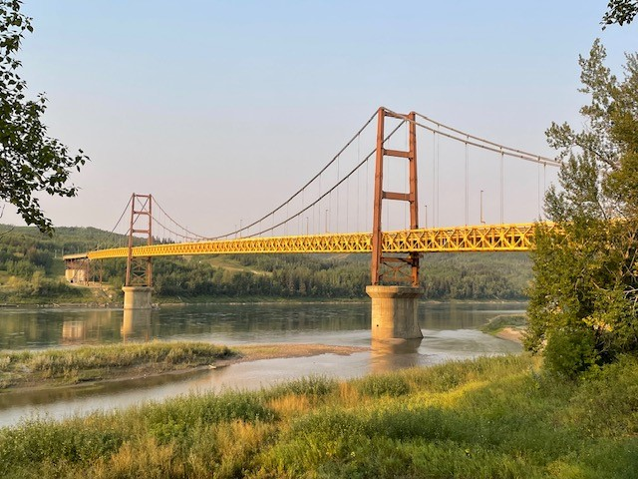
ALBERTA RJ LANDSCAPE
22 programs funded through 24-25 ARJ Grant
1 provincial organization works with more complex cases
2 sexual assault centres are developing RJ programs in-house to serve survivors of sexualized violence
Developing programs in Cold Lake First Nation, Gift Lake Metis Settlement, Lethbridge, and Camrose.
Long standing RJ programs are located in Bigstone Cree Nation, Calgary, Fort McMurray, Kainai Nation, Peace River, Red Deer, Siksika Nation, Tsuut’ina Nation.

Slide 32
CHallenges
Lawyers need to re-imagine what justice can look like. They are trained to be adversarial. This requires a culture shift.
Difficulties of this approach for more senior vs junior prosecutors.
Concerns re civil liability.
Perception of being soft on crime.
Limited funding by governments that want ‘jail not bail’-swings in the criminal justice system

Slide 33

Questions
Visit the RJ Alberta Courts website:
https://rjalbertacourts.ca
Visit Alberta Justice’s RJ website:
Restorative justice | Alberta.ca
Thank you!

