Slide 1

The Potential for Socio-Legal Theory in Bail Reform
Dr Megan Beatrice, Deakin Law School
‘Journey #26’
Flick Chafer-Smith
Ngarrindjeri People
All artwork featured in this presentation was created by Indigenous women who are, or have been, incarcerated. Artwork is displayed and for sale (with the full price going to the artist) at The Torch Gallery: https://thetorch.org.au/

Slide 2
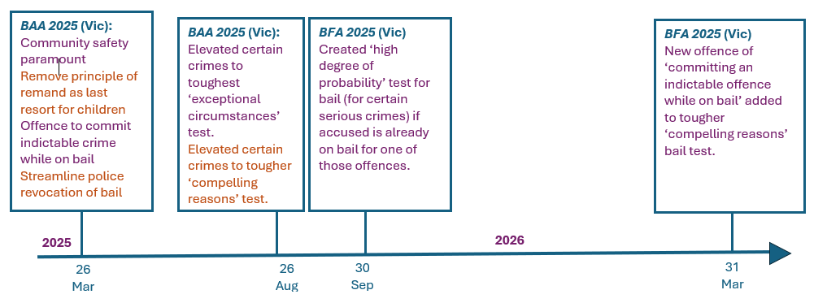
Bail Reform in Victoria, Australia

Slide 3
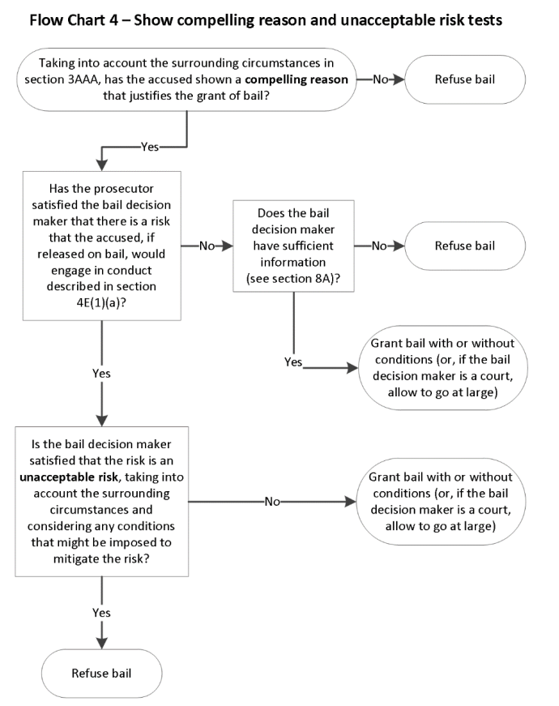
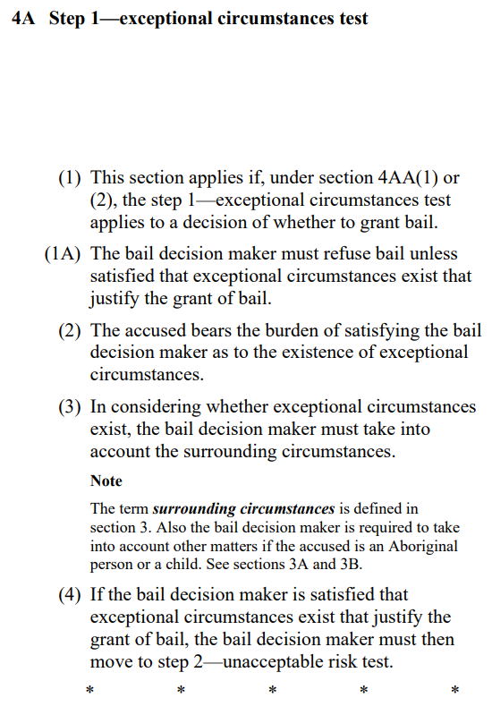
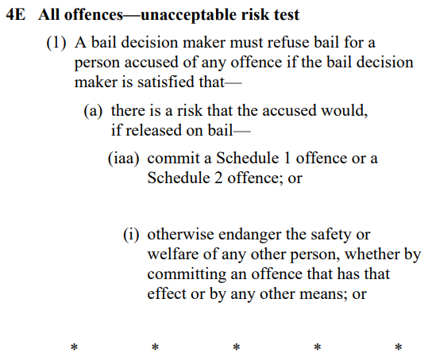
“Exceptional Circumstances” +
“Show Compelling Reasons”
Bail Act 1977 (Vic) s 4
Bail Act 1977 (Vic) s 3

Slide 4
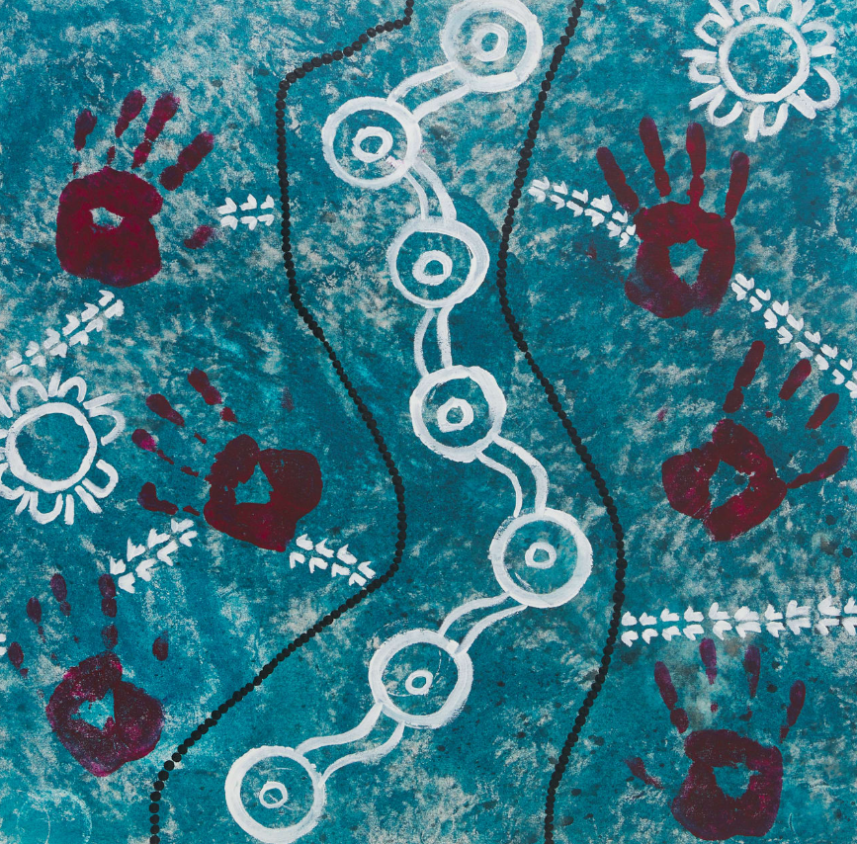
Post-Structuralism: Foucault and Butler
(and Rousseau)
Michel Foucault – Knowledge/power dialectic (Discipline and Punish)
Judith Butler – Grievability framework (Frames of War)
- Jean-Jacques Rousseau – On the Social Contract
- Giorgio Agamben – Homo Sacer
‘The Blue Walk’
Hayley S
Gunaikurnai People

Slide 5
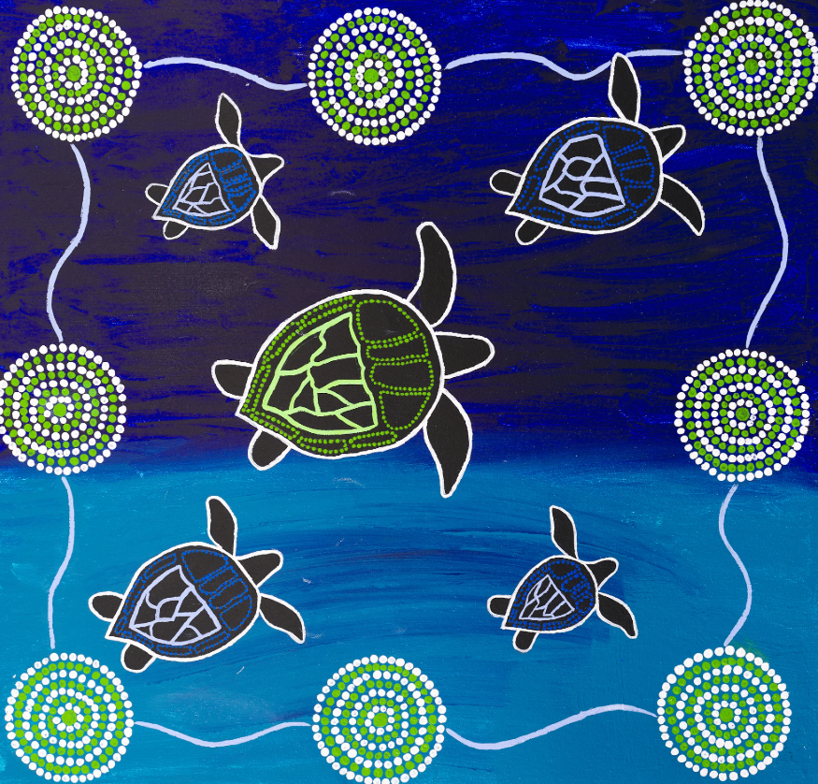
Indigenous Women in the Victorian
Criminal Justice System
Total Victorian remand population increased by over 70% since 2025/26 reforms.
Imprisonment rate of Indigenous women increased over 85% May 2025 – May 2026 → bail reform, ‘two strike’ policy a large reason why.
Indigenous women almost 15 times more likely than non-Indigenous women to be held on remand, this is disproportionately higher than Indigenous men.
Indigenous young people imprisoned at a rate 26 times greater than non-Indigenous young people (gender breakdown unclear).
‘The Turtles’
Zahara
Wiradjuri People
Jacinta Allan, ‘Tough Bai Laws in Full Effect’ (Media Release) <https://www.premier.vic.gov.au/victorias-tough-bail-laws-full-effect>
National Indigenous Times, ‘Bail Reforms Blamed for Rise in Indigenous Incarceration’ (News Article) <https://nit.com.au/29-06-2026/25074/bail-reforms-blamed-for-rise-in-Indigenous-incarceration>
Beatrice, M (2025) When Reform Kills: The Implications for Bail Reform in Victoria, Australia. Alternative Law Journal.

Slide 6
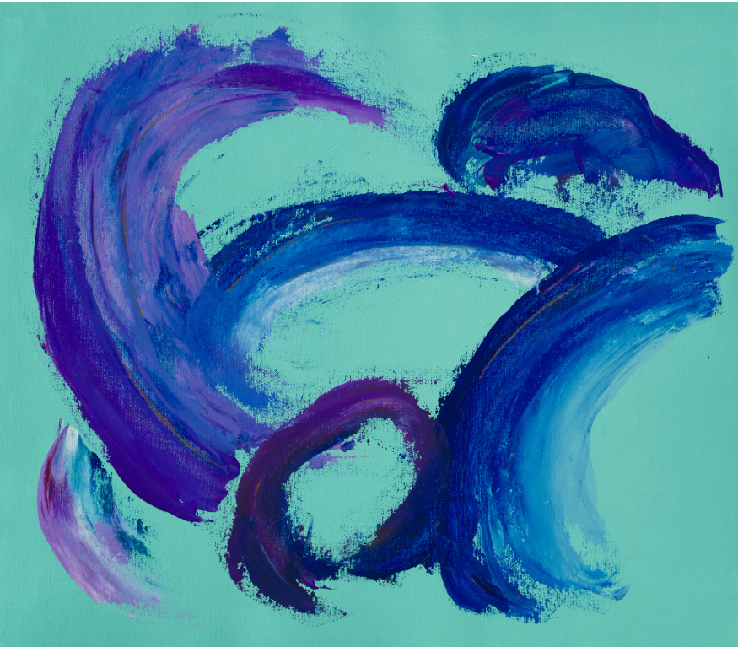
Post-Structural Analysis
Social contract – give up some of our rights in exchange for safe community.
Bail reform aims to capture violent offenders (community safety).
Indigenous women are more likely to be convicted of property offences and crimes against the person than any other offence (often incorrectly identified on Family Violence Intervention Orders, or commit violence in self-defence).
Net cast by bail reform captures Indigenous women disproportionately in the name of the social contract.
‘Emotional Madness #3’
Stacey Edwards
Taungurung/Boon Wurrung/ Bunurong People

Slide 7

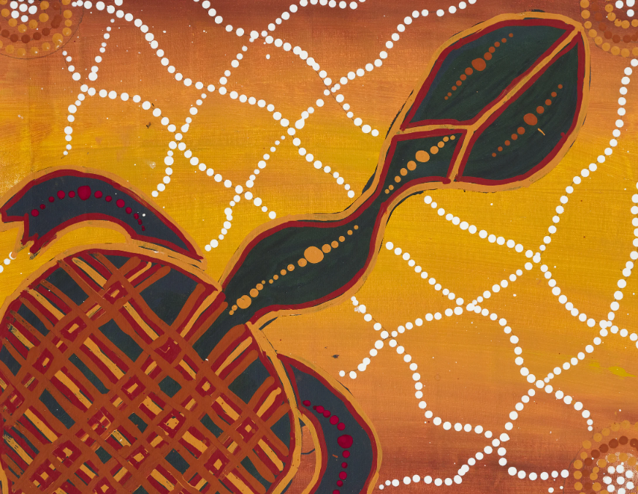
Post-Structural Analysis
Three-point intersectionality: race, gender, colonialism.
Reinforced by knowledge/power dialectic (Foucault).
‘Ungrievable’ population, not apprehended as ‘lives’ (Butler).
Indigenous women a population ‘without legal good’ (Agamben).
‘Turtle Dreaming’
ReiRei
Yorta Yorta/Lama Lama/ Gunditjmara People

Slide 8
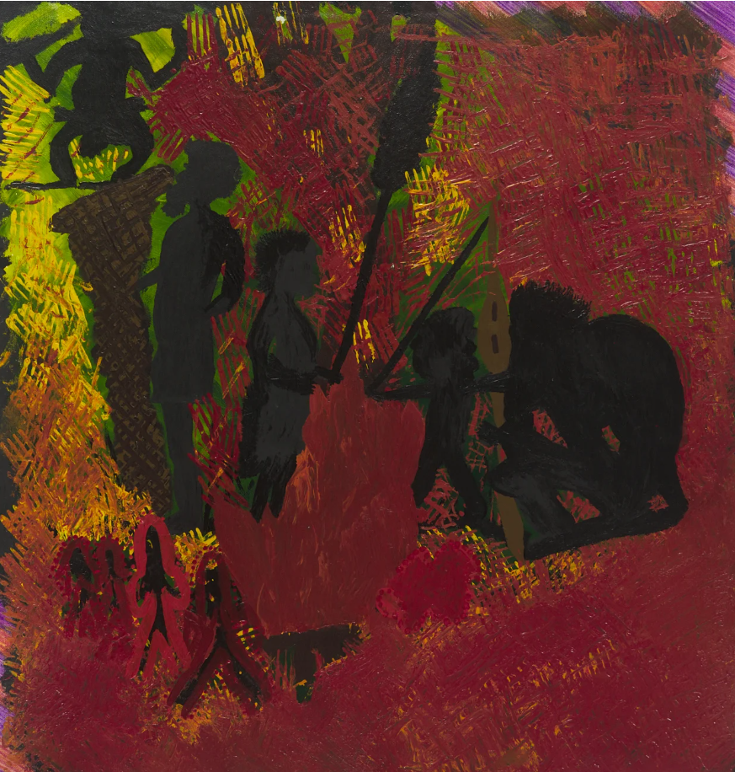
Conclusions
Victorian bail reforms (2025-2026) reinforce knowledge/power dialectic.
Reforms further ‘Other’ Indigenous women.
Promote the “sacrifice” of a population in the name of community safety, and for the purpose of the social contract.
Socio-legal theory illuminates the impact of bail reform on Indigenous women.
‘My Children’
TES
Gunditjmara/Barngarla People
The impact is unacceptable.

