Slide 1
Le déshonneur à l’honneur
Shame on you! Shame on us!
The historical and modern role of shaming in sentencing
International Society for the Reform of Criminal Law
Montreal, CANADA, July 13-16, 2026
Trevor Shaw – Head of BC Prosecution Service*
*Any opinion expressed is personal and not of the BCPS
Thanks to Danika Freiter and Cedrik Durand (interns) for their contribution

Slide 2
  Definitions
All sentences involve a certain degree of shame
  no one is proud to go to jail (or almost)
  a sentence implies a social break with the offender
This presentation focuses on sentences that:
  have social stigmatization as their objective or
  have a desired collateral consequence that leads to the same social demotion
We will discuss shameful, stigmatizing, exemplary sentences

Slide 3
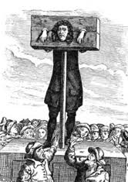

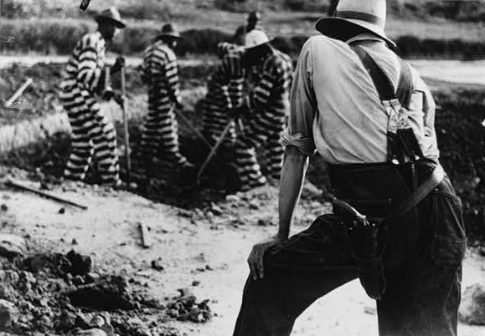
  Concrete Examples
Punishments that directly brought shame (the pillory of the Middle Ages)
Declaratory punishments (“dégradation nationale” —national degradation— during the Liberation)
Deprivation of social rights (loss of the right to vote)
Shameful aspects in the execution of the sentence (chain gang)

Slide 4
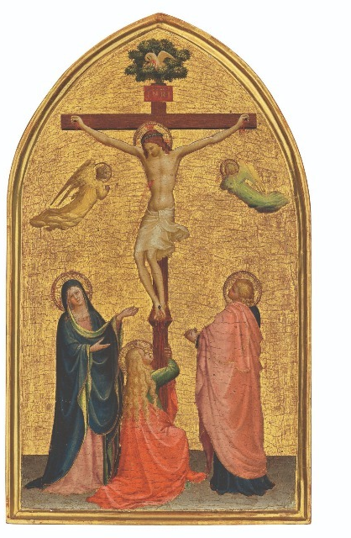
Justifying Shameful Sentences
Justifications overlap and fluctuate:
  a strong religious or chivalrous component ¹
  social marking as an immediate protective element
  shame as a specific and general deterrent
  denunciation of the criminal act as something bad
The social context is paramount
  the effectiveness of the shameful penalty depends on the social reaction
  but these sentences can confirm or exacerbate racial and other biases
Modern counter-justification
  Destigmatize and reintegrate the offender
¹ H. Dumont, “Le casier judiciaire : criminel un jour, criminel toujours ?” in Journées Maximilien-Caron, Le respect de la vie privée dans l'entreprise : de l'affirmation à l'exercice d'un droit, 6th, Montreal, University of Montreal: Thémis, 1995, 103 at pp. 109–110.

Slide 5
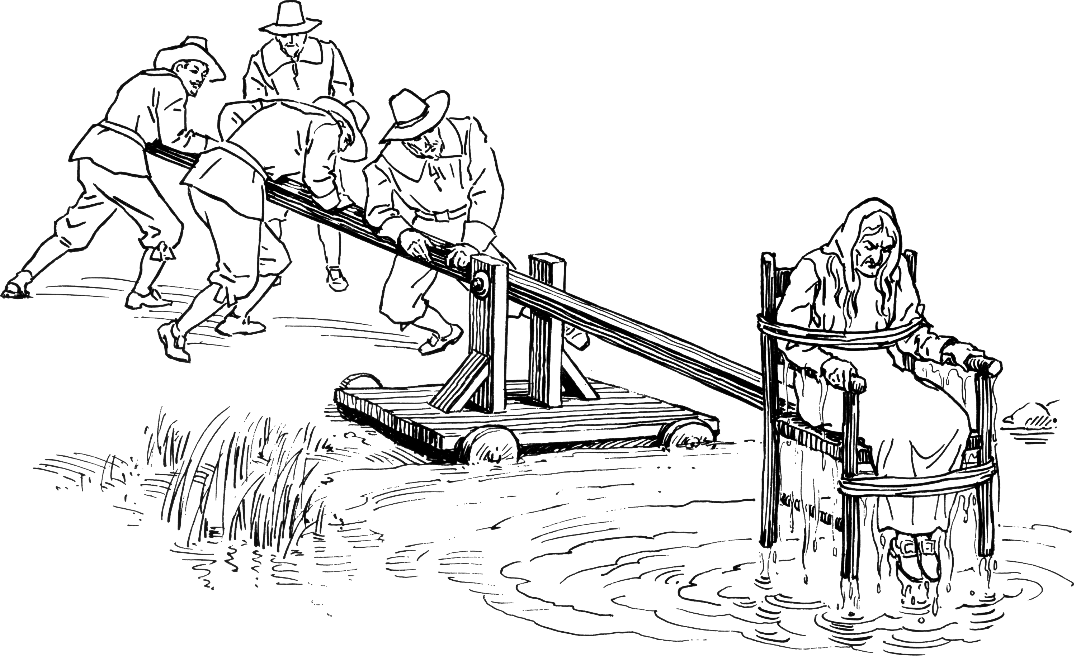
Medieval Period (physical punishments)
The height of shameful sentencing
  Almost all sentences are carried out publicly in a spectacular and stigmatizing manner
  the pillory ²
  The ducking chair ³
  the exposure of persons who
  died by suicide ⁴
² H.V. Hentig, “The Pillory: A Medieval Punishment” (1939) 11:3 U Colo L Rev 186. ³ Hentig at p. 190.⁴ D. Godineau, S'abréger les jours: Le suicide au XVIIIe siècle, Paris, Armand Colin, 2012.

Slide 6
Medieval Period (Context)
The justification is
  public denunciation of wrongdoing and
  religious –public expiation of sin before rejoining the community ⁵
A society without police or prisons as we understand them today
  few arrests – a strong need to set an example
  no facilities in which to segregate a significant number of offenders
Dual contemporary perspective on punishment in the Middle Ages
  one of rejection and progress
  despite this, an approach that remains thought-provoking
⁵ Hentig at pp. 189, 197.

Slide 7

The Liberation (1944) – Indignité nationale (National Indignity)
In 1944, France was emerging from a period of occupation and collaboration with Pétain’s regime, which had to be punished
New offence called “indignité nationale” (national indignity) is created ⁶
⁶ A. Simonin, Le déshonneur dans la République, Paris, Grasset, 2008.

Slide 8
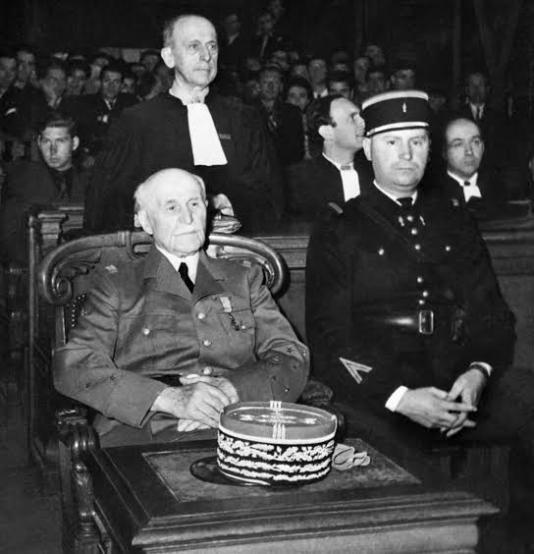
The Liberation (1944) – Indignité nationale (National Indignity)
the penalty incurred is called “dégradation nationale” (national degradation)
  public designation
  prohibition against practicing their profession ⁷
  confiscation of property ⁸
  loss of the right to vote ⁹
  ban on recovering the bodies of family members who had fallen victims of the war ¹⁰
the degradation can go as far as a form of "civil death" ¹¹
⁷ Simonin, at pp. 410, 463.⁸ Simonin, at p. 417.⁹ Simonin, at p. 453.¹⁰ Simonin, at p. 465.¹¹ Simonin, at pp. 364, 421.

Slide 9
The Liberation (1944) – Indignité nationale (National Indignity)
Application
  relates to offences less serious than treason, etc.
  95,000 people subject to indignity (1946-51), including 10,000 significantly ¹²
  but few confiscations (5%) and a high acquittal rate over time ¹³
  increasingly narrow legal interpretations ¹⁴
¹² Simonin, at pp. 430, 476.¹³ Simonin, at pp. 469, 493.¹⁴ Simonin, at pp. 477, 485, 492.

Slide 10
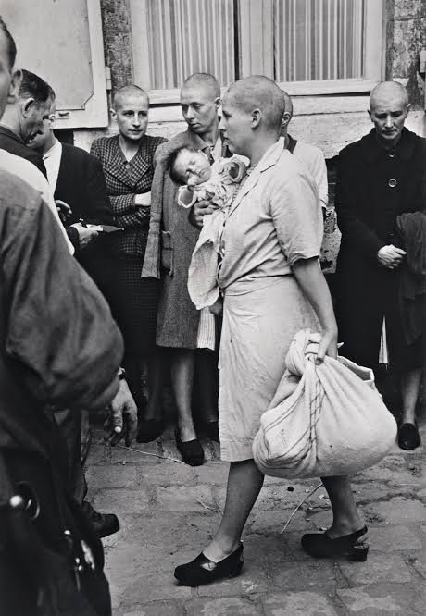
The Liberation (1944) – Indignité nationale (National Indignity)
Social context
  initially, replace the vigilante justice
  respect the principle of non-retroactivity of criminal penalties (hence the administrative nature of the sanctions) ¹⁵
  in its implementation, a gradual easing to promote national reconciliation
¹⁵ Simonin, at pp. 410—11.

Slide 11

Shameful Sentences, American Style
Requirement to wear a humiliating sign ¹⁶
  no proof of effectiveness ¹⁷
public sex-offender registries ¹⁸
Social context:
  sad story of humiliating sanctions against the African American community (including lynching) ¹⁹
¹⁶ M.L. Perlin & N.M. Weinstein, « Friend to the Martyr, a Friend to the Woman of Shame: Thinking about the Law, Shame and Humiliation » (2014) 24:1 S Cal Rev L & Soc Just 1 at p. 20; J. Bellott, « To Humiliate or Not to Humiliate: Does the Sentencing Reform Act Permit Public Shaming as a Condition of Supervised Release » (2008) 38:4 U Mem L Rev 923 at
pp. 923—24, 934. ¹⁷ Perlin at pp. 23—26.¹⁸ Perlin on pp. 41—47.¹⁹ Perlin at pp. 28—29.

Slide 12
The Canadian Approach
Clear distinctions
  right to vote maintained ²⁰
  the sex-offender registry is not public ²¹
Few if any codified shaming penalties :
  denunciation as a sentencing principle ²²
  house arrest (collateral effect) ²³
  loss of public office with a federal sentence²⁴
  in case of fraud, prohibitions
    from employment/volunteer work involving responsibility for assets or property ²⁵
    from contracting with the federal government ²⁶
²⁰ Sauvé c. Canada (Chief Electoral Officer), 2002 SCC 68. ²¹ J. Benedet, « A Victim-Centred Evaluation of the Federal Sex Offender Registry » (2012) 37:2 Queen’s LJ 437.²² Criminal Code, RSC 1985, c C-46, s. 718(a); R. v. Proulx, 2000 CSC 5 at para 102. ²³ Code, s.742.1; Proulx at para 105. ²⁴ Code, s. 750(1). ²⁵ Code, s. 380.2. ²⁶ Code, s. 750(3)

Slide 13
Stigma as Defining Factor
In the Vaillancourt decision, under s. 7 of our Charter, the Court establishes stigma as a constitutional standard to assess the requirement for guilty intent
The greater the shame associated with the offence, the greater the mens rea of the accused must be:
  because of the special nature of the stigma attached to a conviction therefor or the available penalties, the principles of fundamental justice require a mens rea reflecting the particular nature of that crime. ²⁷
²⁷ R. v. Vaillancourt, 1987 CanLII 2 (SCC), [1987] 2 SCR 636 at para 28.

Slide 14
Shaming, in Just Proportion
According to the same Court, this cap has limits:
  While a conviction [...] will no doubt result in the stigmatization, or even vilification, of the accused, this stigmatization is neither unfairly disproportionate nor unrelated to the culpable conduct of which the accused was found guilty. ²⁸
²⁸ R. v. Naglik, 1993 CanLII 64 (SCC), [1993] 3 SCR 122 at para 52.

Slide 15
Sentencing and Shame
Similarly, under the caselaw on sentencing principles, a balance must be struck between the negative social consequences and the social obligation to denounce crimes:
  As a result of the commission of an offence, the offender may suffer physical, emotional, social, or financial consequences. [… ] The mitigation will depend on weighing these obstacles against the degree of denunciation appropriate to the offence.²⁹
the stigmatization of young people ³⁰ or of the sick may be disproportionate ³¹
²⁹ R. v. Pham, 2013 SCC 15, [2013] 1 SCR 739 at para 12 citing A. Mason, The Law of Sentencing, Toronto, Irwin Law, 2001.
³⁰ R. v. B. (D.) , 2008 SCC 25 at para 32.³¹ R. c. Chaulk, 1990 CanLII 34 (SCC), [1990] 3 RCS 1303..

Slide 16
The Stigma Dilemma
However, the courts are divided as to the application of these principles:
  “Being shamed and having a negative reputation because of a finding reached on a beyond reasonable doubt standard that a person has committed a sexual offence against a minor are deserved.”³²
  As one author noted: “The stigma that an offender faces is a result of society's denunciation of his or her actions [...] the severity of sentence should reflect this stigma, not be mitigated by it.”³³
³² R. v. Porcher, 2025 BCSC 669 at para 57; see also R. v. Walsh, 2019 ONSC 1286 at paras 39–40; R. v. Bellows, 2025 ABCA 100 at paras 106–08. ³³ E. Monkman, “A New Approach to the Consideration of Collateral Consequences in Criminal Sentencing” (2014) 72:2 UT Fac L Rev 38 at p. 61.

Slide 17
The Stigma Dilemma
  However, “the need for a sentence that conveys a strong message of general deterrence and denunciation has, to some extent, been attenuated by the public shaming of [the accused] in his community” ³⁴
³⁴ R. v. Anthony, 2014 BCSC 2132 at para. 62; see also, R. v. Harry, 2018 BCSC 2069 at para. 41; R. v. Samson, 2015 YKCA 7 at para. 13; R. v. Siddiqui, 2021 ONSC 179 at paras. 27–28; R. v. Large, 2020 BCPC 216 at paras. 25–28; R. v. Dizon, 2018 BCPC 328 at para. 43; R. v. Finlan, 2007 CarswellOnt 9982, [2007] O.J. No. 5791 at para. 27, aff'd 2009 ONCA 203; R. v. Huston, 2021 ABPC 108 at paras. 33–37; Bagaric, at pp. 249, 267–69, 277 (similarly in Australia, but the trend is contrary in the United States in high-profile cases that are more severely punished); Monkman, at pp. 52–53.

Slide 18

Indigenous Law
In some Indigenous nations, the practice of a shame feast or circle exists, as a tool for social expression ³⁵
  There is a ceremony called a Shame Feast [… ] facilitated and paid for by the house group [… ] and holds the offender accountable [… ]. Many offenders do not want to partake in this feast as it is a very public event where [… ] [the offender] is literally shamed in front of his community. However, the matter is not mentioned again after the ceremony is over [...].
³⁵ R. v. Casimir, 2016 BCSC 65 at para. 15; These are so-called “non-stigmatizing practices”, see House of Commons, Standing Committee on Justice and Human Rights, Evidence, 36th Leg., 2nd Sess., No. 28 (March 1, 2000) at pp. 1620–1625 (Bev Poitras); Melanie Spiteri, Sentencing Circles for Aboriginal Offenders in Canada: Furthering the Idea of Aboriginal Justice within a Western Justice Framework (Master's thesis, University of Windsor, 2001) at paras. 3 and 9.

Slide 19

Three Final Observations
Shame seems to be a universal principle of punishment; it is about finding the right balance between denunciation and reintegration of the offender
a paradox – the shameless criminal
  those without honor to begin with, do not regret losing it
  thus, the shameful penalty is difficult to calibrate ³⁶
we are not too far from the medieval dilemma
³⁶ Simonin at p. 429; Bagaric at p. 284; Monkman at p. 60.

