Slide 1

Prisons in Crisis
The role of the independent public prosecutor
ISRCL Conference, Montreal | John Logue | July 2026
Notes:
[Sources]
Presentation paper: <File>ISRCL Presentation 2026 - John Logue.docx</File>, title and conference details from the document heading. Template style based on <File>COPFS template - Powerpoint.pptx</File>.

Slide 2
Prisons in Crisis
The overcrowding crisis: chronic pressure, acute risk
What changed after 2023 — volume, seriousness, remand and sentence length
Article 3 ECHR: where responsibility sits
Temporary guidance: prosecutorial action
Options for the future
Notes:
[Sources]
Derived from the structure of the document: crisis context, causes, prosecution response, Article 3 analysis, temporary guidance, outcomes and future questions.

Slide 3
Prison overcrowding in Scotland
Chronic pressure, now acute operational risk
Notes:
[Sources]
Section header based on the document section “Prison Overcrowding in Scotland”.

Slide 4
The External Warning - CPT
“Overcrowding remained a worrying feature… a coherent strategy, covering both admission to and release from prison is required. The emergency measures taken to date are insufficient.”
CPT report published 2 July 2026, drawing on its 2025 ad hoc visit to Scottish prisons.
What role should an independent prosecutor play when prisons are in crisis?
Notes:
[Sources]
CPT quotation and publication context from L2-L3. Framing question from L1.

Slide 5
The Long View: chronic overcrowding, limited capacity growth
8,134
8,474
21%
prisoners in 2012; design capacity 7,840
prisoners on 13 July 2026; capacity 8,007
awaiting trial in July 2026
2012
2026
Population +4% against capacity +2%
The crisis lies less in the 14-year increase than in the rapid, sustained rise since 2023 and the lack of timely additional capacity.
Notes:
[Sources]
Figures and comparison from L13-L15.

Slide 6
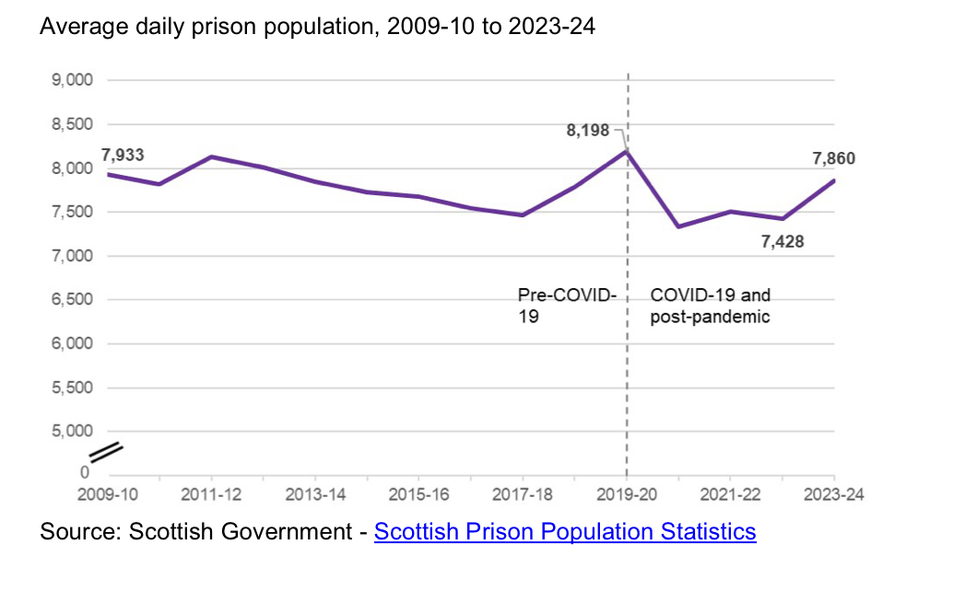

Slide 7
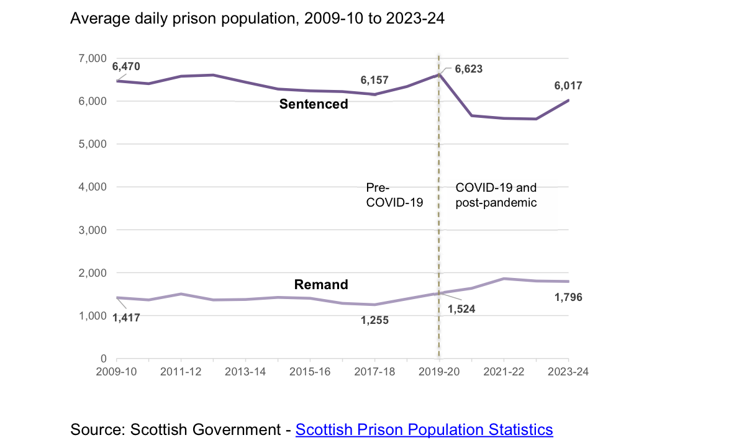

Slide 8
The Long View: chronic overcrowding, limited capacity growth
8,134
8,474
21%
prisoners in 2012; design capacity 7,840
prisoners on 13 July 2026; capacity 8,007
awaiting trial in July 2026
2012
2026
Population +4% against capacity +2%
The crisis lies less in the 14-year increase than in the rapid, sustained rise since 2023 and the lack of timely additional capacity.
Notes:
[Sources]
Figures and comparison from L13-L15.

Slide 9
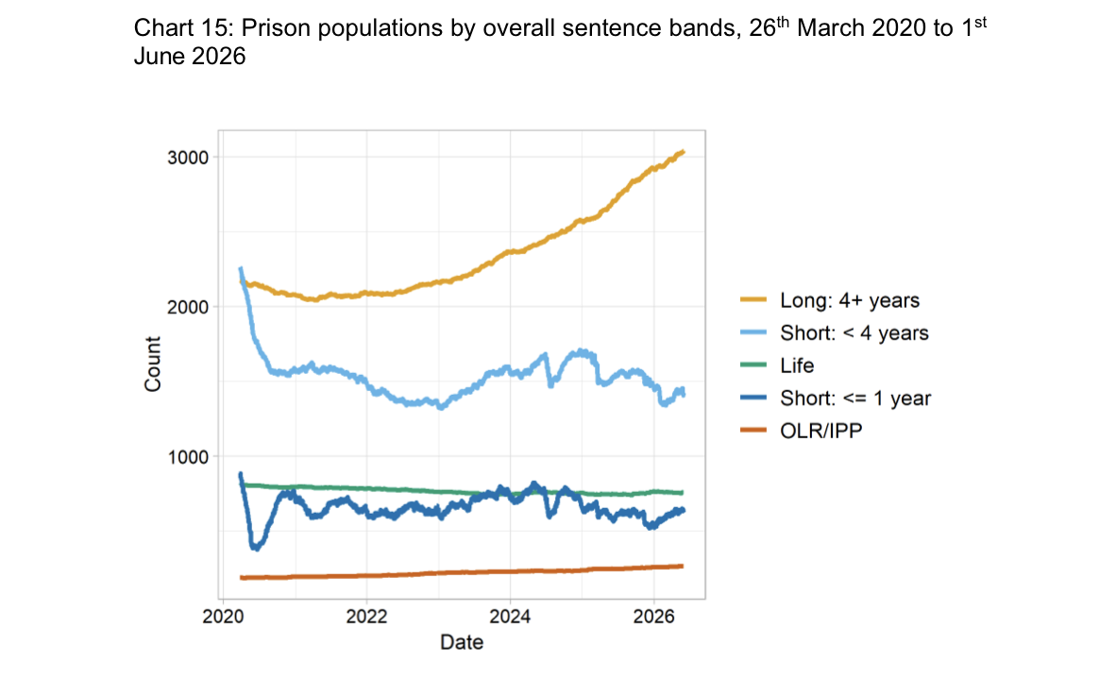

Slide 10
What has driven the recent increase?
More serious case mix
Lower overall volumes, but more complex and serious cases
Key offence types
Violence +4%; sexual crime +12%; domestic abuse and rape +19%
Longer custodial sentences
Average custodial sentence length at a record 393 days in 2023/24
Durability of sentences
Policy changes mean longer time before early release
Pandemic backlog
Remand pressures remain higher and longer-lasting
Notes:
[Sources]
Causes summarised from L17-L18.

Slide 11
The prosecution response
Notes:
[Sources]
Section header based on “The Prosecution Response” and L19-L20.

Slide 12
Article 3 ECHR
“No one shall be subjected to … inhuman or degrading treatment or punishment.”
Court’s starting point
Exceptional intervention
Implication for prosecutors
Primary responsibility for Article 3 compliance rests with the state.
Only if imprisonment itself would inevitably expose the person to Article 3 breach.
Proceed on the basis that the state will meet its obligations — but still consider mitigation.
Considered in RC v Her Majesty’s Advocate [2019] HCJAC 62
Notes:
[Sources]
Article 3 quotation from L21-L22. RC v HM Advocate discussion from L23-L32.

Slide 13
RC V HM Advocate [2019] HCJAC 62
“[34] When sentencing an offender a court is bound to have regard to the provisions of the ECHR. However, in doing so the court will bear in mind that the primary responsibility for meeting the United Kingdom’s obligations in respect of Art 3, in connection with prisoners, rests with the state (R v Qazi). The court is entitled to take into account that there is a statutory and practical machinery in existence designed to ensure the state’s compliance with its obligations under Art3….”

Slide 14
Temporary Guidance: the public safety test
Bail should not normally be opposed where individuals do not represent a risk to members of the public or to specific individuals.
Risk to public / specific individuals
Risk of reoffending
Opposition to bail remains available.
No longer sufficient to seek remand unless there is an identifiable risk.
Failure to appear risk
Temporary and reviewed
Not a standalone basis for seeking remand.
Applied while others pursue longer-term measures.
Notes:
[Sources]
Temporary guidance and Lord Advocate statements from L34-L43.

Slide 15
What has been achieved — and what has not
Achieved
Not achieved
Reduced custody appearances and remand decisions
Increased alternatives to prosecution
Demonstrated that prosecution levers can mitigate short-term pressure
Reduced the overall prison population
Created sustainable capacity
Resolved what happens if prisons cannot accept new prisoners
Bottom line: prosecutors can blunt the increase; they cannot substitute for system-wide capacity and sentencing reform.
Notes:
[Sources]
Achievements and limits drawn from L47-L53.

Slide 16
The longer-term path
Shift from short-term crisis management to structured system-wide stabilisation
Coordinated reform across sentencing, bail, remand and release arrangements
Demand reduction through earlier release, widened short-term sentence definition, extended presumption against short custody, stronger community sentences and bail-test changes
Question remains whether there is sufficient political support
The opportunity
The first response in fourteen years that recognises both the pressures driving population growth and the need for a wider range of solutions.
Notes:
[Sources]
Future reform package from L54-L58.

Slide 17
Points for discussion
How far can prosecutors legitimately use existing levers to affect prison inflow?
What safeguards are needed to ensure public-safety-led decision making remains consistent?
If capacity failure occurs, who should authorise delay or prioritisation — prosecutors, courts, or government?
What lessons should be drawn from extraordinary justice-system co-operation during Covid?
How should prisoner welfare, prison officer safety and extradition risks be weighed in prosecutorial policy?
Thank you
Notes:
[Sources]
Discussion points drawn from L59-L65.

