Slide 1

Bail on Appeal: The United States Model and its Distinctive Features
Ellen S. Podgor
Gary R. Trombley Family White-Collar Crime Research Professor
Stetson University College of Law

Slide 2

Three Points
The Law – Constitution, Statutes, Rules, & Cases
Factors for Bail – Post Trial
Key Issues for Appellate Bail (U.S. & Canada)

Slide 3
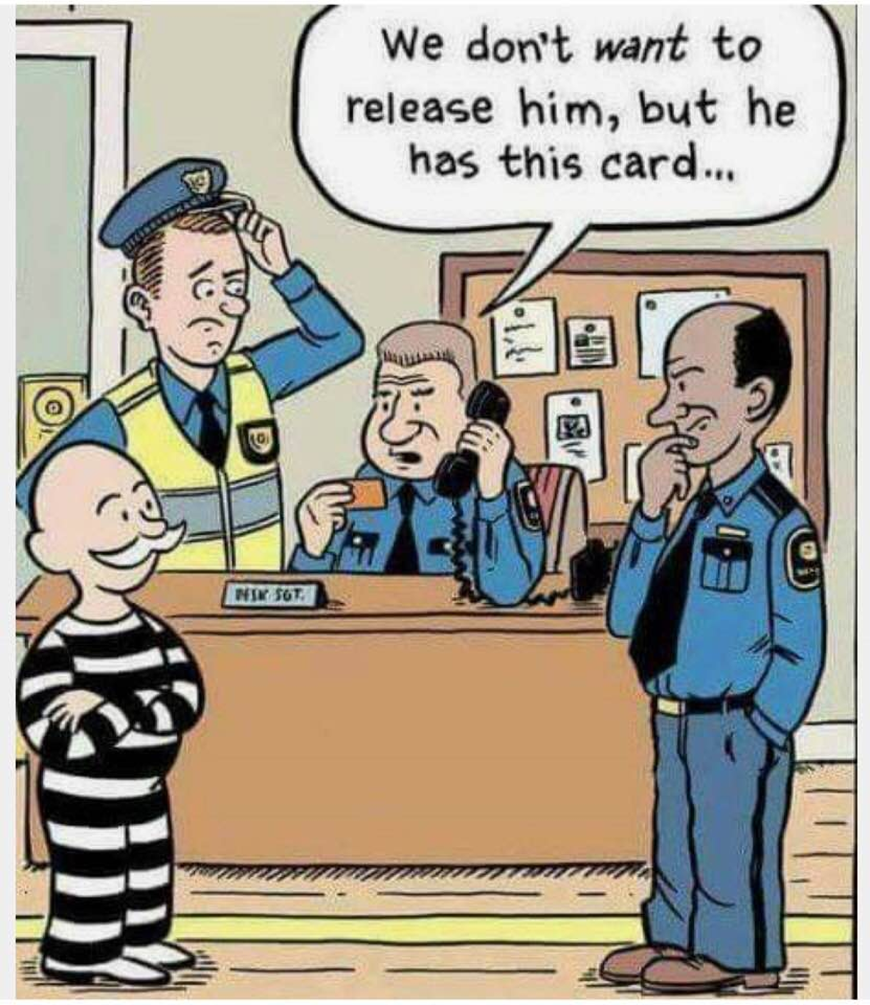

Slide 4
BAIL- Pretrial
U.S. Constitution –
  8th Amendment – “Excessive Bail Shall Not Be Required”
  No Right to Bail – Right to No Excessive Bail
  Stack v. Boyle – not entitled in all cases- e.g., capital cases
  Some State Constitutions grant a Right to Bail often with exceptions
Bail Reform Act of 1984 (18 U.S.C. § 3141 et. seq.)
  Two Factors
    Flight risk
    Danger to Community
  Standard of Review – Burden on the Govt. - Clear & convincing evidence after an adversarial hearing that no condition or combination of conditions of release would ensure the safety of the community of a person

Slide 5
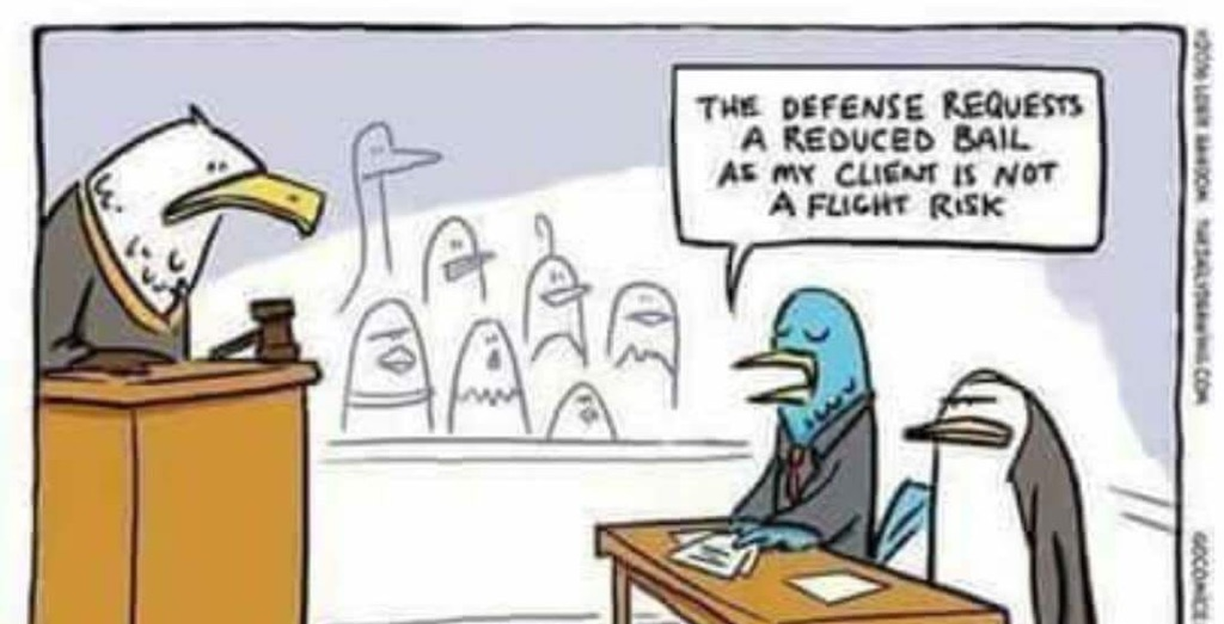

Slide 6
Factors for Detention
Courts - Pretrial
Seriousness of offense
Punishment faced by defendant
Prior criminal record
Ties to the community
Character
Financial status
Any other relevant information (flight risk or future risk to community)

Slide 7
Bail Post-trial – Federal (18 U.S.C. § 3143(b)(1))
Clear and Convincing Evidence - Not likely to flee, or pose a danger to the safety of any other person or the community
Not for Delay
Raises a Substantial Question of Law or Fact
If Decided in Defendant’s Favor - Likely to result in reversal, a new trial, a sentence without imprisonment, or a reduced sentence to a term shorter in time already served plus appeal time

Slide 8
What is a Substantial Question?
“Significant question at issue is one which is either novel, which has not been decided by controlling precedent, or which is fairly doubtful” (U.S. v. Miller)
“A close question that could be decided either way.” (U.S. v. Steinhorn)

Slide 9

Will it Make a Difference?
Key - When likely to result in reversal, new trial, sentence without imprisonment, or reduced sentence to a term shorter in time already served plus appeal time?
“The federal courts are not to be put in the position of “bookmakers” who trade on the probability of ultimate outcome. Instead, that language must be read as going to the significance of the substantial issue to the ultimate disposition of the appeal.” U.S. v. Miller
No reversal or change when –
  harmless
  no prejudicial effect
  insufficiently preserved

Slide 10
Who Gets Bail on Appeal?
Non White-Collar
White-Collar
Flee or pose a danger
Delay
Substantial Question
Likely to Change Result
Flee or pose a danger
Delay
Substantial Question
Likely to Change Result

Slide 11
Canadian Approach
Code s. 679(3), 680(1), & 515(10(c); R. v. Farinacci; R. v. Orland
Appeal not frivolous
Will surrender into custody
Detention not necessary in the public interest
  Public safety
  Public confidence in the administration of justice
  Balancing -
    Enforceability (seriousness of crime- gravity of offense, circumstances surrounding the commission of the offense, potential length of imprisonment)
    Reviewability (“not frivolous” “clearly arguable”)

Slide 12
When Outcomes Diverge: Menendez, Ravenell, and McDonnell
Robert McDonnell
Nadine Menedez
Kenneth Ravenell

