Slide 1


Protecting Society: Evidence-Based Parole Decisions in Canada
Terry Hancock, Appeal Division Board Member
Parole Board of Canada

Slide 2
Presentation Overview
Outline of today’ session:
Role of the Parole Board of Canada
Assessing risk and information considered
Decision-making framework
Culturally responsive approaches
Transparency, outcomes and key takeaways

Slide 3
Parole Board of Canada
The Parole Board of Canada (PBC):
  is an independent administrative tribunal;
  contributes to the protection of society by facilitating, as appropriate, the timely reintegration and sustained rehabilitation of individuals into society as law-abiding citizens;
  makes quality conditional release, record suspension and expungement decisions, and clemency recommendations.

Slide 4
Conditional Release
Conditional release is a structured bridge between incarceration and full community reintegration.
It contributes to public safety by allowing some offenders to serve part of their sentence in the community under the supervision of a parole officer, and subject to conditions.
Conditional release includes temporary absences, day and full parole, and statutory release.

Slide 5
Decision-Making
Conditional release decisions are made by Board members.
Board members are appointed through a Governor in Council process and reflect diverse backgrounds and community views.
Board members are supported by ongoing specialized training.

Slide 6
Information Considered
Board members consider all relevant available information in assessing an offender's risk to re-offend.
Board members are responsible for determining the reliability and persuasiveness of information.
Information from the police, courts, mental health professionals, correctional authorities, and victims of crime is used in assessing risk to re-offend and whether that risk can be safely managed in the community.
Conditions are imposed to manage identified risks.

Slide 7
Decision-Making Framework
The PBC Decision-Making Policy Manual for Board Members provides guidance and supports Board members in exercising discretionary authority fairly, respecting rights, and addressing diverse backgrounds and needs.
Board members use a Structured Decision-Making Framework to assess all relevant available information and determine whether the legal criteria for the decision are met.

Slide 8
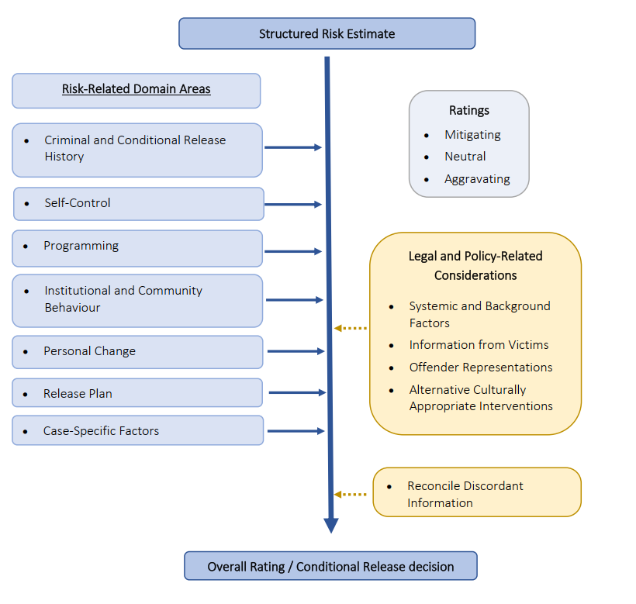

Slide 9
Cultural Responsivity
The PBC recognizes the important role that culture, community, and history play in successful rehabilitation and reintegration.
Board members consider systemic and background factors in their decision-making.
PBC initiatives to support responsive decision-making include providing trauma-informed and Culturally Responsive Hearings as well as conducting targeted in-reach sessions.

Slide 10
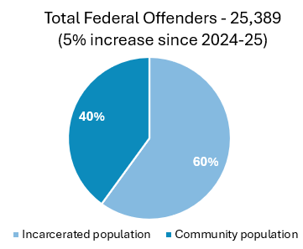
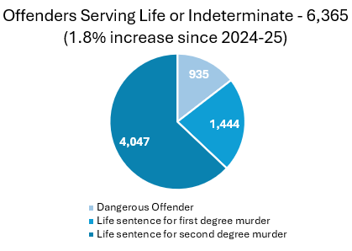
2025-2026 Overview
Long-term supervision population: 496 (6% decrease from 2024-25)

Slide 11
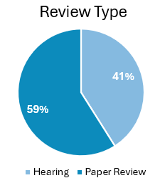
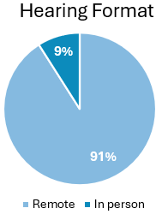
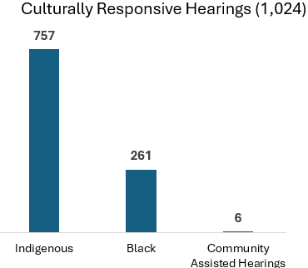
2025-2026 Overview
22,498 decisions rendered / 15,344 reviews conducted

Slide 12
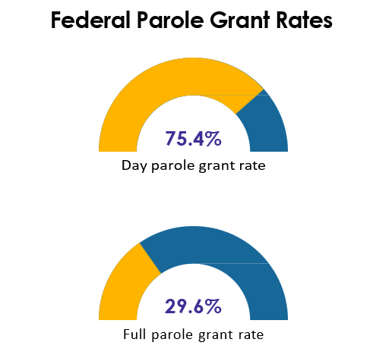
Parole Grant Rates
Federal Day Parole grant rates have increased since the pandemic period of 2020-21.
  from 72% (2020-21) up to 75% (2025-26)
Federal Full Parole grant rates have remained relatively stable over the past 5 FYs (approx. 30%).
Fiscal Year 2025-26

Slide 13
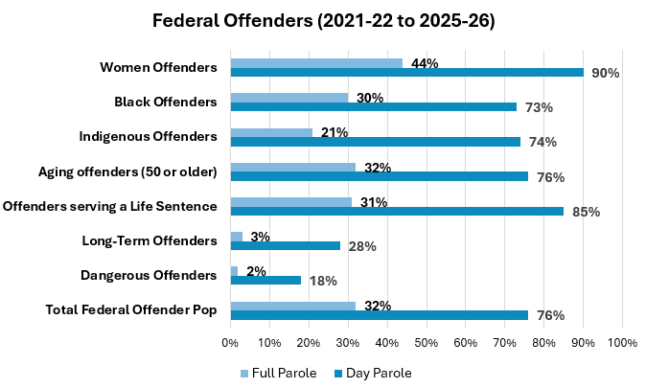
Grant Rates by Sub-Population

Slide 14
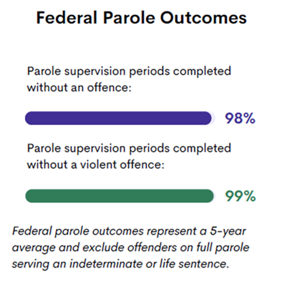
Outcomes
Offenders released at WED are:
4x more likely to be readmitted on a new federal sentence
10x more likely to return to a federal institution because of a new violent offence

Slide 15
Key Takeaways
Parole works because it follows a clear, structured process that supports fair, consistent, and high‑quality decisions.
Board members are supported by robust tools and training to carefully assess risk and make informed decisions.
This structured approach strengthens decision quality, encourages offender engagement, and supports safe reintegration.

