Slide 1
Sentencing Online Child Sexual Exploitation Offenders:
An Analysis of Victorian Court Practice
Professor Jonathan Clough, Faculty of Law
ISRCL Conference, Montreal, July 2026

Slide 2
Partner Acknowledgment
The current study forms part of an Australian Research Council Linkage Project (ARC LP180100090) conducted by Swinburne University in partnership with Victoria Police, Corrections Victoria, the Australian Institute of Criminology, and Monash University.
We wish to thank the County Court of Victoria for their assistance with data collection for this study.
The view expressed are solely those of the author and do not necessarily reflect the views or policies of Victoria Police, Corrections Victoria, the Australian Institute of Criminology or the County Court of Victoria.

Slide 3
The Problem
NCMEC's CyberTipline received more than 20.5 million reports of child sexual exploitation in 2024 alone.
The UK’s IWF confirmed CSAM on a record 291,273 sites in 2024, with 29% of hashed imagery in the most severe category
Since 2017, the Canadian Centre for Child Protection has detected and acted against nearly 50 million images and videos of CSAM.
In Australia, 1 in 6 alleged sexual offenders proceeded against in 2023–24 were for CSAM.

Slide 4
The Study
Cases involving sentencing of OCSE in the County Court of Victoria, over an 18 month period 2018-2019.
99 relevant cases published/released by the County Court.
99% guilty pleas.
72% immediate sentence of imprisonment
Cases were coded to identify key sentencing criteria, including:
  nature of offence
  offender characteristics
  objective seriousness
  sentencing objectives
  mitigating factors
  sentence
Findings are descriptive and illustrative, drawn from detected and prosecuted cases — not a measure of prevalence in the wider community.

Slide 5
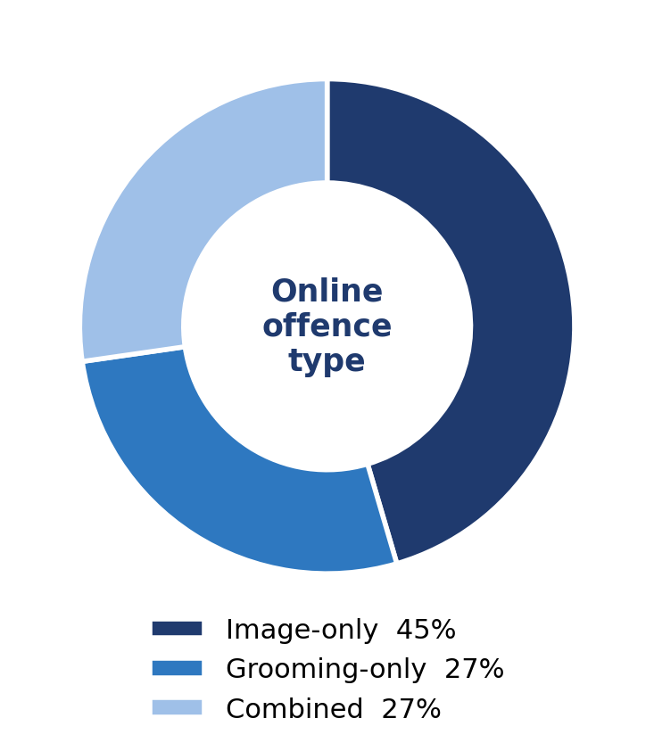
Diverse Offences
Online offences were categorised according to Image-Only, Grooming-Only, and Combined.
Image-only offending predominated (45%); grooming-only and combined offending were equal (27% each).
34% were also charged with contact sexual offences - almost all against children.
41% faced other, non-sexual charge - mostly supervision, bail and SOR breaches.

Slide 6
Classifying CSAM: The ANVIL Scale
Category 1 — Child depicted in a sexually suggestive manner, with no actual sexual activity
Category 2 — Non-penetrative sexual activity between children only, or solo masturbation by a child
Category 3 — Non-penetrative sexual activity between an adult and a child
Category 4 — Penetrative sexual activity, child–child or adult–child
Category 5 — Sadism, bestiality, or child abuse (a child subjected to torture, cruelty or humiliation)
Category 6 — Animated or virtual depictions of any Category 1–5 activity

Slide 7
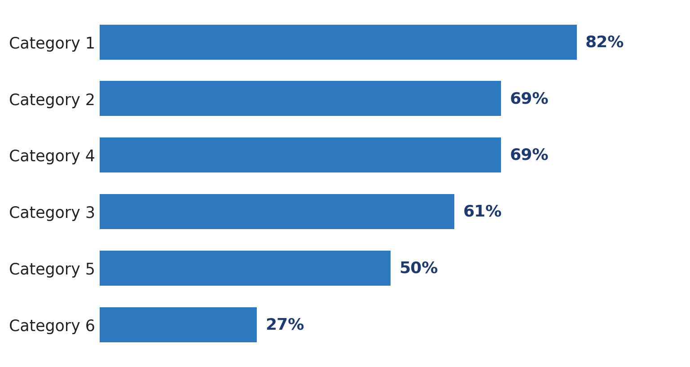
Classifying CSAM: (All Image Offences)

Slide 8
Classifying CSAM
The most common patterns were categories 1-6 (23%) and categories 1-5 (18%).
No single profile predominated, indicating substantial variation in the breadth of material possessed.

Slide 9
Diverse Offenders
Overwhelmingly (97%) male.
Age at sentence ranged from 19 to 67, with an average of 37.
Educational attainment ranged from postgraduate qualifications to early school leaving.
65% were employed at the time of sentence.
Two-thirds had prior good character, rising to 73% among image-only offenders.
Only 17% had prior criminal histories — most had no previous justice-system contact.

Slide 10
Contributing Factors Identified at Sentence
Sentencing remarks revealed recurring personal and contextual factors advanced in mitigation or identified by the courts.
Social and sexual isolation, loneliness, and difficulties forming intimate relationships were frequently recurring themes.
Addiction and compulsive or habitual behaviour emerged as a significant secondary pattern.
Intellectual disability and cognitive impairment featured in a smaller number of cases.
Some defendants reported histories of childhood abuse or other traumatic life experiences.

Slide 11
Sentencing Objectives
Considered
Substantial

Slide 12
Sentencing Objectives
Just punishment, general deterrence and denunciation were almost universal considerations.
Specific deterrence emerged as the most frequently emphasised sentencing objective, followed by general deterrence and denunciation.
Protection of children was consistently recognised, reflecting the vulnerability of victims and the broader harms of OCSE.
Rehabilitation was considered in fewer than half of cases, although when raised it frequently assumed particular importance.

Slide 13
Psychological and Cognitive Factors
Mental conditions were identified in approximately two-thirds of defendants.
Depression was the dominant condition, often accompanied by anxiety.
Neurodevelopmental and cognitive impairments formed a distinct subgroup.
Personality disorders, PTSD and psychotic disorders were less common.
Paraphilic disorders, such as pedophilia, were identified in almost a quarter (22%) of cases.

Slide 14
Mental Impairment and Sentencing
Mental impairment may mitigate sentence.
OCSE sentencing places particular emphasis on deterrence and community protection.
Paraphilic disorders are often treated differently from other mental conditions.
Diagnoses that help explain offending may also increase concerns about future risk and rehabilitation.
Explanatory factors do not necessarily operate as mitigating factors.

Slide 15
Profiles of OCSE Offenders: Empirical Complexity
The findings of the present study accord with a growing body of empirical literature and other studies in this Project, all of which point to the complexity and diversity of offender profiles in OCSE cases.
No single offender profile.
Multiple contributing factors.
Online and contact offending are not neatly distinct.
Offence category alone is a poor proxy for risk.

Slide 16
Themes
Tailored interventions that address the specific factors associated with offending.

Slide 17
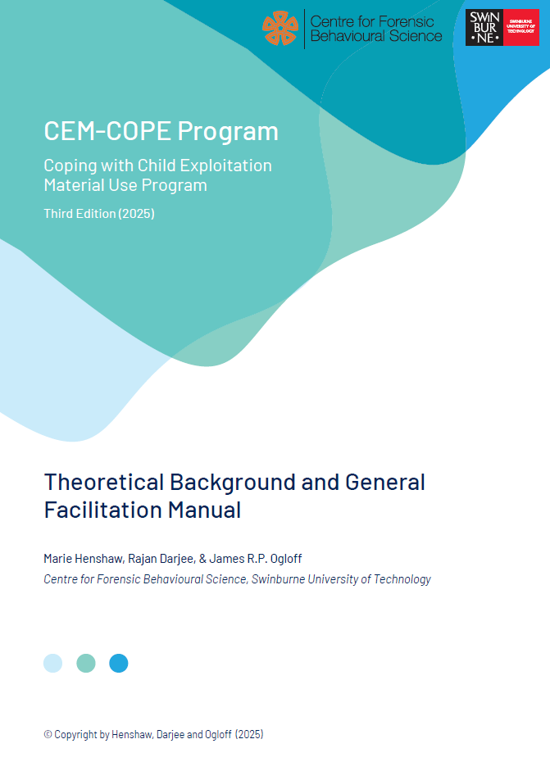
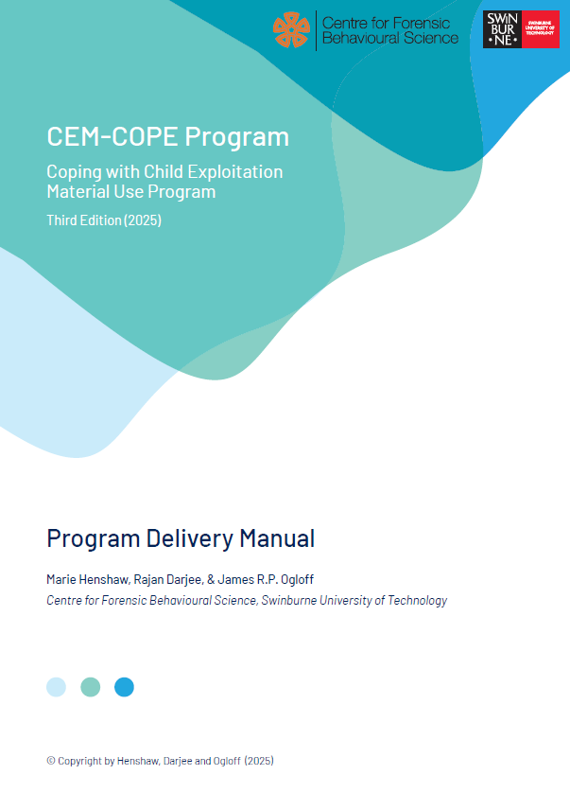
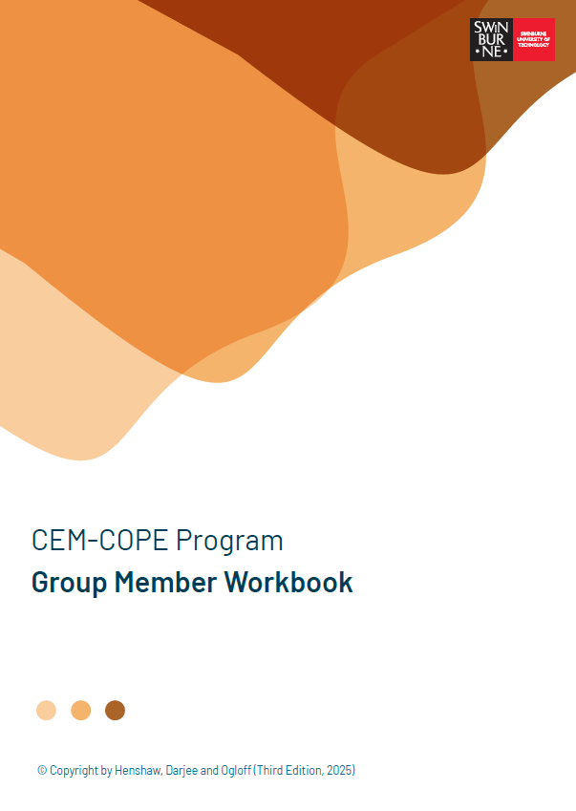
Need Principle
The CEM-COPE Program (3rd edition, 2025)
Henshaw, Darjee & Ogloff (2025)
Offence-specific psychoeducation and skills-based group program
Designed for CEM offenders with no online or offline sexual offences involving direct contact with children
Lower intensity – 17 sessions
Targets criminogenic needs related to CEM offending to prevent CEM reoffending
Evidence and expert informed

Slide 18
Themes
Tailored interventions that address the specific factors associated with offending.
A nuanced approach to sentencing, informed by a greater understanding of the diversity and complexity of individuals convicted of OCSE offences.
Greater attention to protective factors.
Further empirical research examining pathways to offending and the effectiveness of interventions.

Slide 19
Thank you

