Slide 1


Slide 2


Sentencing Battered Women who Kill their Abusers – Reimagining Sentencing for Imperfect Victims and the Myth of “Mutual Violence”
Dr. Frances E. Chapman, PhD, LLM, JD, BA
Lakehead University, Bora Laskin Faculty of Law
Thunder Bay, Ontario Canada

Slide 3
Acknowledgements
Lakehead Thunder Bay is located on the traditional lands of the Fort William First Nation, Signatory to the Robinson Superior Treaty of 1850. Lakehead University acknowledges the history that many nations hold in the areas around our campuses, and is committed to a relationship with First Nations, Métis, and Inuit peoples based on the principles of mutual trust, respect, reciprocity, and collaboration in the spirit of reconciliation. Also acknowledge the unceded Indigenous lands here in Montreal. The Kanien’kehá:ka Nation is recognized as the custodians of the lands and waters on which we gather today. Tiohtià:ke/Montréal is historically known as a gathering place for many First Nations. Today, it is home to a diverse population of Indigenous and other peoples. I respect the continued connections with the past, present and future in our ongoing relationships with Indigenous and other peoples within and around the Montréal community.

Slide 4
Acknowledgements
Referring to women as subject to violence and men as perpetrators – recognize that men are subject to violence
Trigger warning

Slide 5
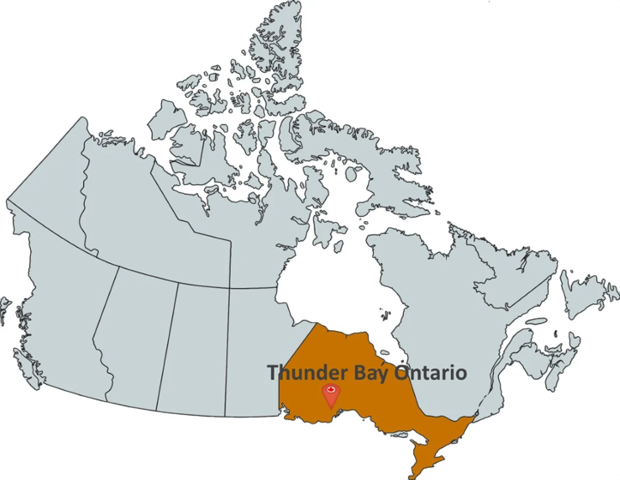


Lakehead University
Bora Laskin Faculty of Law,
Thunder Bay, Ontario Canada

Slide 6


outline
Introduction
Myths and Stereotypes
Evidence
Typology
Is Mutual Violence Real?
R v Naslund

Slide 7

Family/Criminal/Civil Silos

Slide 8
“Their convictions erase their victimization”
Lila Meadows & Leigh Goodmark, “Discretion and Credibility, Dignity and Mercy: The Case of PT, A Criminalized Survivor” (2023) 38:1 Wisconsin Journal of Law, Gender & Society 53 at 54.

Slide 9


how are women discredited?
Those who are racialized, or who do not conform to traditional gender roles (including those who have a mental disorder, substance abuse or are the primary breadwinner) are labelled as “imperfect victims”
  Leigh Goodmark, Imperfect Victims: Criminalized Survivors and the Promise of Abolition Feminism (Oakland California: University of California Press, 2023) at 10 [Goodmark, Imperfect].
In a system that is operating in a binary fashion (victim or offender), there is little room for an imperfect victim who must be fabricating, or elaborating, on their “victimization” and downplaying their role as aggressor

Slide 10
Intimate partner violence before the Courts
Those who come before the criminal and family law systems with Family Violence (FV) issues are in peril
Women who disclose Intimate Partner Violence (IPV) risk losing their children to a parent who alleges that she fabricated abuse
Those who find themselves before the criminal law system may find their status as victims ripped away from them if they are seen to be at fault in any way, especially through the use of “mutual violence”
Although the Canadian government added a definition of FV to the Divorce Act in 2021, there is little action behind these words for women who assert they have experienced domestic violence (DV)

Slide 11
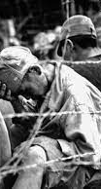
PRISONERS OF WAR & IPV
Parallels between prisoners of war and battered women in hopes of clarifying the concept for those who have never been in a coercive and controlling environment
Coercive control = hard to classify and study because it calls on both the emotional and intellectual.
Evokes questions about our own agency, of being used and controlled by a loved one, and perhaps most insidiously of losing your identity
This has been the theme of the last decades – where the criminal law system has failed to protect women, the family law system has struggled to recognize the issues

Slide 12
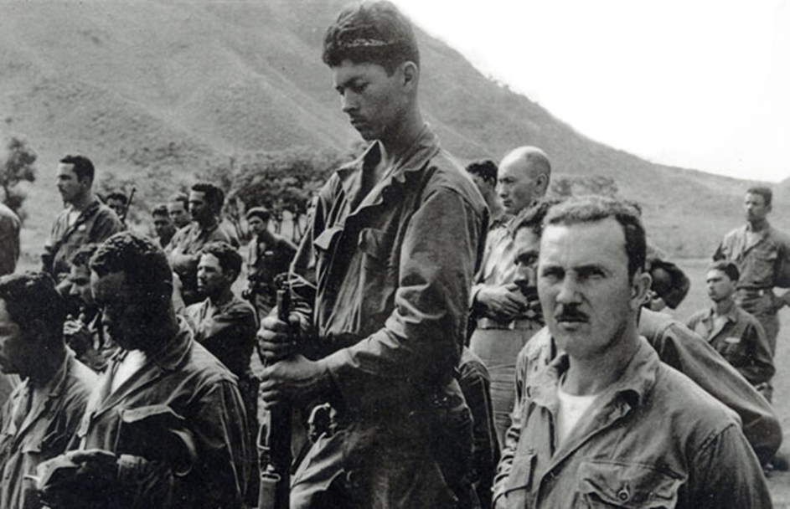
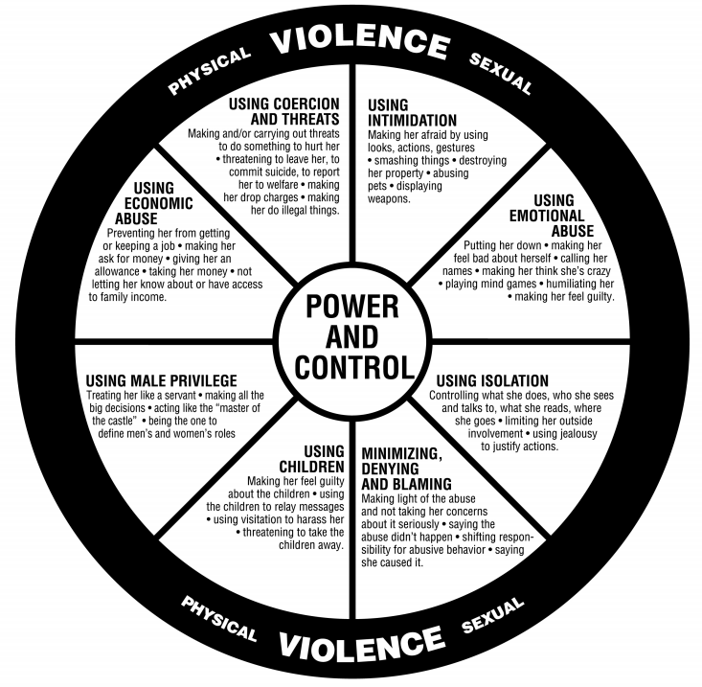
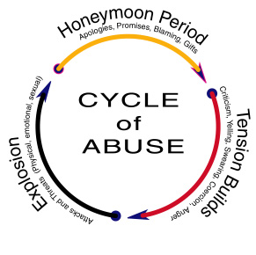
Cycle of Violence –
Battered Women & Prisoners of War
http://conflictseries.com/gallery3.html
http://info.umkc.edu/womenc/2010/05/07/trying-to-understand-abuse/
https://www.acpsk12.org/theogony/2018-2019/february-is-teen-dating-violence-awareness-month/

Slide 13
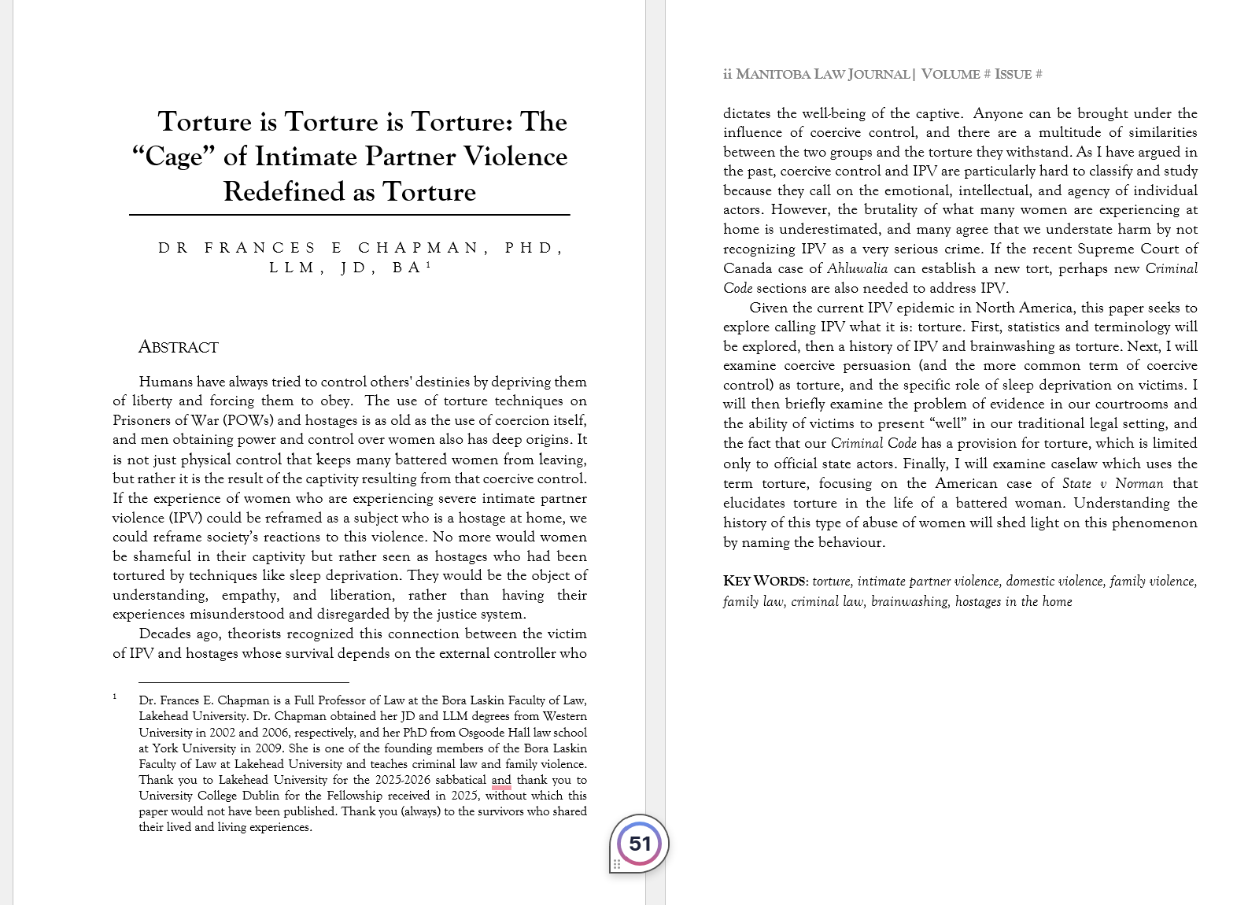

Torture

Slide 14

Evan Stark, Coercive Control: The Entrapment of Women in Personal Life (New York: Oxford University Press, 2007) at 204.
“Hostages at Home” – Evan Stark

Slide 15
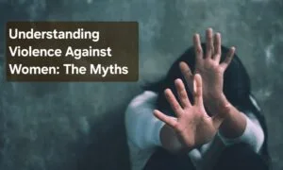
Myths & Stereotypes
Is Mutual Violence a New Myth in Old Clothes?

Slide 16
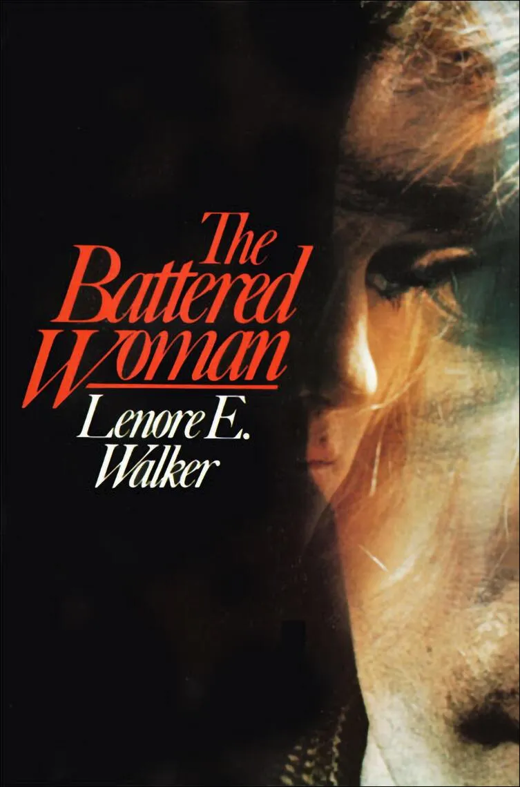
Lenore Walker
Myths and stereotypes
  “Good wives” 1970s were told to change their behaviour to avoid abuse by being “less provocative, less aggressive, and less frigid” as the burden for battering was squarely placed on masochistic women
  Walker notes that battered women are often described as “too bossy, too insulting, too sloppy, too uppity, too angry, too obnoxious, too provocative, or too something else” (at 29)
  Stereotype that the battered woman should be “weak, passive and powerless” (Goodmark, Reframing at 40)
  Need a victim and villain – all or nothing

Slide 17
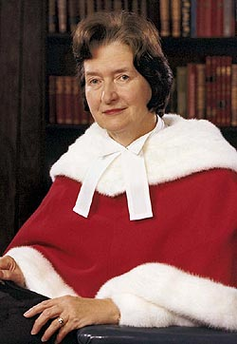
Lewis Okun:
“Battered Women subjected to almost identical conditions as brainwashed prisoners believed to be masochists and provocateurs, while the prisoners are not so accused?”
Lewis Okun, Woman Abuse: Facts Replacing Myths (Albany: State University of New York Press, 1986) at 87.
Justice Bertha Wilson:
“not as badly beaten as she claims or she would have left the man long ago. Or, if she was battered that severely, she must have stayed out of some masochistic enjoyment of it.”
R v Lavallee, [1990] 1 SCR 852 at para 34

Slide 18
Introduction
Women’s motives for reporting this crime are invariably scrutinized using myths and stereotypes to discredit women. The obvious question is, why?
A woman’s lived experience is consistently labelled internally inconsistent and untrue, often because of the trauma that victims of violence have experienced
Second, victims are not seen as credible simply because they are women who are painted with false motives
The more that the victim feels that her credibility is questioned, the angrier, more disbelieving and more agitated she appears, making her less credible in the eyes of the court
Thus, this merry-go-round of credibility results in failing survivors of IPV
Mandatory arrest policies have only perpetuated the problem
Women are not allowed to be angry – mutual violence is unacceptable

Slide 19
Women who “fight back” (even in very small ways) are accused of engaging in “mutual violence,” “bidirectional violence,” or “situational violence”

Slide 20
Mutual Violence
Suzanne Zaccour stated that parental alienation makes DV disappear. Does the concept of “mutual violence” make male-perpetrated IPV disappear?
R v Lavallee & R v Naslund show that not only does IPV disappear, but even more troubling, that it may be used as a weapon against women to erase their victimization

Slide 21
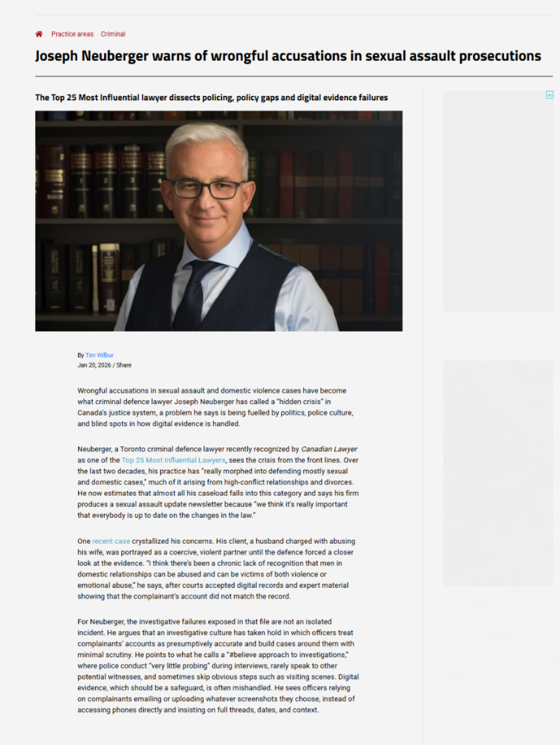
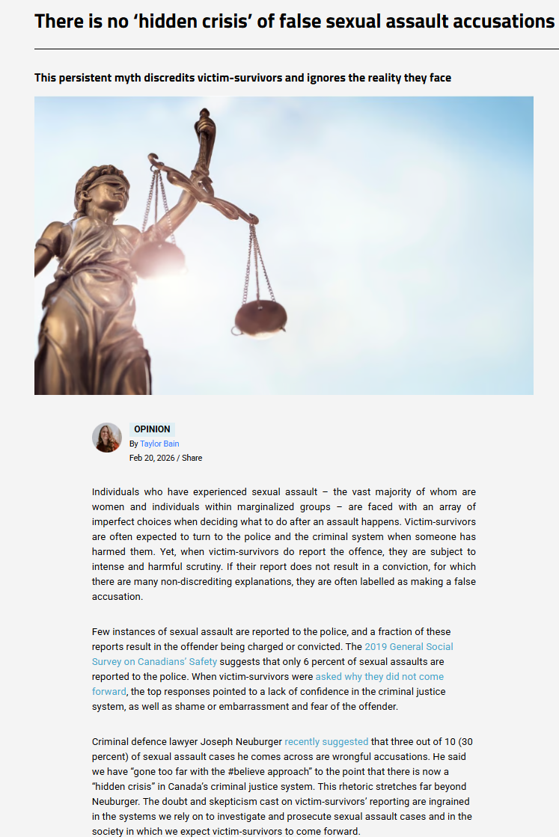
Myths?
Reinforced in Media
  “Hidden Crisis” of “wrongful accusations in sexual assault and domestic violence” cases
  3 out of 10 matters they can assemble evidence that the allegations are “demonstrably false”
Imperfect Choices

Slide 22
Mutual violence
Gender symmetry ignores most severe outcomes are perpetrated by men against women, and in cases of intimate partner homicide, sexual assault and criminal harassment, there are predominantly female victims
Mutual violence is actually very rare and little studied, and our history of mandatory arrest policies has obfuscated the situation even further.
“[t]he concept of the “ideal victim” serves to undermine their credibility and enforce blame onto them for not responding in the ‘correct’ way with physical or active resistance, despite research showing that the most common reaction to rape is ‘freezing,’ otherwise known as tonic immobility.”
  Sophie Heritage, “Why didn’t she fight back? An exploration of victim blaming through tonic immobility reactions to sexual violence” in Researching Domestic Abuse and Sexual Violence: Critical Perspectives for Student-Practitioner Researchers, Claire McLoone-Richards, ed. (New York, NY: Routledge, 2024) at 52.

Slide 23

Why Is mutual violence Described in vague terms?
Mavis Morton et al noted in their study of 46 cases that the court used 37 different words or phrases to refer to violence in the intimate relationship . . . As an example, in Vodden v Furgoch (2019), the judge alluded to intimate partner violence in 12 different ways: 'abuse,' 'adult conflict,' 'aggression, 'an altercation,' 'challenging behaviour,' 'conflict,' 'control,' 'difficulty regulating emotions,' 'emotional blackmail,' 'high conflict,' 'parental conflict,' and undefined abuse.”
    Mavis Morton et al, "The De-Gendering of Male Perpetrated Intimate Partner Violence against Female Partners in Ontario Family Law Courts" (2021) 43:2 J Soc Welfare & Fam L 104 at 107.
Women who are hostile or obstructive are seen as blameworthy and described as emotional or hysterical
Why can we not accept that people are “neither angels nor demons” (Kathleen J. Ferrarro)

Slide 24
Evidence
Do We Need to Alter our Conception of Evidence in IPV?

Slide 25
Traditional Evidence concepts not Work in these Cases?
Is “affect” a problem?
    Deborah Epstein and Lisa A Goodman, “Discounting Women: Doubting Domestic Violence Survivors’ Credibility and Dismissing their Experiences” (2019) 167:2 University of Pennsylvania Law Review 399 at 402.
Might be subtle triggers in court (and abuser may be cross-examining their victim)
  “gripped by fear, frustration, fury, or all three. But to the judge, who has no window into the triggering event, the survivor is likely to sound out of control, even a bit crazy. The survivor now fits the stereotype of a classic hysterical female - an image commonly associated with exaggeration and unreliability. The judge is therefore more likely to apply a credibility discount in such settings and assume that, regardless of the content of her story, the survivor is not a fully trustworthy witness” (Ibid at 421-422.)
Already discredited just for being a woman using stereotypes?

Slide 26
Women who “fight back”
Reluctance to be “imperfect” and not tell an unconventional narrative for fear they will be seen as unpersuasive
Not done what they “should” have done
Lawyers tell women not to talk about their abuse or narratives that are not conventional
Transactional basis of the criminal law not recognize patterns of abuse over the whole relationship
Traditional assaults often not by someone who is psychologically, financially or socially in control
Many do not fit within the “box” that criminal system designed for

Slide 27

Typologies
Michael P. Johnson

Slide 28
Johnson Typologies
Common Couples Violence (CCV) or Mutual Violence
violent resistance (usually female resistance and self-defence)
situational couple violence (used equally by men and women in response to a particular conflict with more women injured in this type of conflict)
coercive control
separation-instigated violence
and what was termed mutual violence (where both partners use violence to control the other in a battle between two intimate terrorists)

Slide 29
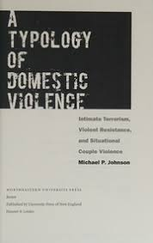
What is “Mutual Violence” in the Typologies?
Johnson wrote in his 2008 book that, “in a very small number of cases, both members of the couple are violent and controlling, each behaving in a manner that would identify him or her as an intimate terrorist.” He continued that very little is known:
  about the dynamics of such relationships other than they seem to involve the ‘mutual combat’ that researchers have for decades attributed to any relationship in which both partners reported that they had been violent. In most such cases, however, that so-called mutual violence was a product of intimate terrorism with violent resistance, or situational couple violence in which both partners had been violent. With mutual violent control, we have the true mutuality of two people fighting for general control over the relationship.
Johnson concludes that this type of violence is “very rare,” and little is known about this type of violence.
  Michael P. Johnson, A Typology Of Domestic Violence: Intimate Terrorism, Violence Resistance, And Situational Couple Violence. (University Press of New England, Lebanon New Hampshire: 2008) at 12

Slide 30
What is “Mutual Violence” in the Typologies?
Nonetheless, this term was adopted by some Canadian courts as an easy “catch-all” category of violence.
Johnson himself acknowledged in 2015 that this type of violence appears, “in very small numbers in some samples, and there is some debate about whether it is a true type or an artifact of the constraints of imperfect operationalization.”
  Michael P. Johnson, “Differentiating Among Types of Domestic Violence: Implications for Healthy Marriages” in Elizabeth H. Peters & Claire M Kamp Dush eds, Marriage and Family: Perspectives and Complexities (New York: Columbia University Press, 2009) at 294 n1 [Johnson, “Differentiating”].

Slide 31
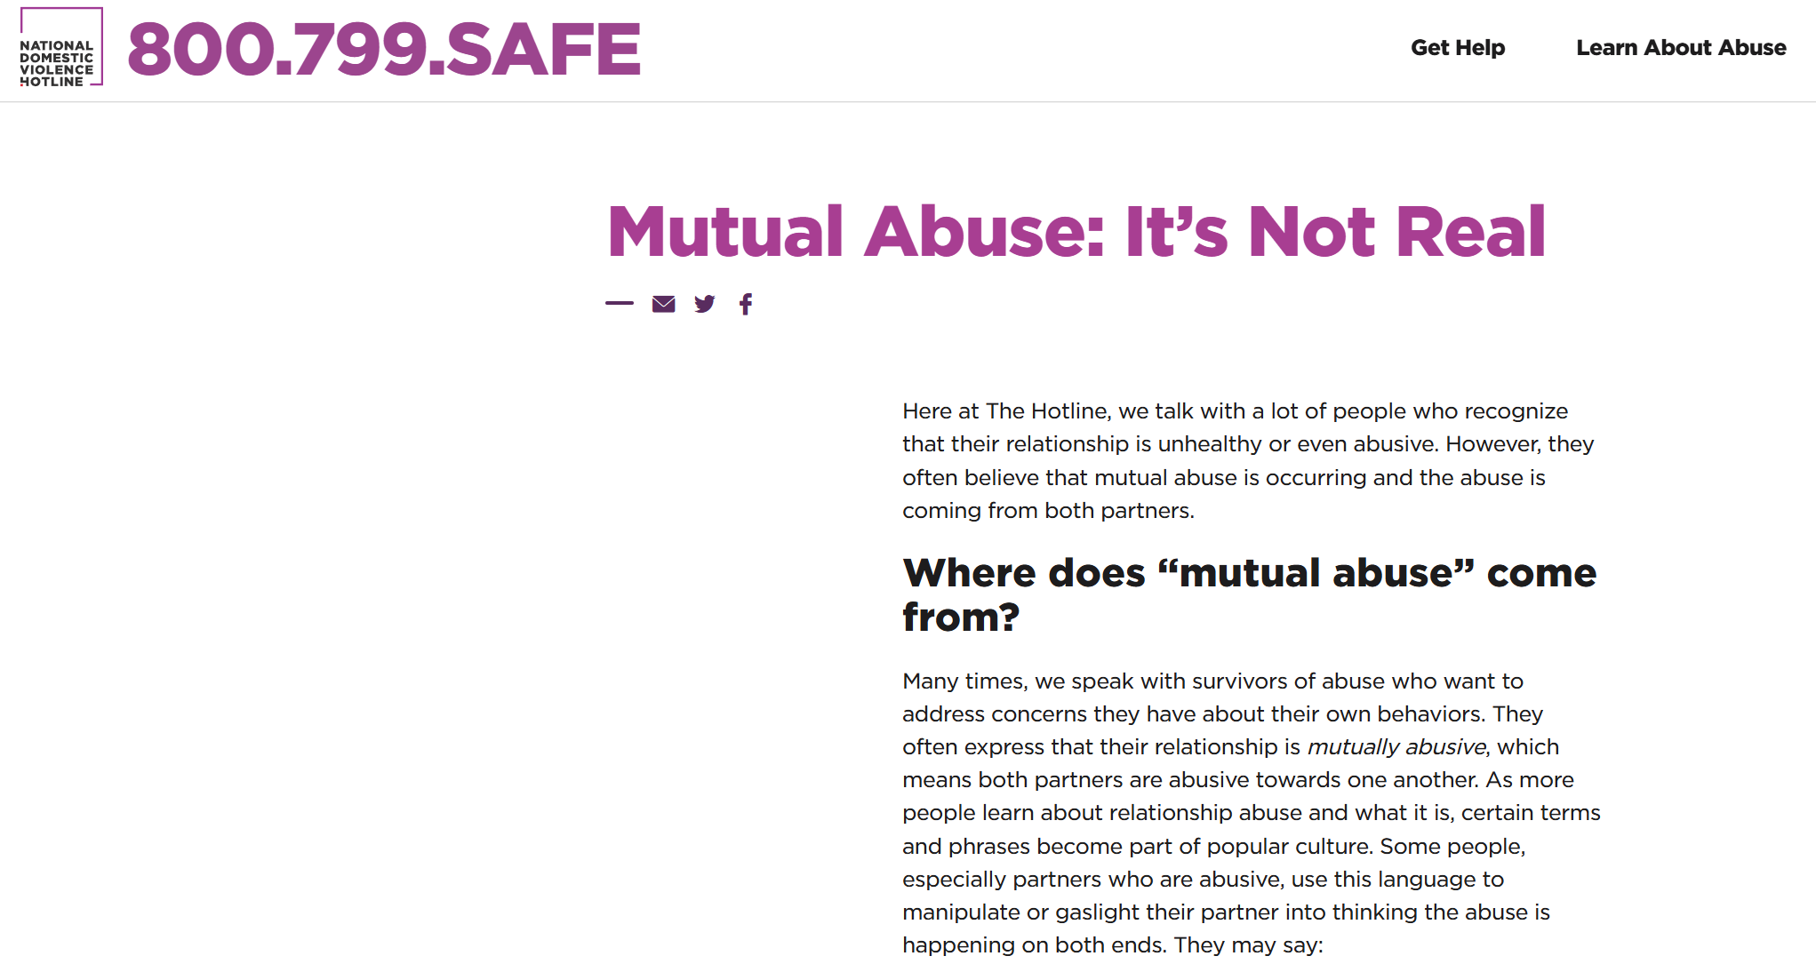
Is Mutual violence not real?
The presumption that women are just as violent ignores the concept of “violent resistance” as well as increases in the severity, impact, and harm associated with male-perpetrated acts of violence.
The aim of violent resistance is very different from that of mutual violence. The victim uses violence as a survival tactic
It is important to recognize that a woman who fights back in anger is not engaged in mutual battering.
Viewing violence only as a product of relationship conflict makes the assumption that both parties are just as violent
This leads to the conclusion that if the parties are no longer in a relationship, there will be no further violence. This proposition has been shown to be categorically untrue.

Slide 32
2024 Study Ahmed, Helmus & Lysova
Distinguished between mutual violence (in 1 incident) and bidirectional violence (any time in the relationship)
When the vignette had bidirectional violence, participants found lower harm was perceived and higher victim responsibility
Victim “deserved” what happened to them, took the victims less seriously, and said it was difficult to tell who the “real victim” was
Seen as victim “victim had it coming”
Lower offender risk, lower physical harm, lower psychological harm to the victim and more responsibility on the victim
Blaming both parties can obscure bad behaviour and justify the abuser’s actions
Victims are less likely to see as strong and tough and capable of standing up for themselves
Are we viewing serious abuse by the man and minor abuse on the part of the woman as mutual violence?
Simran Ahmed, L. Maaike Helmus, and Alexandra Lysova, “Public Perception of Bidirectional Intimate Partner Violence” (2024) 90 Journal of Criminal Justice [Ahmed, Helmus & Lysova]. See also Alexandra Lysova, Kenzi Hanson & Jennifer Mackay, “Bidirectional and Unidirectional Intimate Partner Violence: A Comprehensive Review” (2023) Partner Abuse 1.

Slide 33
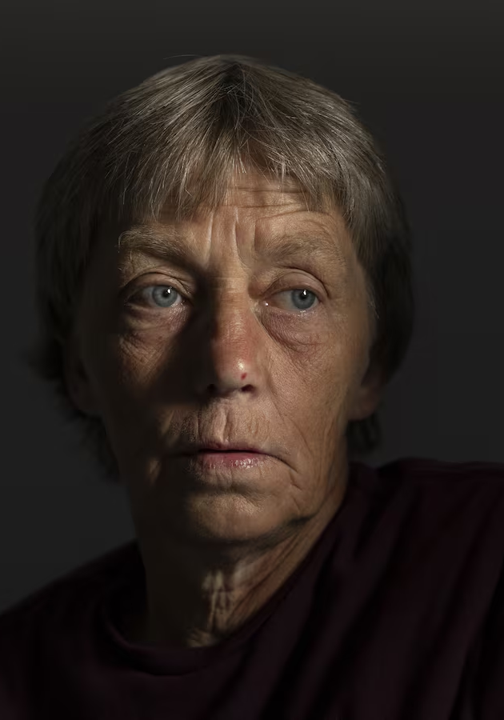
Case Example:
Sentencing
Helen Naslund
When the Victim becomes the offender

Slide 34

R v Naslund
[2022] AJ No 32
  Case out of Alberta – Mrs. Naslund was sentenced to 18 years for the killing of her abusive husband in 2011
    One of the longest sentences for a battered woman who kills her abuser in Canada
  Her almost 30-year history of abuse was all but wiped away after the death of her husband
    She was emotionally, physically, sexually and financially abused and treated her and her sons much like coerced forced labour on their rural farm
    Miles Naslund held guns to her and her children’s heads, threatened them harm on a regular basis
    Son Neil Naslund helped dispose of the body (pleaded guilty to offering an indignity to a human corpse)
  Trial and sentencing were not reported
  Sentencing was reduced on appeal to the Court of Appeal for Alberta

Slide 35
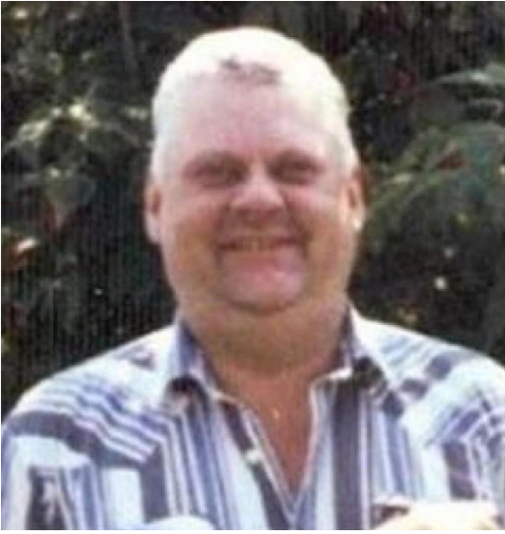
R v Naslund
[2022] AJ No 32
  Naslund’s sons recall that the psychological abuse that their mother endured was more significant
  she was critiqued by her husband, including what she made for dinner. Wes recalled that Miles, “threatened her life—even over things as small as having macaroni more than once a week . . . If she made a supper that he deemed not fit or suitable for himself, he threatened her. [He’d say], ‘If you don’t start f-cking making supper, I’ll f-cking kill you.’”

Slide 36
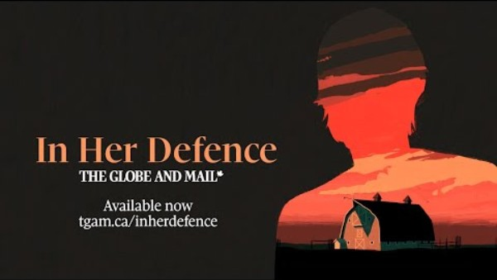

Slide 37
R v Naslund
[2022] AJ No 32
  She “genuinely feared for her safety” given what Miles Naslund had threatened, but because of an “unhappy marriage” and a “history of abuse, concern for her children, depression and learned helplessness, she felt she could not leave.”
While he slept that night in 2011, Helen Naslund took a .22 calibre revolver and shot Miles twice in the back of the head while he slept.
With the help of her youngest son, Neil Naslund, she disposed of the body and made it appear like her husband had left their farm and likely died by suicide.
By August 2017, Darrell Naslund (the middle son) had told multiple people about the killing of his father, and where the remains were located.
The remains of Miles Naslund were found, and Helen and Neil Naslund turned themselves in to the police, pleaded guilty, and Helen Naslund entered into a joint submission for sentencing.
  Criminality erases victimization?

Slide 38
R v Naslund
[2022] AJ No 32
Sentencing
  Defence counsel did not present one case on DV and what the range was for battered women who kill
Defence counsel also said in their submissions that they would not be mentioning that Helen Naslund was battered
Counsel said, “I’ll be quite frank. This was a circumstance wherein the central issue for the defence was whether or not the application of the concept of battered woman syndrome would apply. This was the struggle for the defence in that respect. I’m not alleging any particular circumstances. Given the joint submission, I don’t think it to be appropriate.”
Defence counsel went on to mention only two mitigating factors; that there was a guilty plea well in advance of trial, and that she was a contributing member of society without a prior criminal record.
There was no mention of the abuse that Helen Naslund had experienced for 27 years.

Slide 39
R v Naslund
[2022] AJ No 32
  CROWN did mention IPV in the aggravating factors
  They identified that this case involved an intimate partner and position of trust (being the spouse of Helen Naslund), that it occurred in the “victim’s own home, a place where he’s entitled to feel safe” and that he was asleep in the bed that he shared with his wife at the time of the shooting”

Slide 40
R v Naslund
[2022] AJ No 32
In his sentencing, Justice Sanderman (orally noted that):
“most people who are charged with criminal offences in this building aren’t evil people. They are not bad people. They are people who make mistakes because they are generally overwhelmed by their personal difficulties. They react poorly when other options are open to them, but they then have to pay for the manner in which they have overreacted because it offends our sense of morality and our sense of the law.”

Slide 41
R v Naslund
[2022] AJ No 32
  Mr. Naslund became the only victim
  The egregious abuse that Helen Naslund had suffered was reduced by the sentencing judge as, “difficulties within the home.”
  Judge described her actions as “a callous, cowardly act on a vulnerable victim in his own home, so his domicile, by a partner. That is summarizing it, but I think it summarizes it quite nicely.”
  Suddenly, Helen Naslund is no longer a wife who was battered in every way for 27 years; she is now the aggressor. She is now the abuser

Slide 42
R v Naslund
[2022] AJ No 32
  Sentence appealed to the Court of Appeal
The majority of the Court of Appeal recognized that the sentence was “unhinged from the circumstances of the offence and the offender” and that this sentence was untenable.
There was no expert evidence in this case
On the very scant agreed statement of facts Justice Greckol noted that there was agreement by the parties that there was physical, emotional, coercive controlling abuse by Miles Naslund to Helen Naslund, that alcohol had increased and contributed to these behaviours, that there were firearms present, that Helen Naslund feared for her safety, and that “due to the history of abuse, concern for her children, depression and learned helplessness, she felt she could not leave.”

Slide 43
R v Naslund
[2022] AJ No 32
Justice Greckol found that “battered women syndrome” applied to Helen Naslund even though her counsel did not make this clear assertion
Justice Greckol - woman who had suffered 27 years of “egregious abuse may be accustomed to seeing herself as worthy only of harsh punishment. This does not mean the justice system should follow suit.”
Her abuse was a significant mitigating factor and would reduce the sentence from 18 to 9 years
Equating one very violent (fatal) act after 30 years of continuous abuse deserves examination

Slide 44
R v Naslund
[2022] AJ No 32
  Alberta Court of Appeal Dissent – Justice Wakeling
    Defendant did not “invoke” battered women’s syndrome
    Very experienced counsel came to a “bargain” that was best for both sides after a lengthy negotiation – she did not have to accept
“does not, on this record, diminish the blameworthiness of Ms. Naslund’s decision to shoot her husband in the head” (para 326)
No expert evidence – NOT a BWS case

Slide 45
R v Naslund
[2022] AJ No 32
Dissent concludes with the thought that a woman “may be battered but not suffer from battered woman syndrome. And a woman may not suffer from battered-woman syndrome but still be adversely affected by living with an abusive spouse.” (para 392)
Myths and stereotypes?
  Likes the abuse, stays because of a payoff?

Slide 46

A survey by Rise: “Gender-bias and myths about family violence are as prevalent as the myths about sexualized assault. Nearly half of the women we surveyed were told that they should not bring up the family violence in court, partly because ‘[j]udges don’t like to hear about that.’ An approach to family law that silos women’s experiences of family violence by treating those experiences as less than integral to achieving a just result in all the circumstances of the case is at best a disservice to the administration of justice and, at worst, continues the perpetration of violence through indifference.”
Haley Hrymak & Kim Hawkins, "Why Can't Everyone Just Get Along: How BC's Family Law System Puts Survivors in Danger" (2013) at 69-70.

Slide 47
Solutions?
We need to purge our system of any notion of the “perfect victim” and see rational women in irrational circumstances.
Schneider notes that women, in particular, are only seen as a pure victim or a pure agent “when in fact they are profoundly interrelated. Neither victimization nor agency should be glorified, understood as static, viewed in isolation or perceived as an individual or personal issue, for gender subordination must be understood as a systemic and collective problem – one in which women experience both oppression and resistance.”
  Elizabeth M. Schneider, “Feminism and the False Dichotomy of Victimization and Agency” (1993) 38 NYL Sch L. Rev. 387 at 396.

Slide 48
Sentencing is judge dependent
George Fletcher rightly noted the difficulties of leaving compassion to the Courts. He notes that there are far too many variables in human emotion, noting that whether the “conduct is blameworthy can hardly depend on whether the judge feels like blaming the defendant. The judge’s proper response is not to ask whether she feels like blaming the defendant, but whether the defendant deserves blame.”
“if there is a system of discretion built within criminal justice . . . we should choose a public system of excuses instead of a semi-secret system of administrative grace.”
George P. Fletcher, “The Right and the Reasonable,” (1985) 98 Harvard Law Review 949 at 970 [Fletcher, “The Right”]. George P. Fletcher, “The Individualization of Excusing Conditions” (1974) 47 S. Cal. L. Rev. 1269 at 1309.

Slide 49
Conclusion
Women who speak-up, women who are aggressive in any way to their abusers, women who defend themselves, and women who do not objectify traditional gender roles are all imperfect victims. If victims become the perpetrator or the wrongdoer in any way a “switch flips for prosecutors; the ability to appreciate a defendant’s victimization disappears.” By saying that the IPV experienced was not very serious, was mutual, or that a woman could have just left to avoid dispute, or that they are a “strong” woman who would not possibly have been abused, results in women being silenced. To distinguish resistance from mutual violence one must, “examine patterns of behaviour over time when assessing dominance.”
Linda C. Neilson, “Responding to Domestic Violence in Family Law, Civil Protection & Child Protection Cases” 2017 CanLIIDocs 2 (updated 2020) at 347-48 fn 50.

Slide 50
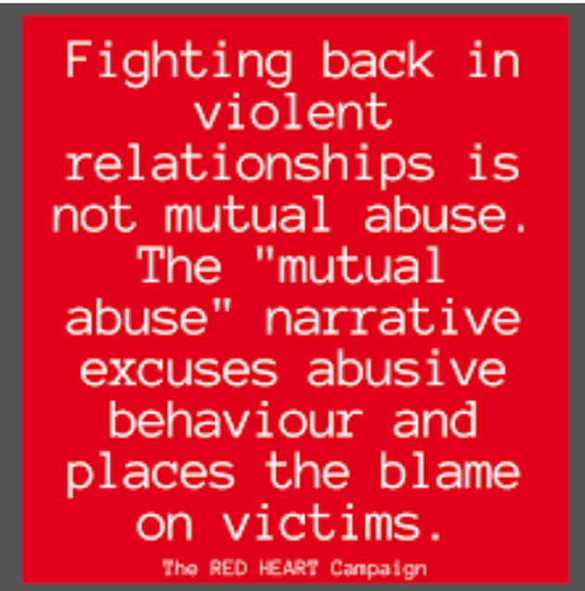
Erasing victimization in sentencing is erasing justice

Slide 51
Thank you!
Dr Frances E Chapman, PhD, LLM, JD, BA
Lakehead University, Bora Laskin Faculty of Law
fchapman@lakeheadu.ca
https://www.lakeheadu.ca/users/C/fchapman
Blog on Freedom of the Mind Blog – Steve Hassan
https://www.youtube.com/watch?v=tlrhHHLvP48
SSRN –my papers https://papers.ssrn.com/sol3/cf_dev/AbsByAuth.cfm?per_id=2165357
Thank you!

