Slide 1

Creating inclusive courts to support people with disability
Professor Lorana Bartels
Dr Sally Eales
International Society for the Reform of Criminal Law Montreal, July 2026

Slide 2
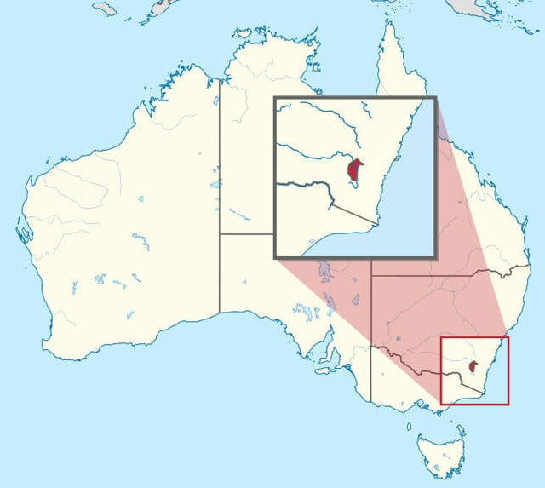
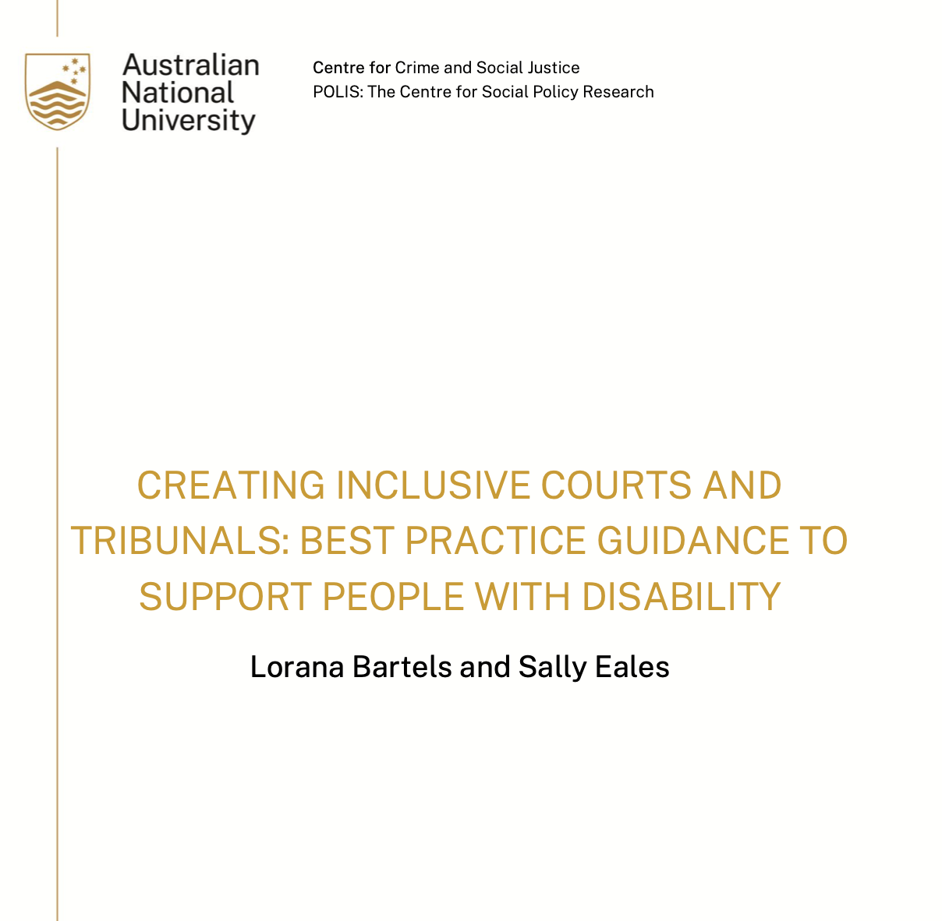
Context
Australia has 9 court systems
    8 state/territory and 1 federal
    nearly all criminal matters resolved in state/territory courts
ACT is Australia’s smallest jurisdiction in size and 2nd smallest in population
highly urbanised and educated, it has the lowest imprisonment rate
this project commissioned by ACT Courts and Tribunal in 2024

Slide 3

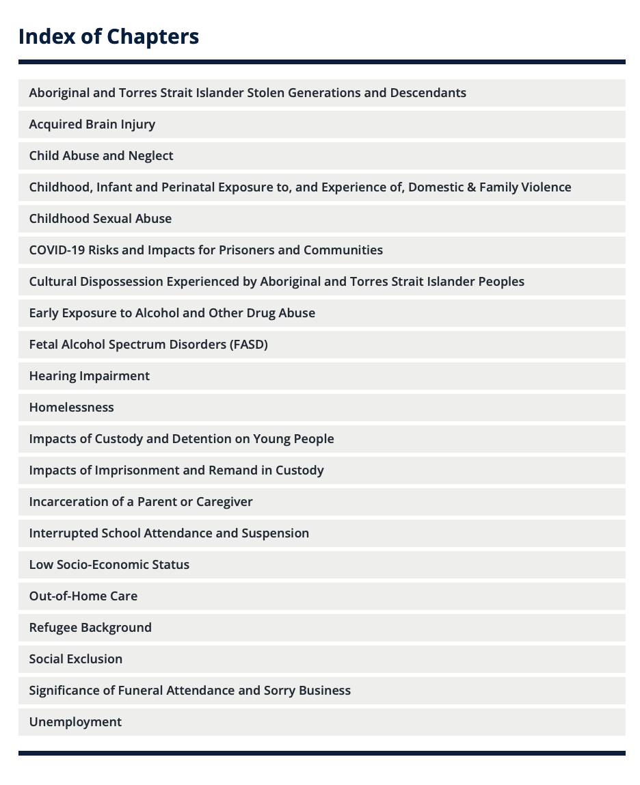
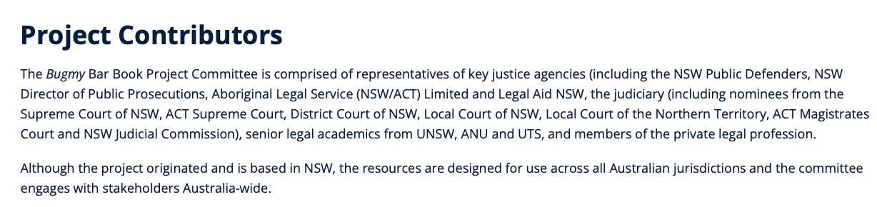
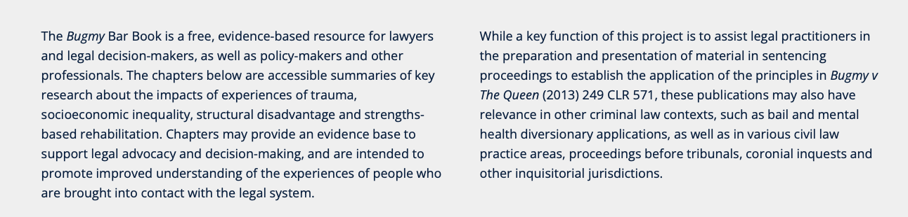
Context
national Disability Royal Commission (2023) made numerous recs about CJS
several bar/bench books provide information on disability issues

Slide 4
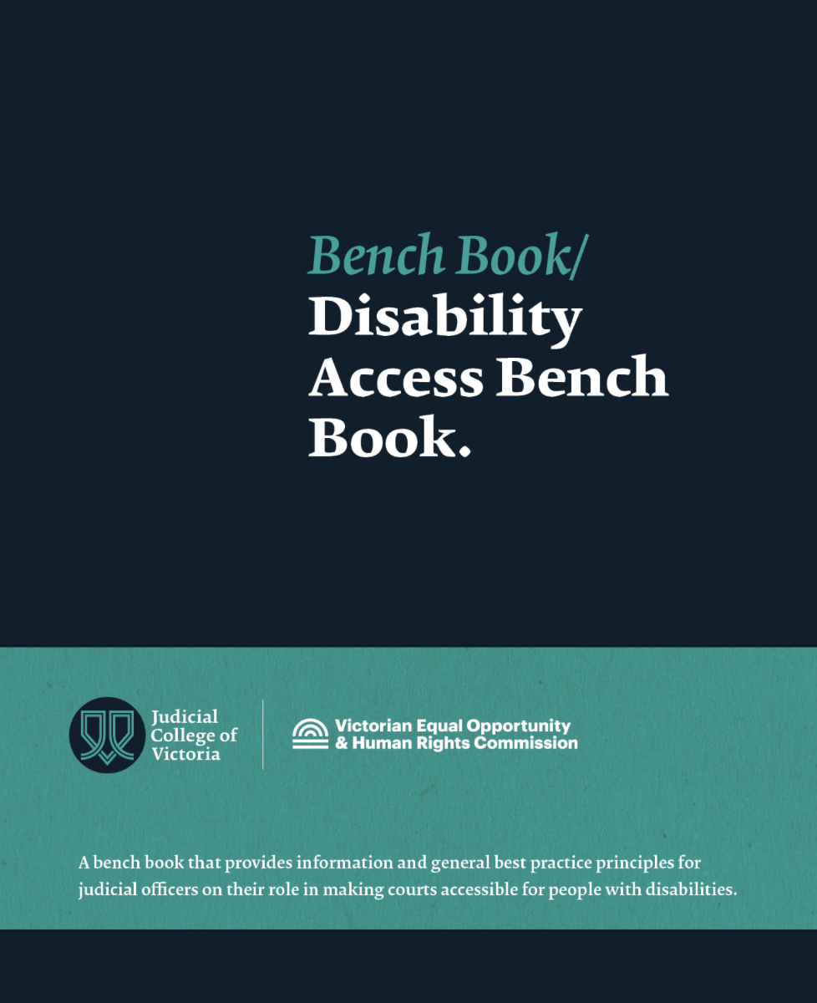
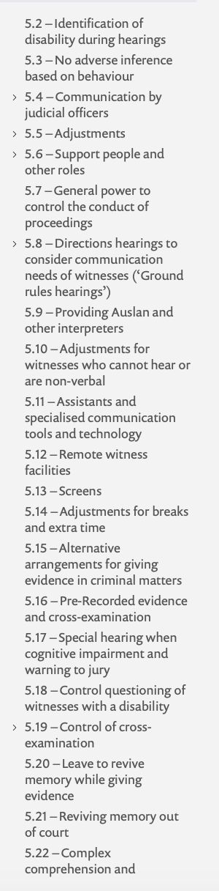
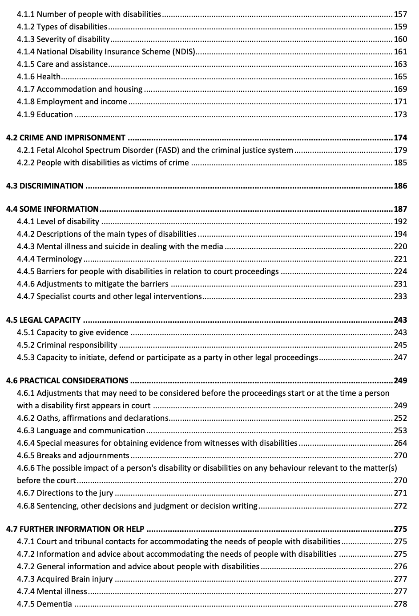

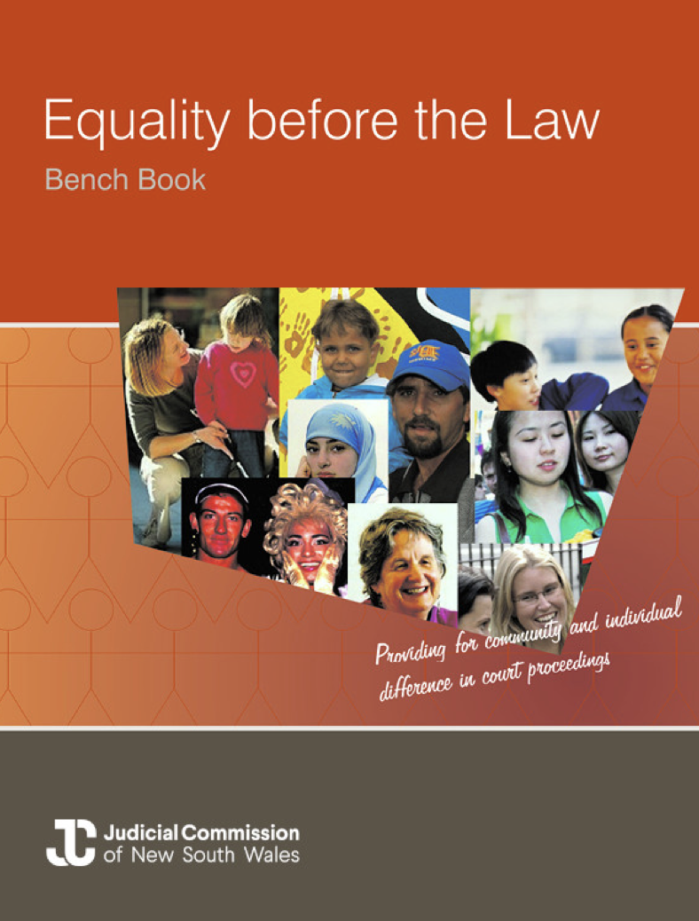
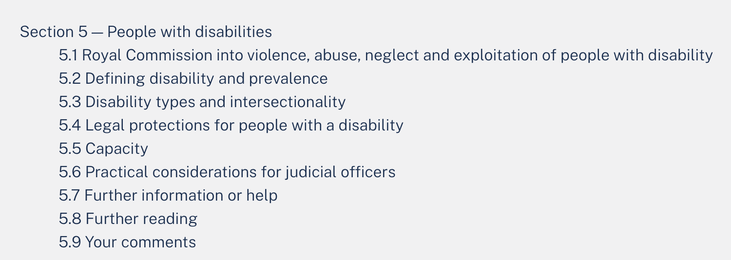

Slide 5
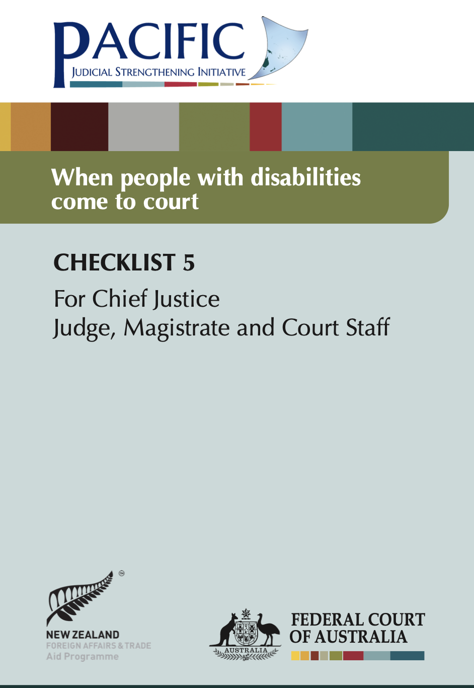
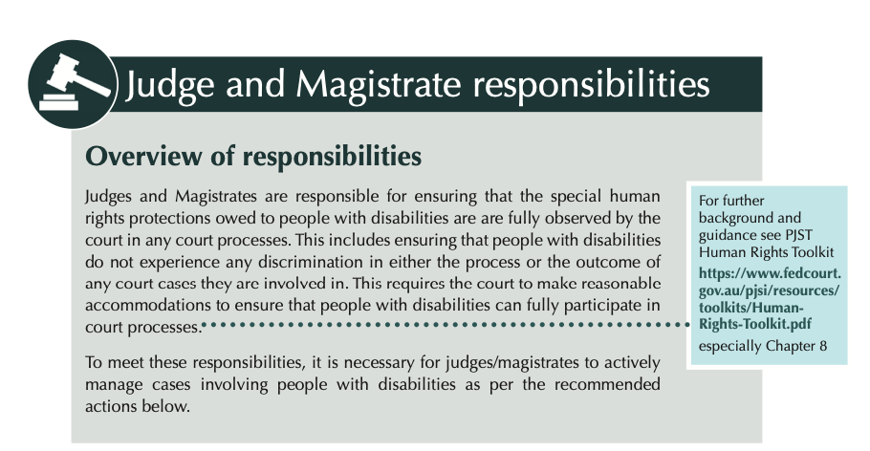
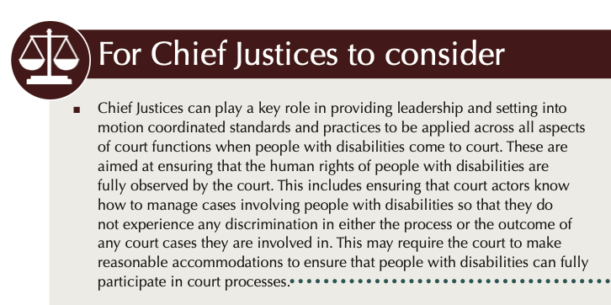
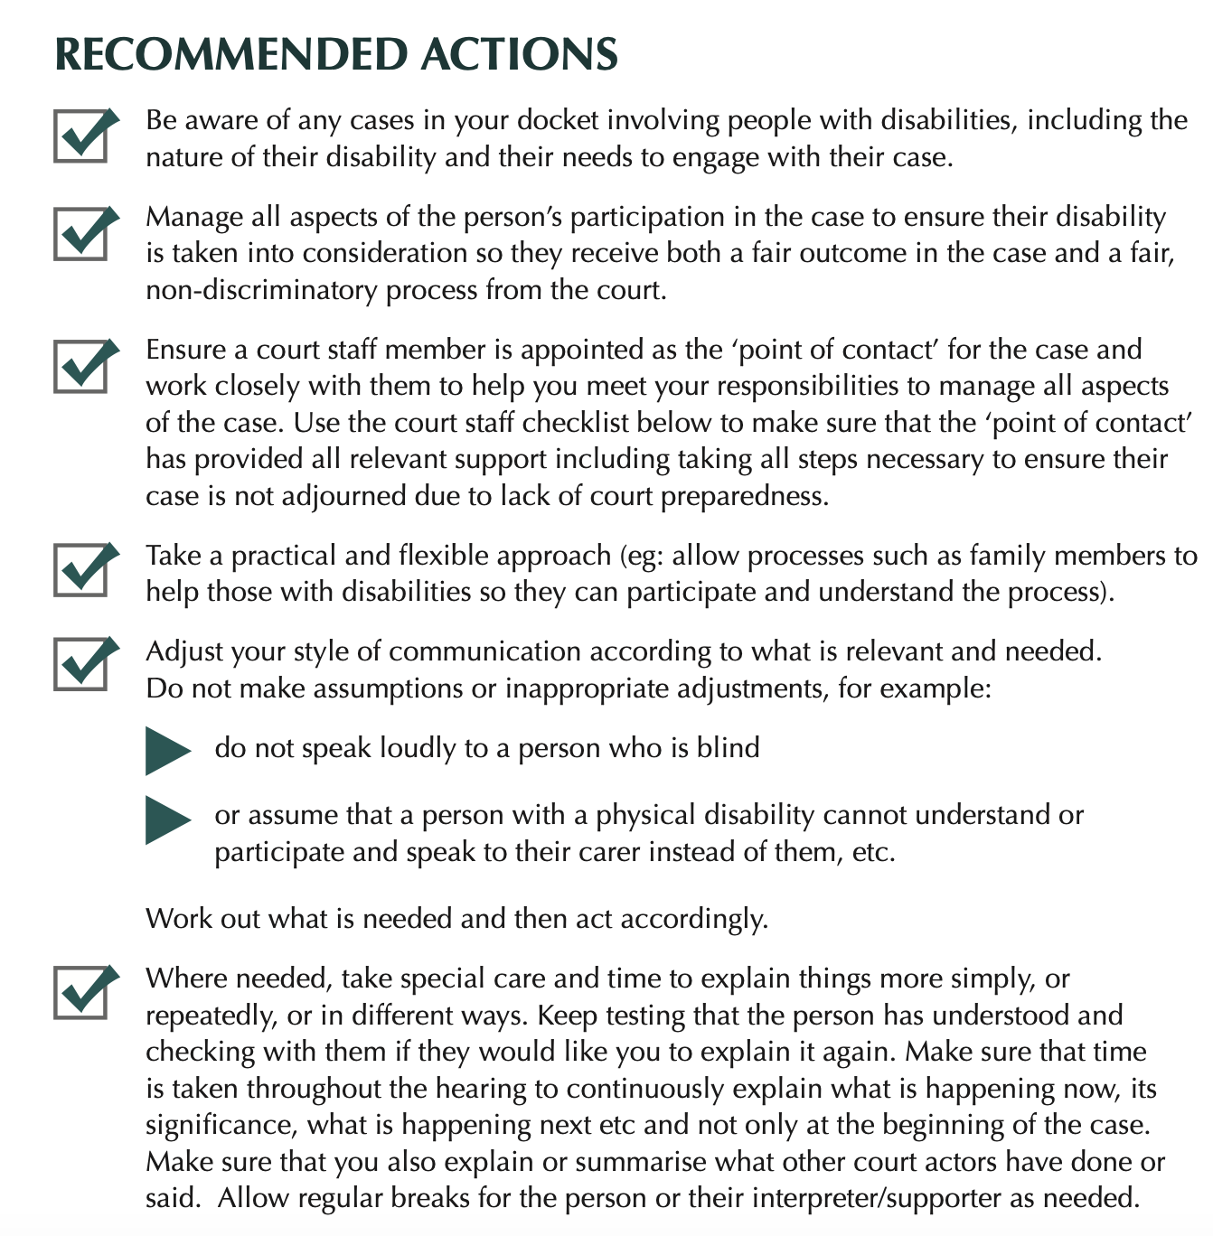

Slide 6
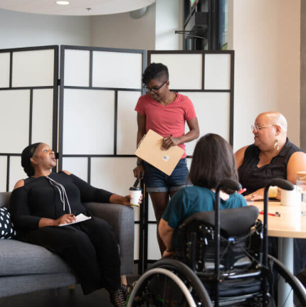
Court accessibility barriers
Core accessibility barriers
Physical barriers (eg, courtroom layout, acoustics, seating)
Communication barriers (lack of language assistance, devices)
Negative attitudes, stigma, misunderstanding
Inadequate support services and legal assistance
Discriminatory practices
⚠️ Additional CJS challenges
Fear of reporting crimes (eg, loss of support services, children)
Power imbalances and competence assumptions
Inadequate time and communication support
🌐 Intersectional impact
Barriers are compounded for certain people with disability (PwD), eg, female, young people, Indigenous, CALD, LGBTIQ+, self-represented litigants
Our research identifies solutions to address these barriers
Disabled and Here/ Gritchelle Fallesgon

Slide 7
Why this research matters
♿ Disability is widespread
around 21% of Australians and 26% of Canadians live with disability
📊 PwD are over-represented in the justice system
34% of people in prison in UK self-identify as having a learning difficulty or disability
Aus data show much higher rates for PwD as both victims and offenders
Indigenous people are over-represented in custody and as PwD
approx. 32% of people in prison in Canada and Australia are Indigenous, despite making up only 5% and 3% of general population
in Australia, 95% of Indigenous defendants have mental illness and/or intellectual disability/cognitive impairment
👁️‍🗨️ Many disabilities are hidden or undiagnosed
courts can’t provide accommodations they don’t know are needed

Slide 8
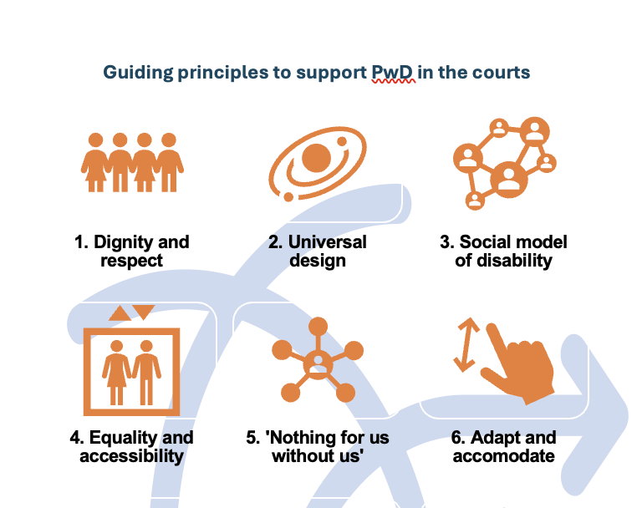
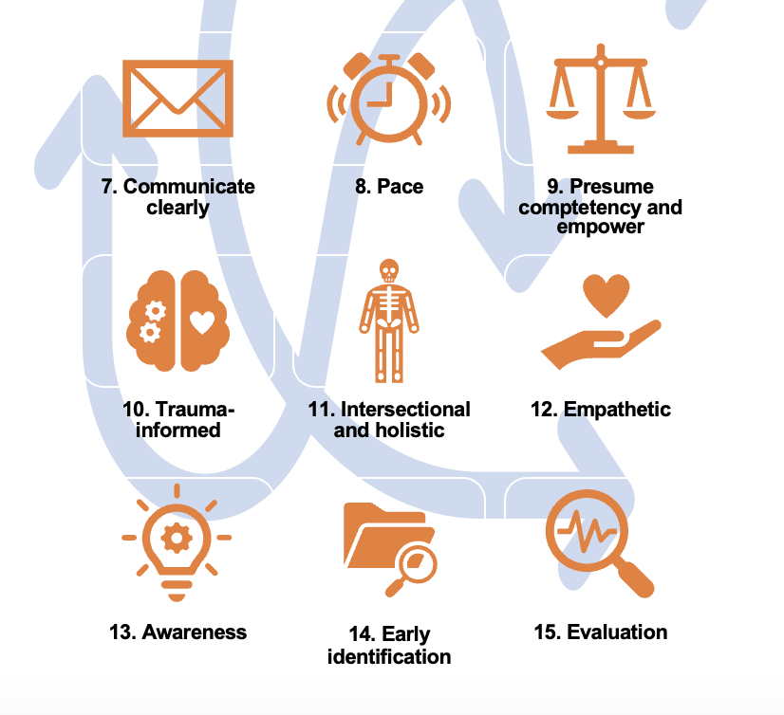

Slide 9
Max’s story Max is an unrepresented defendant. He has one minor assault charge, for which he received a good behaviour bond. This was followed by a long list of failures to appear and breaches of his bond. When the magistrate asks about this, Max explains tearfully that he has always struggled to understand, read and remember things. He says a minor disagreement landed him in court. He also shares that, until recently, he lived at home with his father, who cared for him and read everything to him. However, since his father moved to a nursing home, Max has been left to navigate the legal system alone and doesn’t know who to ask for help. He says that listening to complex information in his own time helps him process it. The magistrate lets Max put his phone on the bar table, to make a voice recording of the order. She dismisses the charges and explains her decision in simple terms. She also suggests some services, where Max can seek support to help him navigate his challenges. Max can play this information back later, to jog his memory.

Slide 10
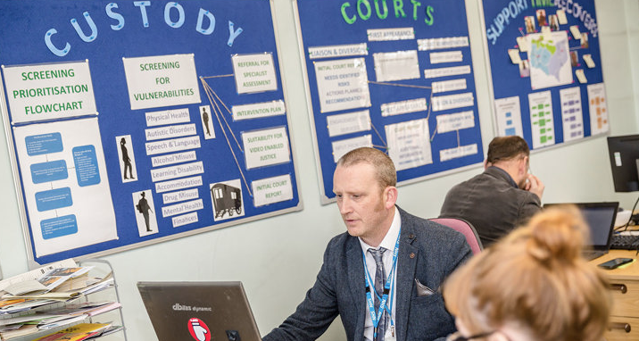
What works: screening
⚠️ Many people willing to disclose, but experience shyness, embarrassment or uncertainty about relevance
Liaison & Diversion (L&D) (UK)
Medical practitioners embedded in police stations and courts
Systematic screening of all people in custody
Increased identification of MH, learning disabilities, neurodiversity, brain injuiries
Information shared with courts → better judicial decisions
→ Data integrated into national health records and shared with defence and courts
Impact: ‘Seen as more independent than police → encourages disclosure’
Kent Liaison & Diversion service.
Source: Kent and Medway NHS and Social Care Partnership Trust

Slide 11
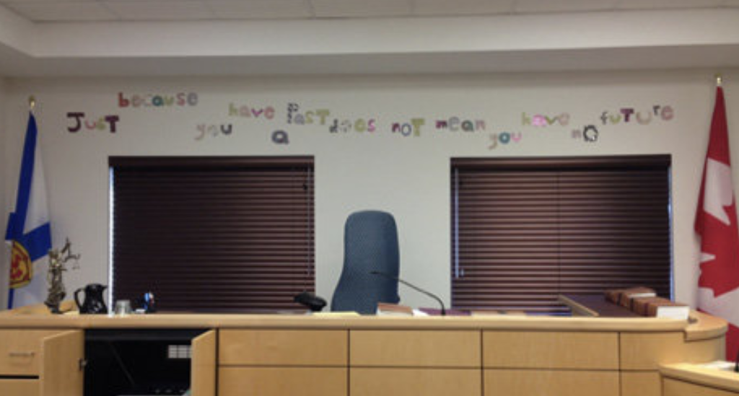
What works: diversion
Mental Health Courts (US)
Began in US in late 1990s
meta-analysis of 30 evaluations linked participation to 74% drop in recidivism
Dartmouth Wellness Court – Nova Scotia (Canada)
Evolved from Nova Scotia MH Court
86% of participants completed the program
‘Wellness’ reframing destigmatises MH and substance use, focusing on wellbeing, without compromising community safety
Emphasises working with victims and repairing relationships
Recognises victims are often defendat’s family, friends and caregivers
Dartmouth Wellness Court, Nova Scotia
💡 Early identification + long-term, wrap-around support = people don’t come back

Slide 12

What works: accessible courts and integrated services
Neighbourhood Justice Centre, Melbourne (Aus)
One facility houses Magistrates’/Children’s Court (criminal) and and Victims of Crime Tribunal
Multi-jurisdictional hub, with on-site MH, housing, AOD services
Single point of entry: one referral connects clients to all services
25% lower reoffending rate vs comparable courts
Cognitive Impairment Diversion Program, NSW (Aus)
Diverted over 87% of participants from court
26% of participants Indigenous
Included screening, assessment, support planning, monitoring and court reporting
described by Disability Royal Commission as ‘life-changing’ and ‘best practice’
despite this, defunded by government
Neighbourhood Justice. Source: Architecture AU

Slide 13
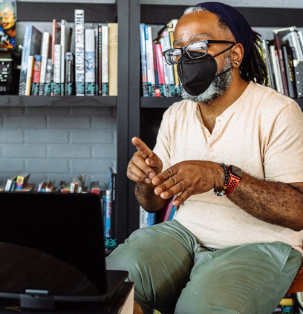
What works: communication and support
The right people around the court user make participation possible
Communication intermediaries (Canada)
Communication Access to Justice trained intermediaries help
police interview appropriately
support lawyers in planning court accommodations
advise judges on the challenges witnesses may face giving evidence
Speech pathology intervention with children (Aus)
significant cost savings and critical for identifying hidden communication needs
  💡 Earlier intervention equals better outcomes Photo: Disabled and Here/ Gritchelle Fallesgon

Slide 14
Amy’s story Amy has a brain injury, from when her ex-husband attempted to strangle her. She has struggled financially and been unemployed since the attack, due to ongoing trauma and physical pain. She started gambling, but this only increased her financial stress. She has been charged with fraud, after making medical claims she was not entitled to. Her lawyer facilitated access to the court’s support dog program and the disability liaison officer, and took steps to make sure that the family violence order against her ex-husband was still in place. He also put relevant information about her situation before the magistrate, who took it into account on sentencing and imposed a community-based order. The order included financial, mental health and employment counselling. Amy also received information about community support and services for gambling, family violence issues and people with disabilities.

Slide 15
Key lessons: CJS interventions
Systematic screening 🔍
Early identification at first contact with CJS
Screening for all suspects
Information-sharing across key agencies
Diversion programs 🔄
Alternative pathways addressing underlying needs
No diagnosis or guilty plea required
Long-term holistic support (housing, employment, health etc)
Adapt for young and Indigenous people
Witness support 👁️
Trauma-informed approach, recognise overlap between victims and defendants
Pre-trial visits/assistance while giving evidence
Co-ordination across CJS

Slide 16
Key lessons: Making courts accessible
Case management 📋
Early identification and data collection
Single point of contact for each person
Colour-coded system
Physical design ♿
Accessible pathways, signage, waiting areas
Hearing loops, tactile information, appropriate lighting
Separate spaces for victims and support services
Communication 🗣️
Plain language and visual guides throughout court precinct
Speech pathologists
Intermediaries to bridge communication gaps

Slide 17
Key lessons: Making courts accessible
Use of technology 💻
Virtual hearings can remove physical barriers
Use technology to demystify processes (eg, apps)
AI has potential to simplify forms and create accommodations (eg, visual tools)
Training and education 📚
Comprehensive staff training (eg, bench/bar books), co-designed with people with lived experience
Disability Access Advisory Committee to monitor progress

Slide 18
Key references
Bartels, L. & Eales, S. (2026). Creating inclusive courts and tribunals: Best practice guidance to support people with disability. Australian National University. https://doi.org/10.25911/6Y 4P-1Y37
Bugmy Bar Book (2026). Home. https://bugmybarbook.org.au
Federal Court of Australia (2020). Checklist 5: When people with disabilities come to court. https://www.fedcourt.gov.au/__data/assets/pdf_file/0009/81666/Human-Rights-Checklist-5.pdf
Judicial College of Victoria (2026). Disability access bench book. https://resources.judicialcollege.vic.edu.au/article/1053839
Judicial Commission of New South Wales (2026). Equality before the law bench book. https://www.judcom.nsw.gov.au/publications/benchbks/equality/index.html

Slide 19
Other sources
Addo, R., et al. (2020). Economic evaluation of the impact of speech pathology services on criminal justice outcomes. Speech Pathology Australia.
Australian Bureau of Statistics. (2024). Disability, ageing and carers, Australia: Summary of findings. https://www.abs.gov.au/statistics/health/disability/disability-ageing-and-carers-australia-summary-findings/latest-release
Australian Institute of Health and Welfare (2024). The health and wellbeing of First Nations people in Australia's prisons 2022. https://www.aihw.gov.au/reports/prisoners/the-health-and-wellbeing-of-first-nations-people-i/summary
Australian Law Reform Commission (2017). Pathways to justice - Inquiry into the incarceration rate of Aboriginal and Torres Strait Islander peoples (ALRC Report 133). https://www.alrc.gov.au/publication/pathways-to-justice-inquiry-into-the-incarceration-rate-of-aboriginal-and-torres-strait-islander-peoples-alrc-report-133/
Disley, E., et al. (2016). Evaluation of the offender liaison and diversion trial schemes. RAND Corporation.
Fox, B. et al. (2021). Assessing the effect of mental health courts on adult and juvenile recidivism: A meta-analysis. American Journal of Criminal Justice, 46, 644–664.
Heath, S. (2023). Communication intermediaries in the Canadian criminal justice system. University of Winnipeg.
Nova Scotia Courts (2024). Wellness court programs. https://www.courts.ns.ca/courts/provincial-court/wellness-court-programs
New South Wales (NSW) Bureau of Crime Statistics and Research (2026). Disability. https://bocsar.nsw.gov.au/topic-areas/disability.html
NSW Department of Communities and Justice (2020). Cognitive Impairment Diversion Program. https://dcj.nsw.gov.au/resources/cognitive-impairment-diversion-program.html
Prisoners' Education Trust (n.d.). Written evidence submitted by Prisoners' Education Trust. UK Parliament. https://committees.parliament.uk/writtenevidence/6266/html
Provincial Court of Nova Scotia Wellness Court Programs Steering Committee (2019). Best practice framework for Nova Scotia wellness court programs.
Public Safety Canada (2023). Parliamentary committee notes: Overrepresentation of Indigenous people in the criminal justice system. https://www.publicsafety.gc.ca/cnt/trnsprnc/brfng-mtrls/prlmntry-bndrs/20230720/12-en.aspx
Ross, S. (2015). Evaluating neighbourhood justice: Measuring and attributing outcomes for a community justice program. Australian Institute of Criminology.
Royal Commission into Violence, Abuse, Neglect and Exploitation of People with Disability (2023). Home. https://disability.royalcommission.gov.au
Statistics Canada (2023). Canadian survey on disability, 2017 to 2022. https://www150.statcan.gc.ca/n1/daily-quotidien/231201/dq231201b-eng.htm
Statistics Canada (2026). Overrepresentation of Indigenous and Black adults in provincial and federal custody. https://www150.statcan.gc.ca/n1/daily-quotidien/260114/dq260114b-eng.htm
Walsh, C., et al. (2023). Supporting Indigenous people with disability in contact with the justice system: A systematic scoping review. Disability & Society, 39(10), 2697–2733.
Image credits
Photographs: Disabled and Here / Gritchelle Fallesgon, CC BY 4.0. Kent Liaison & Diversion service: Kent and Medway NHS and Social Care Partnership Trust. Neighbourhood Justice Centre: Architecture AU. Dartmouth Wellness Court: Dartmouth Provincial Court, Nova Scotia.

Slide 20
Thank you
  Lorana Bartels
  +61 422 729 283
  lorana.bartels@anu.edu.au
  Acknowledgments: This project was funded by the Australian Capital Territory Courts and Tribunal. All views and any errors are the authors’ responsibility.

