Slide 1
Who Decides When a Child Becomes an
Adult? Institutional Design and the Gate
to Adult Punishment in the U.S.
Cara Shaffer, J.D.
Assistant Professor of Law
South Texas College of Law Houston

Slide 2
Sentencing & Imprisonment

Slide 3
Transfer, waiver of jurisdiction, certification as an adult, bindover
The mechanism through which a child is transferred from the juvenile system to the criminal justice system.

Slide 4
How much explanation is required to send a child to the criminal system?

Slide 5
What are appeals courts reviewing in decisions that send children to the criminal system?

Slide 6
Stakes

Slide 7
Background Statistics
Outcomes & notes: children in prison.
Incarceration of US children in adult prisons or jails was associated with a 30% increased risk of mortality during early to mid-adulthood (between ages 18 -39), compared to peers. (This is compared to an 18% increase in the juvenile system).
Children in U.S. carceral facilities face a significantly heightened risk of suicide, rape, and other forms of violence.
Elizabeth S. Barnert, Confining Children in Adult Prisons May Kill Them: New Evidence to Inform Policy Action, J. Am. Med. Assoc. Open, 1 (2023).

Slide 8
U.S. Statistics
Every state has laws that allow children to be transferred from the juvenile system to adult court.
Last year, around 2,000 children were incarcerated in U.S. jails and prisons.
Statistics compiled from fifteen states revealed that juveniles prosecuted in adult court and released from state prisons were rearrested 82 percent of the time.
Youth in Adult Courts, Jails, and Prisons 2 (The Sentencing Project Ed., 2019).

Slide 9
Juvenile Transfer
Transfer decisions are “the single most serious act the juvenile court can perform . . . because once waiver of jurisdiction occurs, the child loses all protective and rehabilitative possibilities available . . .”
Hidalgo v. Texas, 983 S.W.2d 746, 755 (Tex. Crim. App. 1999).

Slide 10
Common Factors
United States v. Kent, 383 U.S. 541 (1966).
o The seriousness of the alleged offense to the community;
o Whether the alleged offense was committed in an aggressive, violent, premeditated, or willful manner;
o Whether the offense was against persons or against property;
o The merit of the complaint;
o Where the co-defendants are adults, the desirability of trying the entire action at one trial;
o The sophistication and maturity of the juvenile;
o Previous contact with the juvenile court; and
o The likelihood of reasonable rehabilitation of the juvenile.

Slide 11
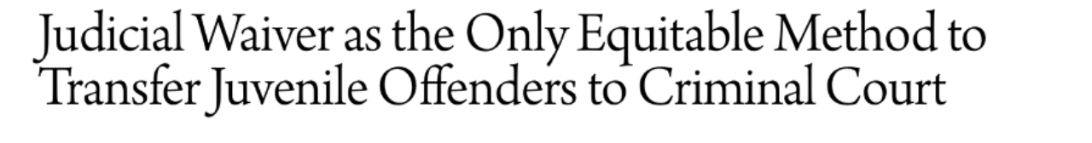
U.S. Juvenile Transfer Laws
Automatic waiver
Prosecutorial waiver
Judicial waiver*

Slide 12
U.S. Transfer- Background
United States v. Kent, 383 U.S. 541 (1966).
Kent v. U.S. established that states that choose to provide transfer hearings must provide reasonable and legitimate procedures, including:
  A hearing;
  Right to counsel
  Sufficient notice to a juvenile's family and attorney;
  and a statement of reasons for the decision to transfer the child.

Slide 13
Issues
The Supreme Court in U.S. v. Kent mandated that juvenile judges must give a statement of considerations or reasons when they decide to transfer a child to adult court. 383 U.S. 541, 547 (1966).

Slide 14
“
[The] statement must set forth the basis for the order with sufficient specificity to permit meaningful review.”
Kent v. United States, 383 U.S. 541, 553-54 (1966).

Slide 15
“Meaningful Review”
Meaningful review requires that the reviewing court should review. It should not be remitted to assumptions.
It must have before it a statement of the reasons motivating the waiver, including, of course, a statement of the relevant facts. It may not "assume" that there are adequate reasons, nor may it merely assume that "full investigation" has been made.

Slide 16
Standards of Review
Abuse of Discretion- An appellate court will only overturn a ruling if it was “manifestly unreasonable, arbitrary, or based on an incorrect application of the law.”

Slide 17
Case Study

Slide 18
Texas
Moon v. State
451 S.W.3d 28, 46 (Tex. Crim. App. 2014).

Slide 19
Language of the Statute
(f) In making the determination required by Subsection (a) of this section, the court shall consider, among other matters:
(1) whether the alleged offense was against person or property, with greater weight in favor of transfer given to offenses against the person;
(2) the sophistication and maturity of the child;
(3) the record and previous history of the child; and
(4) the prospects of adequate protection of the public and the likelihood of the rehabilitation of the child by use of procedures, services, and facilities currently available to the juvenile court.
Language of the Transfer Order
“There is probable cause to believe that the child committed the OFFENSE alleged and that because of the seriousness of the OFFENSE, the welfare of the community requires criminal proceeding. . .
[i]n making that determination, the Court ... considered among other matters:
(1) whether the alleged offense was against person or property, with greater weight in favor of transfer given to offenses against the person;
(2) the sophistication and maturity of the child;
(3) the record and previous history of the child; and
(4) the prospects of adequate protection of the public and the likelihood of the rehabilitation of the child by use of procedures, services, and facilities currently available to the juvenile court.

Slide 20
Court of Appeals- 1st
First Court of Appeals reverses the juvenile court’s transfer decision.
The first transfer determination reversal in 25 years.
See Jack Carnegie, Juvenile Justice A Look at How One Case Changed the Certification Process, 78 Tex. B.J. 866, 867 (2015).

Slide 21
After granting the State's Petition for Discretionary Review, the Court of Criminal Appeals went further. In addition to affirming the appeals court's rulings, it rejected the use of printed form orders and required juvenile courts to “show their work” by making individualized fact findings to allow appellate courts to determine whether the juvenile court's “decision was in fact appropriately guided by the statutory criteria, principled, and reasonable ....”
See Jack Carnegie, Juvenile Justice A Look at How One Case Changed the Certification Process, 78 Tex. B.J. 866, 867 (2015).

Slide 22
Meaningful Review in Moon
Moon v. State, 451 S.W.3d 28, 35 (Tex. Crim. App. 2014), overruled by Ex parte Thomas, 623 S.W.3d 370 (Tex. Crim. App. 2021).
“Given this legislative regime, we think it only fitting that a reviewing court should measure sufficiency of the evidence to support the juvenile court's stated reasons for transfer by considering the sufficiency of the evidence to support the facts as they are expressly found by the juvenile court in its certified order.
The appellate court should not be made to rummage through the record for facts that the juvenile court might have found, given the evidence developed at the transfer hearing, but did not include in its written transfer order.”
Rachel M. Zahorsky, Landmark ruling restricts certification of teen offenders as adults, ABA Journal (Aug. 9, 2013), https://www.abajournal.com/news/article/landmark_ruling_restricts_certification_of_teen_offenders_as_adults.
Notes:
Harris County Assistant Public Defender Cheri Duncan said she wasn't sure whether these smaller counties were relying on the same form order certification process used in Harris County.

Slide 23
Ex parte Thomas
Ex parte Thomas, 623 S.W.3d 370 (Tex. Crim. App. 2021).

Slide 24
“But as discussed below, Moon’s court-made requirement—that transferring juvenile courts set out specific fact-findings in the transfer order for transferring the case—is not supported by the text of the statute nor United States Supreme Court precedent.”
And Subsection (h), in any event, requires a juvenile court waiving jurisdiction under (j) to “state specifically in the order its reasons for waiver. . . “None of the provisions quoted above require the juvenile court to recite the underlying facts upon which its reason for transfer is based. Rather, the statutory scheme merely directs the juvenile court to state the reasons for the waiver set out in the statute. The additional language “including the written order and findings of the court” in Section 54.02(h) allows for “findings,” but it does not require case-specific fact-finding beyond a statement of the reasons for transfer. To the extent that language in Moon suggests otherwise, we disavow it.”
Ex parte Thomas, 623 S.W.3d 370, 377, 379 (Tex. Crim. App. 2021).

Slide 25
The Texas District & County Attorneys Association
“Moon is about as overruled as a case can get. After thoroughly deconstructing the purported statutory and constitutional bases for Moon, the court asks the question, “So What is Left of Moon?” The court’s one-word response is ‘Nothing.’”
Ex parte Thomas, The Texas District & County Attorneys Association (Apr. 9, 2021), https://www.tdcaa.com/case-summaries/april-9-2021/

Slide 26
States with case law that demonstrates thin or pro forma reasoning
Nevada
Indiana
Iowa
Kansas
Kentucky
Georgia
Ohio
Alabama

Slide 27
What is meaningful review?

Slide 28
Meaningful Review? United States v. Kent, 383 U.S. 541, 561 (1966)
What does Kent require?
“Meaningful review requires that the reviewing court should review. It should not be remitted to assumptions.

Slide 29
“Meaningful Review”
Consistency & uniform treatment
Fairness
Logic of the decision
Specific facts that guided the decision
ABA Standards for Criminal Justice § 21-1.2(b) (2d ed. 1980), available at http:// www.americanbar.org/publications/criminal_justice_section_archive/crimjust_standards_crimapp
Notes:
This era of changes reveals gaps in the application of the Kent factors, suggesting the need to protect appellate rights.

Slide 30
50-State Survey
Roughly half of the states have statutory language requiring some sort of specificity in the statement of reasons. The language varies widely.
Over half of the states have case law that addresses this issue. States broadly differ in interpreting the language of Kent.

Slide 31
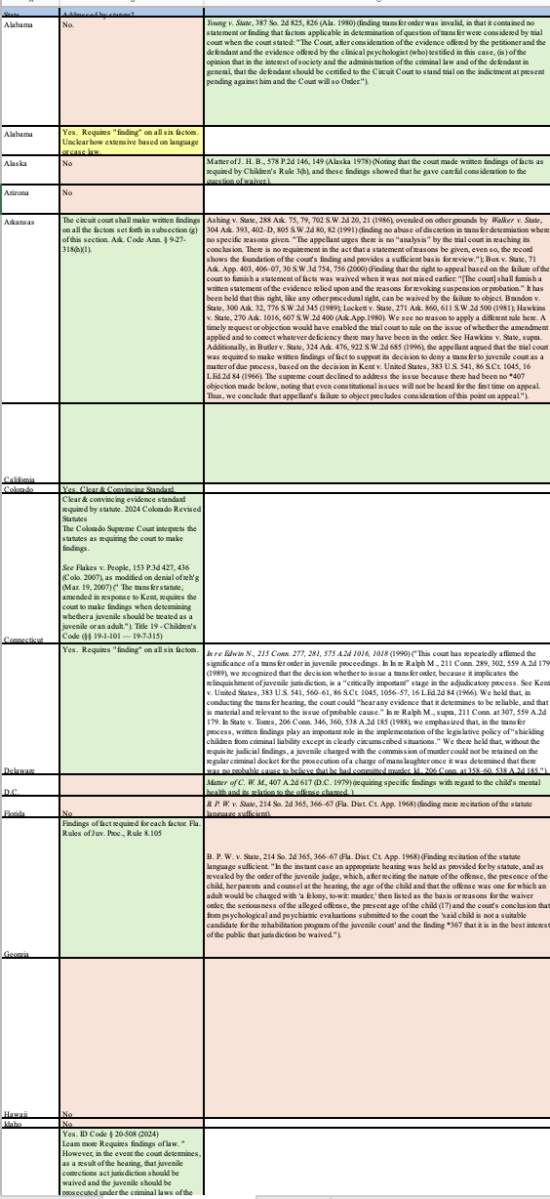
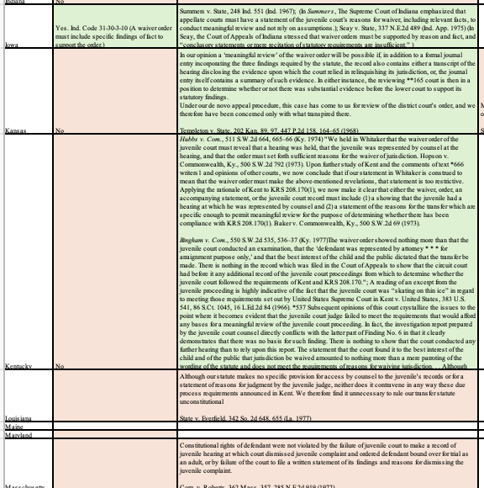
Broad variation in statutory requirements.
Spectrum of requirements in the case law.

Slide 32
Administrability?
In Int. of Doe, 610 P.2d 509, 514 (Haw. 1980) .
“While the circumstances in this case, like those in Stanley, allowed a departure from a literal compliance with Kent and its standards, we think the better practice for the court to follow is to state the reasons for its conclusions in writing and with a degree of specificity that would facilitate a review of its actions without further search of the record for [its] reasons.”

Slide 33
Youth Justice: Policy Landscape Considerations

Slide 34
U.S. legislative landscape: 1990s-2020s

Slide 35
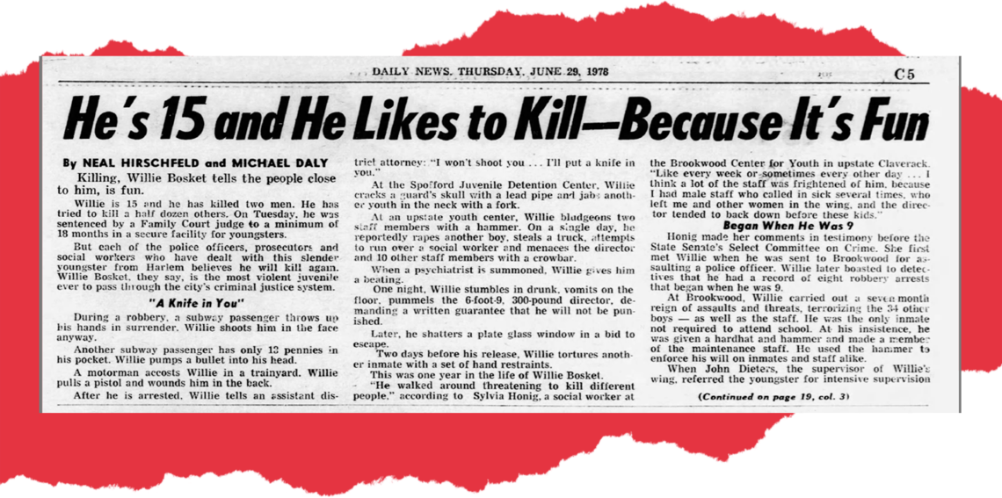
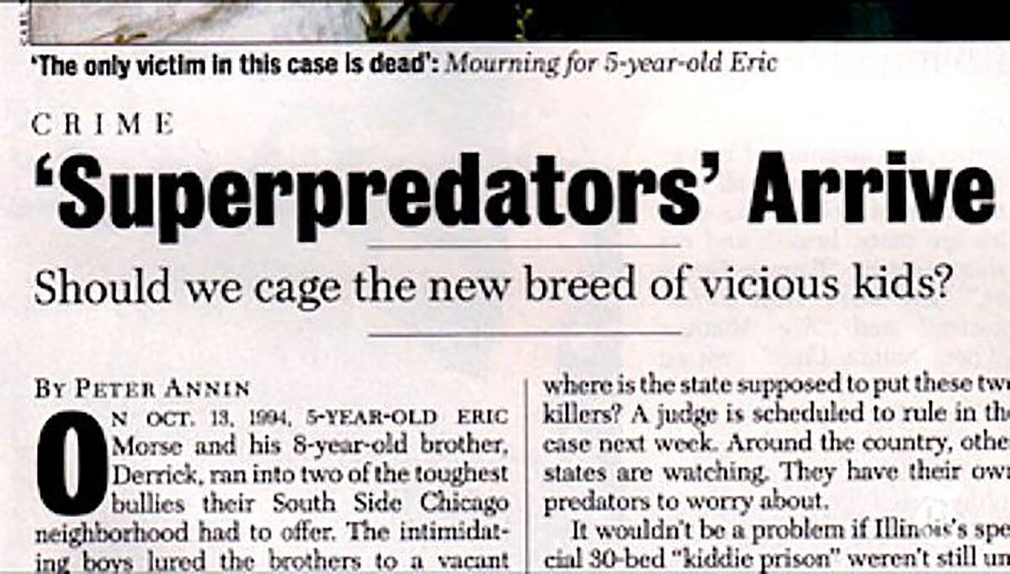

Slide 36
The term “super predator’’ in the context of juvenile crime is ascribed political scientist John J. Dilulio Jr. He used the term in 1995 to describe a “frightening picture” of youth crime—a “coming menace.” Dilulio predicted that there would be a surge of violent youth crime, driven by “moral poverty.” He reported that children of the era were known to “kill or maim on impulse, without any intelligible motive.”
John J. Dilulio Jr., Super Predators, The Weekly Standard (Nov. 27, 1995), http://fbaum.unc.edu/teaching/articles/DiIulioTheWeeklyStandard1995.pdf.

Slide 37
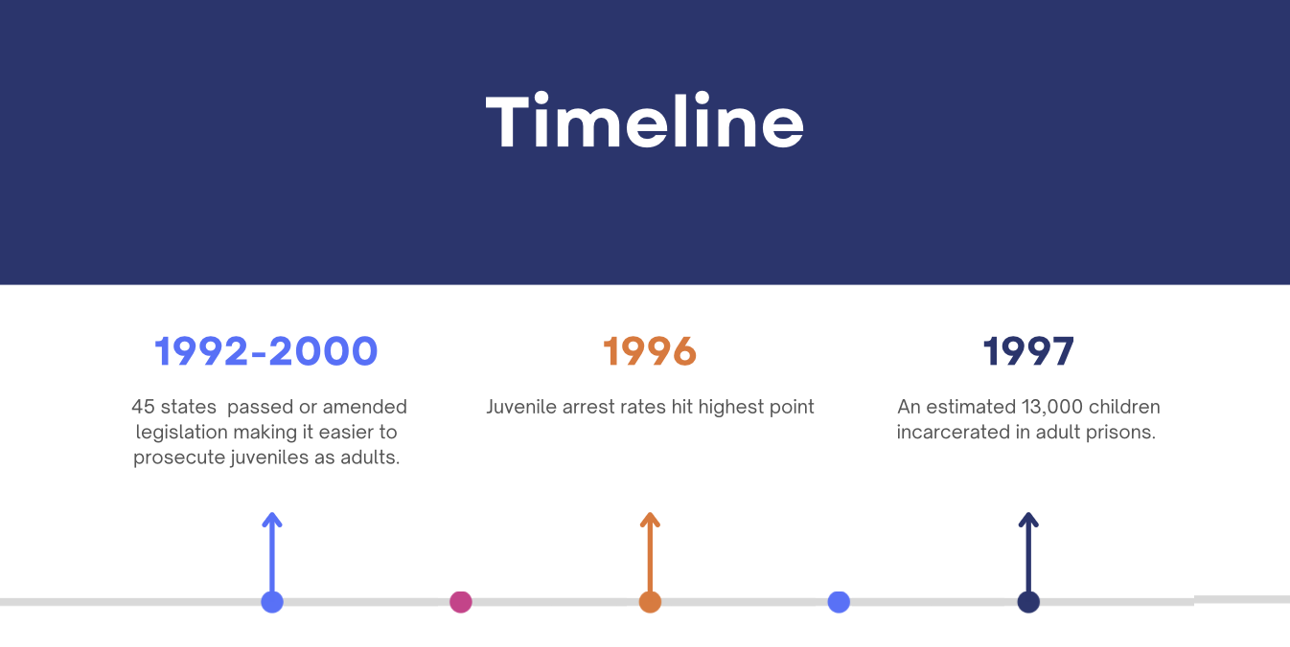
Resources
Reading Materials
1992-2000, 45 states passed or amended legislation that made it easier to prosecute juveniles as adults.
Juveniles in Adult Prisons and Jails: A National Assessment, U.S. Department of Justice (Oct. 2000).

Slide 38
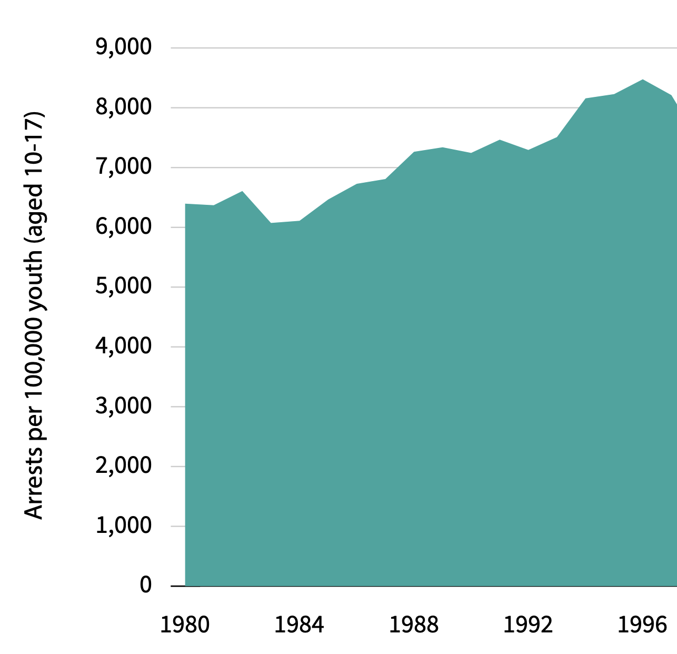
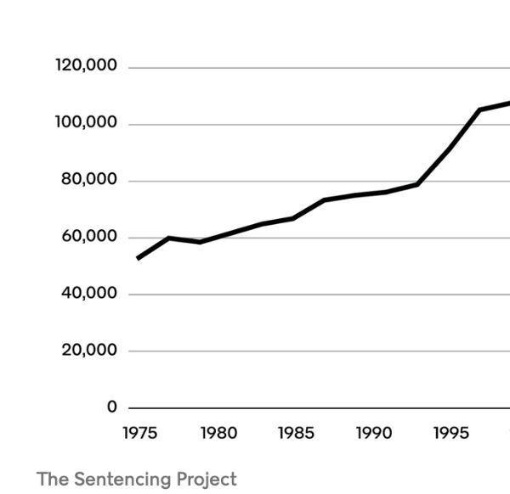
Youth arrest rates 1980-1996
One-day count of youth in juvenile facilities 1975-1995
See Joshua Rovner, Youth Justice by the Numbers, The Sentencing Project (Aug. 14, 2024).

Slide 39
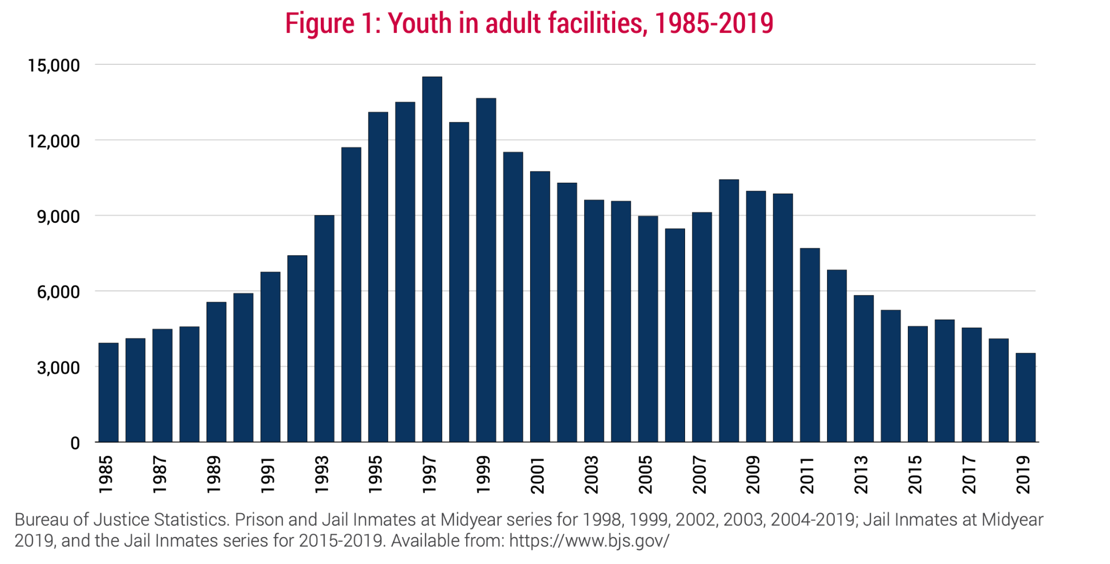
2005-2015: Sea Change

Slide 40
Kent factors- other considerations in fairness & consistency
County discrepancy: Sample discrepancy: Where Harris County's transfer rate stood at 7.4 for every 100,000 juveniles in 2013, the rates in Val Verde and Starr Counties were more than 200 times that.
Demonstrated racial disparity: In U.S. transfer data, Black youth are 53.1% of youth transferred for person offenses— despite the fact that black and white youth make up an equal percentage of youth charged with person offenses, 40.1% and 40.5% respectively, in 2015.
  As of the late aughts in Texas, 8 out of 10 children transferred were Black or Hispanic.

Slide 41
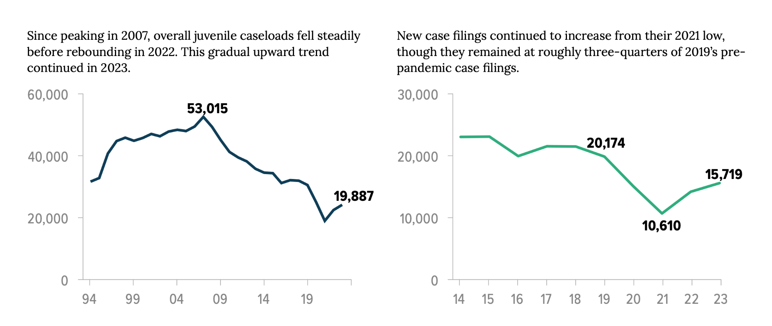
Why Now?

Slide 42
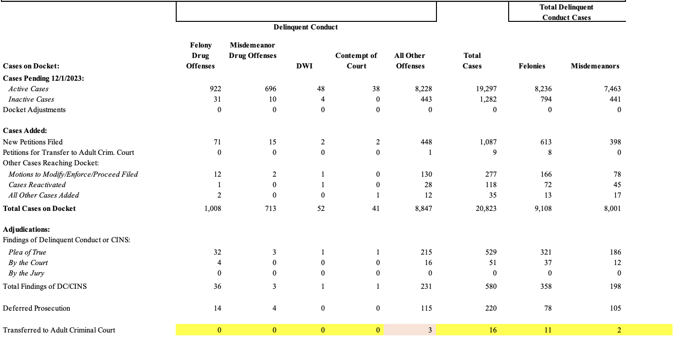

Slide 43
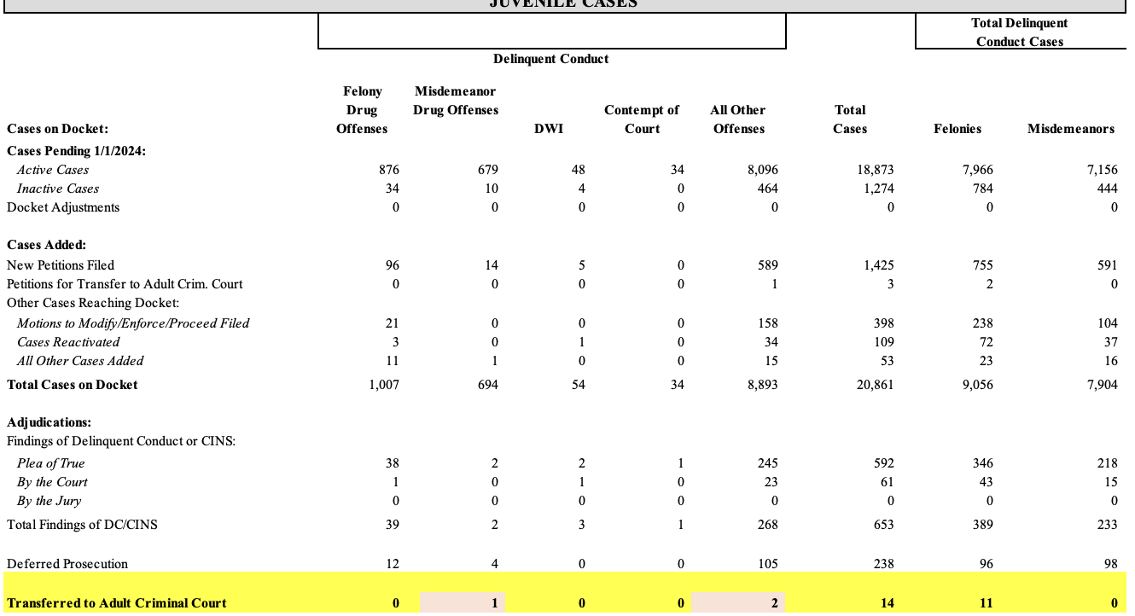
Harris County (January)

Slide 44
New trends?
Last four years: states have begun to put forward legislation that reverses some juvenile justice reforms.
  Key examples: Louisiana (2023) and North Carolina (2022) have passed laws that rolled back reforms and allowed more teenagers to be prosecuted as adults.
See Jeremy Loudenback, After Juvenile Justice Reforms, Two States Return to Prosecuting More Teens as Adults, The Imprint (Aug. 23, 2024), https://imprintnews.org/top-stories/after-juvenile-justice-reforms-two-states-return-to-prosecuting-more-teens-as-adults/251395 (summarizing key legislative efforts).

Slide 45
Data Issues & Limitations
The appellate process acts as a check on abuse of power and misapplication of the law and is particularly important in juvenile court. “Yet, there is universal agreement among scholars that this process is lacking, even astonishingly so, in juvenile practice.” When the issue is raised, scholars and policy makers have limited access to statistical data to define the scope of the problem. This leads to common attribution to few sources, only one of which contains statistical case data.
How frequently courts deny judicial transfer
Appellate data related to how frequently transfer decisions are overturned
See Megan Annitto, Juvenile Justice Appeals, 66 U. MIAMI L. REV. 671, 678 (Spring 2012).

Slide 46
INTERVENTIONS
Statutory Shifts
Juvenile Court Policy

Slide 48
Sample Language:
INDIANA
Seay v. State, 337 N.E.2d 489 (Ind. App. 1975) (finding that, in waiver orders, conclusory statements or mere recitation of statutory requirements are insufficient.”).
KENTUCKY
Schooley v. Com., 556 S.W.2d 912, 914–15 (Ky. Ct. App. 1977) (“A transfer order does not meet the foregoing test if the statement of reasons for the transfer does no more than parrot the language of [the statute.]”)
WASHINGTON
State v. Holland, 635 P.2d 142, 147–48 (Wash. 1981) “The standardized form used by the juvenile court to decline jurisdiction in this case did not provide the necessary specificity to permit meaningful review of the court's decision.”)

Slide 49
Jurisprudence: Trends after Kent
NEW HAMPSHIRE
State v. Smagula, 377 A.2d 608 (N.H. 1977) (requiring separate findings of fact and for counsel to reference “relevant criteria to assist juveniles and their counsel in obtaining meaningful review.”).
WISCONSIN
D.H. v. State, 251 N.W.2d 196 (Wisc. 1977) (holding that to provide meaningful review, juvenile courts must carefully set forth the “relevant facts and reasons motivating the waiver”).

Slide 50
Jurisprudence: Trends after Kent
But see:
ARKANSAS
Ashing v. State, 702 S.W.2d 20, 21 (1986), overruled on other grounds by Walker v. State, 805 S.W.2d 80, 82 (1991) (finding no abuse of discretion in transfer determination where no specific reasons given. "There is no requirement in the act that a statement of reasons be given, even so, the record shows the foundation of the court's finding and provides a sufficient basis for review.").
FLORIDA
B. P. W. v. State, 214 So. 2d 365, 366–67 (Fla. Dist. Ct. App. 1968) (finding mere recitation of the statute language sufficient).
MONTANA
Lujan v. District Court, 505 P.2d 896 (Mont. 1973) (“Juvenile Court Act does not require conventional findings of fact or an express, formal statement of reasons for ordering waiver of juvenile court jurisdiction over juvenile”).

