Slide 1
ADULT TIME FOR
ADULT CRIME?
Sentencing law reform lessons from a case study of moral panic in Melbourne, Australia
PAIGE DARBY, MONASH UNIVERSITY
ISRCL Conference, Montreal, July 2026

Slide 2
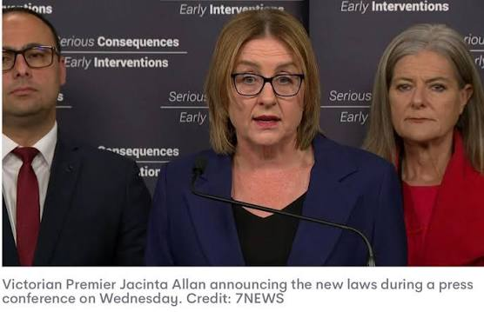
ADULT TIME FOR VIOLENT CRIME
On 12 November 2025, the Victorian state government announces it will introduce ‘Adult Time for Violent Crime’ reforms
By 10 December 2025, the policy is law
The tension between responsive reform and ‘frank
and fearless’ advice is amplified (and avoided)
How can traditional evidence-based policy
mechanisms adapt to fast-paced reform?
What lessons can we take from the Victorian experience and the future of sentencing law reform?

Slide 3
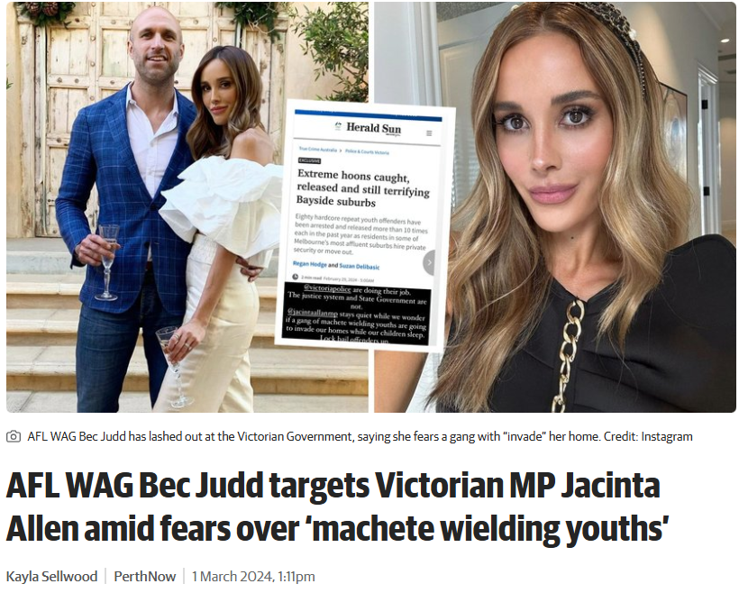
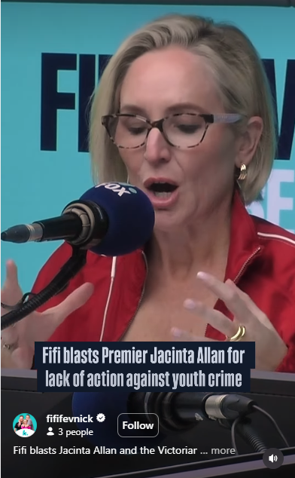
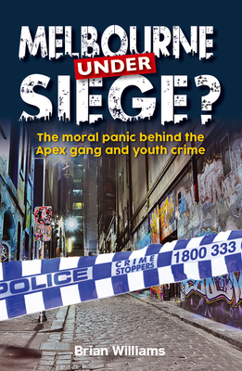
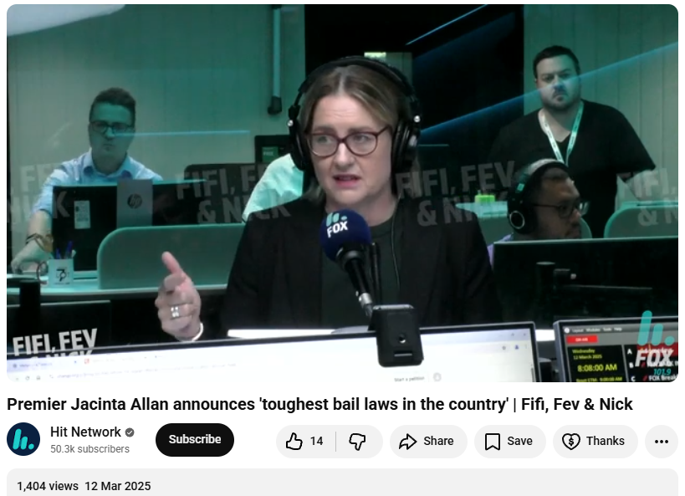
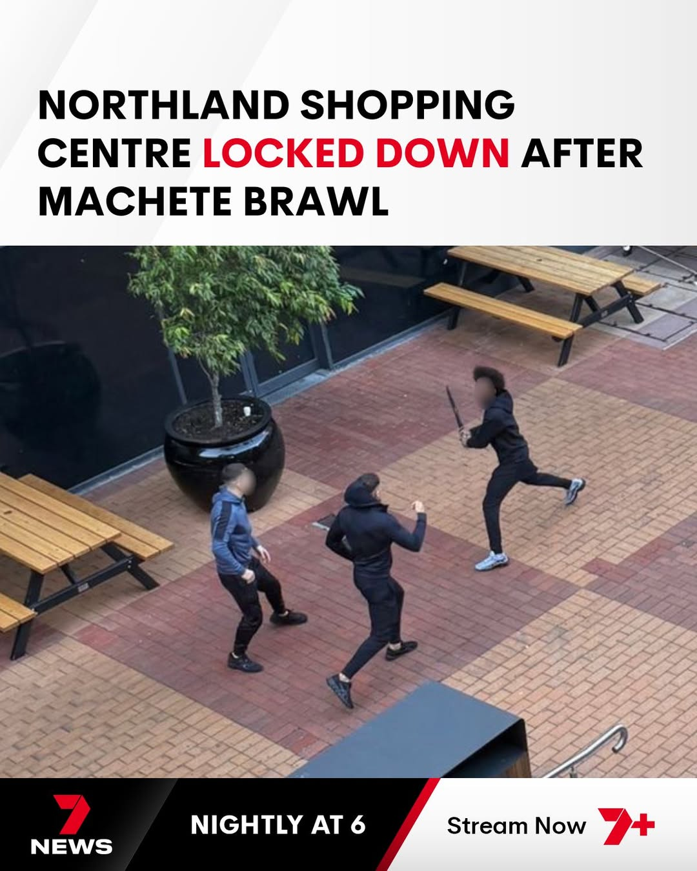
In the 12 months to 30 September 2025, the number of criminal incidents increased, up 12.3% or 52,780 to 483,313 incidents. The rate also increased, up 10.4% to 6,810.2 per 100,000 Victorians. Criminal incidents have reached their highest recorded figures since the commencement of CSA reporting in 2004-05.
- Crime Statistics Agency, December 2025
CATALYSTS FOR REFORM
Increasing crime rate?
High-profile incidents?
Community concern?
Media beat up?
Responsive democracy?
An electoral problem?
Notes:
Mainstream interest in criminal justice policy?!

Slide 4
WHAT DO THE REFORMS DO?
‘Uplift’ children 15 and older to the higher courts
    Aggravated home invasion
    Home invasion
    Intentionally causing injury in circumstances of gross violence (includes
    machete crime)
    Recklessly causing injury in circumstances of gross violence (includes machete crime)
    Aggravated carjacking
    Carjacking (unless substantial and compelling reasons to hear in a lower court)
    Aggravated burglary (if serious and repeated)
    Armed robbery (if serious and repeated)
Increase in maximum penalty for aggravated home invasion and aggravated carjacking (life imprisonment!)
New ‘knife crime’ offence
Amended sentencing principles for young offenders who remain in the lower courts
Serious Consequences, Early Interventions plan – Violence Reduction Unit
Notes:
Violence Reduction Unit: https://www.premier.vic.gov.au/violence-reduction-unit-stop-it-starts
“In short, we have a crime prevention bureaucracy, but what we need is a crime prevention community. That’s where the Violence Reduction Unit comes in – to work with schools, employers, mental health services and more.”
Like all good government programs, this new unit is a rebadging of a pre-existing Community Crime Prevention Unit which had been successfully supporting community programs but had just been abolished through departmental efficiency gains.
Significantly, these reforms did not amend the Sentencing Act 1991 – meaning that current sentencing practices will apply to those offenders uplifted to the higher courts

Slide 5
ADULT TIME FOR VIOLENT CRIME
204 Sentencing principle—protection of the community from reoffending
    A sentence imposed on a child should protect the community from any further offending by the child, noting that efforts to support rehabilitation and positive development are the most effective ways to reduce reoffending.
208 Sentencing principle—minimum intervention
    A sentence imposed on a child should be the minimum intervention required in the circumstances, with a custodial sentence imposed as a last resort and for the minimum period appropriate and necessary.
AMENDED SENTENCING PRINCIPLES
Notes:
Violence Reduction Unit: https://www.premier.vic.gov.au/violence-reduction-unit-stop-it-starts
“In short, we have a crime prevention bureaucracy, but what we need is a crime prevention community. That’s where the Violence Reduction Unit comes in – to work with schools, employers, mental health services and more.”

Slide 6
PURPOSE OF REFORM
ACCORDING TO THE ATTORNEY-GENERAL’S SECOND READING SPEECH:
“There is growing community concern that serious offenders are not being held
accountable for their criminal behaviour.”
“To deter and denounce incidents of serious violent and confrontational offending”
“Increasing the maximum penalties denounces this conduct in the strongest terms and helps ensure that people who commit these offences will face appropriately strong consequences.”
“The Bill makes changes that will prioritise the consideration of community protection and impact on victims when young people are sentenced. Right now, judges are guided by legislative principles that are often out-of-step with the community’s expectations and don’t always recognise what victims have been through.”
“The prevalence of knife crime has had a significant impact both on community safety and the community’s perception of safety – using knives to commit serious and violent offences increase the level of harm caused by crime, exacerbating community concerns and fear.”

Slide 7
IMPACT OF REFORMS?
Alternate charges?
More severe sentences?
More children facing juries?
More guilty pleas?
Less violent crime?
Increased public confidence?
SO FAR… CONFUSION…

Slide 8
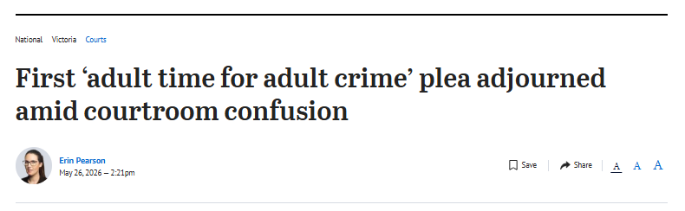
In addressing the relevant sentencing regimes, [the Prosecutor] wrote that pursuant to section 586(1) of the Children, Youth and Families Act 2005, the County Court may exercise any of the sentencing powers of the Children’s Court “except youth detention”. …
Defence lawyer Kate Perry apologised to the victim on her client’s behalf. She then explained to the judge the way things operate in the Children’s Court, noting the new process was all “very murky and unclear”, before the judge replied: “We’re in the County Court with a different sentencing regime.” …
“I’m being asked to make findings and make determinations in accordance with the law,” Judge Johns said. “In my 35 years in criminal law, I’ve never appeared in the Children’s Court.” …
The case was adjourned so that a youth justice report could be prepared.
https://www.theage.com.au/national/victoria/first-adult-time-for-adult-crime-plea-adjourned-amid-courtroom-confusion-20260526-p600nm.html

Slide 9
SENTENCING IN THE CHILDREN’S COURT

Slide 10
CHILDREN, YOUTH AND FAMILIES ACT
SECTION 362(1) APPLIES TO SENTENCING IN THE CHILDREN’S COURT
 | PRINCIPLE | MODEL
(a) | STRENGTHENING FAMILIES | WELFARE
(b) | LIVE AT HOME | WELFARE
(c) | EDUCATION ETC UNDISTURBED | WELFARE
(d) | MINIMISE STIGMA | WELFARE
(e) | SUITABILITY OF SENTENCE | WELFARE/ JUSTICE
(f) | ACCOUNTABILITY | JUSTICE/ WELFARE
(g) | COMMUNITY PROTECTION | JUSTICE
(h) | GOOD ORDER IN DETENTION FACILITIES | JUSTICE

Slide 11
CHILDREN, YOUTH AND FAMILIES ACT
SENTENCING PRINCIPLES
General deterrence is not applicable in the Children’s Court (CNK v The Queen (2011) 32 VR 641 )
Higher courts may exercise powers of the Children’s Court under s 586 CYFA
If a higher court is sentencing a child and the dispositions of the CYFA are inadequate, then general deterrence can be considered but may play an ‘ameliorated role’ (DPP v Anderson [2013] VSCA 45 )

Slide 12
CHILDREN, YOUTH AND FAMILIES ACT
DISPOSITIONS AVAILABLE IN THE CHILDREN’S COURT (LEAST SERIOUS TO MOST SERIOUS)
Dismissal
Non-accountable undertaking
Accountable undertaking (from child and/or parent)
Good behaviour bond
Fine
Probation
Youth supervision order
Youth attendance order (aged 15 - 20)
Youth control order
Detention in youth residential centre (aged <15)
Detention in youth justice centre (aged 15 – 20)
Supervisory orders
Custodial orders

Slide 13
SENTENCING IN THE HIGHER COURTS

Slide 14
SENTENCING ACT 1991 (Vic)
DISPOSITIONS AVAILABLE IN THE HIGHER COURTS (LEAST SERIOUS TO MOST SERIOUS)
Dismissal (without conviction)
Discharge (with conviction)
Adjourned undertaking (with or without conviction)
Fine
Community Correction Order
Detention in youth residential centre (aged <15)
Detention in youth justice centre (aged 15 – 20)
Drug and Alcohol Treatment Order
Court Secure Treatment Order
Imprisonment
Supervisory order
Custodial orders

Slide 15
AGGRAVATED CARJACKING
OFFENCES CREATED IN 2016 WITH MANDATORY SENTENCES ATTACHED
Aggravated carjacking (s 79A, Crimes Act)
Carjacking with a weapon, OR Causing injury while carjacking
Maximum penalty: 25 years’ imprisonment (increased to life imprisonment under these reforms)
Category A serious youth offence (under 21 at time of sentence)
Category 1 offence (over 18 at time of offending)
Presumptive minimum of 3 years non-parole period (over 18 at time of offending)
Carjacking (s 79, Crimes Act):
Steal a vehicle + by application of force or apprehension of force
Maximum penalty: 15 years’ imprisonment
Category B serious youth offence
Category 2 offence
Can be resolved as a ‘theft of a motor vehicle’ charge, which has no limitations on sentencing discretion
Notes:
Offence created in 2016 and subject to continual reform since.
Category A = young offender cannot receive youth justice detention unless exceptional circumstances exist.
Category 1 = mandatory custodial sentence (no exceptions)
Presumptive minimum = must be imposed unless special reasons exist.
Category B = young offender cannot receive youth justice detention if they have prior Category A or B convictions, unless exceptional circumstances exist.
Category 2 = custodial sentence unless certain circumstances exist

Slide 16
YOUTHFUL OFFENDERS
R v Mills [1998] 4 VR 235
"(i) Youth of an offender, particularly a first offender, should be a primary consideration
for a sentencing court where that matter properly arises.
(ii) In the case of a youthful offender, rehabilitation is usually far more important than general
deterrence. This is because punishment may in fact lead to further offending. Thus, for example, individualised treatment focussing on rehabilitation is to be preferred.
(iii) A youthful offender is not to be sent to adult prison if such a disposition can be avoided, especially if he is beginning to appreciate the effect of his past criminality. The benchmark of what is serious as justifying adult imprisonment may be quite high in the case of a youthful offender; and, where the offender has not previously been incarcerated, a shorter period of imprisonment may be justified.”
Azzopardi v The Queen [2011] VSCA 372
“As the level of seriousness of the criminality increases there will be a corresponding reduction in the mitigating effects of the offender's youth. But only in the circumstances of the gravest criminal offending and where there is no realistic prospect of rehabilitation may the mitigatory consideration of youth be viewed as all but extinguished.”
Notes:
What makes someone ‘youthful’? Generally, under the age of 25 where there is evidence of psychosocial or psychobiological immaturity.
This principle hasn’t been excluded and expect it to be applied to children uplifted to the higher courts. However, the weight of this principle diminishes with the severity of the offending (and always has).

Slide 17
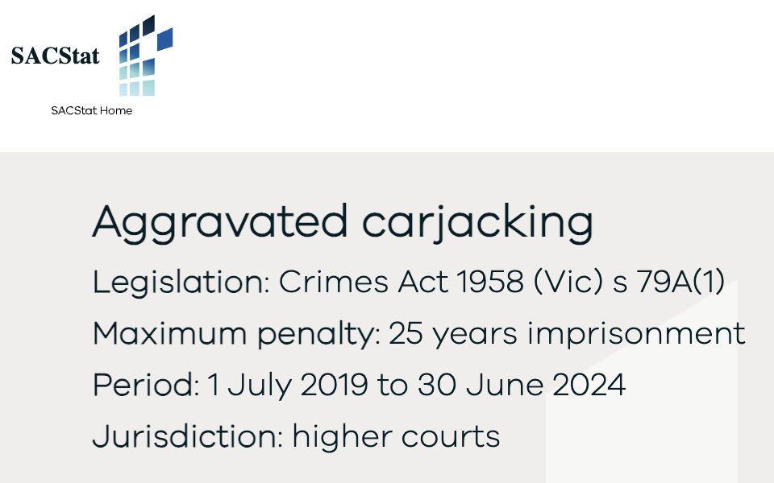
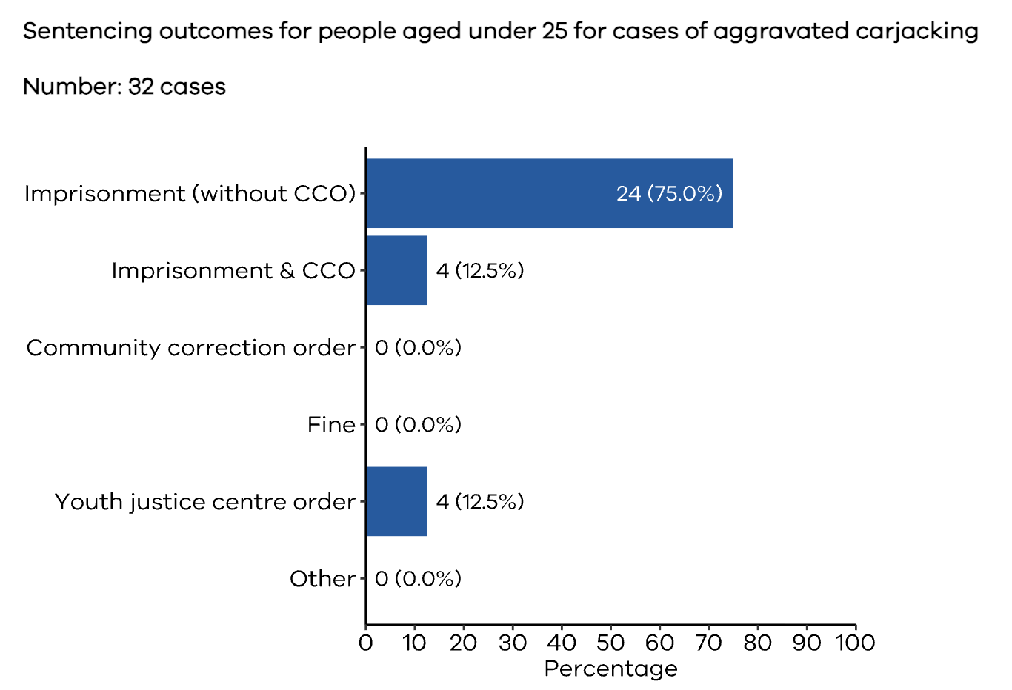
https://www.sacstat.vic.gov.au/hc-vic/aggravated-carjacking-6231-79a-1-hc.html

Slide 18
KEEPING UP WITH THE PACE OF REFORM

Slide 19
AG asks DJCS to brainstorm policy ideas
Key features of the policy remain unsettled
Adult time for violent crime branding prepared
Public announcement
Caucus debates policy settings
Parliamentary introduction
Cabinet considers Premier’s proposals
Urgent drafting for introduction
Bill introduced and second read in both chambers on the same day
Bill passes both chambers in 2 days
Bill receives Royal Assent one week after introduction
Reforms commence (mostly)
TIMELINE OF REFORMS
FROM SLOGAN TO LAW REFORM IN 6 WEEKS
27 Oct
12 Nov
2 Dec
10 Dec
Sumeyya Ilanbey, ‘Inside the Chaotic 48 Hours That Led to Vic Labor’s Crime Crackdown’ Australian Financial Review (12 November 2025) <https://www.afr.com/politics/inside-the-chaotic-48-hours-that-led-to-vic-labor-s-crime-crackdown-20251112-p5nesh>
Notes:
Premier walks a proposal into Cabinet and receives authority to draft a policy without detail
Public announcement on 12 November 2025
Urgent drafting of a Bill
Bill introduced and second read in both chambers on 2 December 2025
Passed both chambers on 4 December
Royal Assent on 9 December
Reforms to offences and penalties commenced 10 December 2025
Changes to sentencing principles and commenced on 26 February 2026

Slide 20
TRADITIONAL LEGISLATIVE PROCESS
Each of these stages usually involves lengthy departmental briefing processes:
Proposals prepared for the annual legislative program
Optional policy proposal stage for endorsement of key policy settings or consultation
Cabinet approval-in-principle (AIP) of drafting instructions
Consultation with key stakeholders
Bill-at-Cabinet (BAC) for endorsement of Draft Bill
Bill Book prepared for introduction to Parliament
Bill first read on next sitting day, and second read the same week. Debate then adjourned to the next sitting week
Bill usually before Parliament for at least four sitting weeks
After debate and passage in both chambers, the Bill receives Royal Assent
Victorian default commencement date 1 year after Royal Assent

Slide 21
TRADITIONAL CABINET PROCESSES
Step 1: Prepare Cabinet submission
(with cover brief and
Cabinet registration forms) for approval-in-principle
Step 2: Send approved Drafting Instructions to Parliamentary Counsel for adequacy
Step 3: When submission is signed by A-G, lodge with Cabinet for circulation to other departments/ ministries
Step 4: Update final draft to include feedback from departments and get Secretary/A-G sign-offs again
Step 5: Lodge final submission with Cabinet Secretariat
Step 6: Prepare speaking notes and a one-page briefing note
for Attorney-General
Step 7: Consideration by Cabinet to approve drafting of a Bill
Step 8: Work with Parliamentary Counsel to draft the legislation according to approved drafting instructions (an iterative process)
Step 9: Consult with stakeholders on policy and draft legislation
Step 11: Prepare second reading, explanatory memorandum and statement of compatibility
Step 12: Support passage through Parliament
Step 10: Repeat steps 1 to 7 to present the Bill to Cabinet

Slide 22
THE PUBLIC CONFIDENCE REFORM ‘CYCLE’
General media coverage
Law reform reports
Emotional drivers
Perceived loss of confidence
Evidence-based drivers
High profile case/s
Academic studies/ measurements
Why?
Judges are wrong
The law is wrong
The community is wrong
Administrators are wrong
How?
Misunderstood law
Out of date
Misunderstood law or reasoning
Misunderstood law
Out of touch
Does not reflect community views
Views not based on facts of cases
Unfair procedures
Too much discretion
Drafting error
Views based on broader distrust
Too much discretion
What is the solution?
Improve operation of the law
Change the law
Make law easier to understand
Change/remove powers
Improve guidance
Repeal the law
Improve communication
Improve guidance
Reduce discretion
Update guidance
Improve education
Improve training
Improve education
Improve relationships
Remove discretion

Slide 23
MODELS OF PUBLIC CONFIDENCE
LAW REFORM
Manage the relationship with public opinion
Harness emotions and target affective policies
Respond directly to penal populism
Make the law more worthy of confidence
Notes:
Managing the relationship with public opinion – including mechanisms that rely on, exclude or inform public opinion (eg, cognitive deficit model)
Making the law more worthy of confidence – including mechanisms that try and
make the law more transparent and comprehensible (like structured sentencing)
make policy development more representative, (through community consultation for example), and
meet, manage or remove expectations through law reform (like setting sentencing ranges or minimums)
Harnessing emotions in crime control – including mechanisms that rely on participatory policy models and leverage lived experience, and
Responding to penal populism – including mechanisms that target the political, media, public and legal aspects of penal populism that are barriers to confidence.

Slide 24
GLIMMERS OF HOPE?
Notes:
There is still scope for large-scale reform – it just must weather the storm of reactive reforms introduced while it is under development.

Slide 25
THE YOUTH JUSTICE ACT 2024
HISTORY OF REFORM
Armitage and Ogloff Youth Justice Review 2017
6 years of policy development in close consultation with the sector and a specific Expert Advisory Group
Introduced to Parliament on 18 June 2024
Passed both chambers on 27 August 2024
Phased commencement:
    Preliminaries – 11 September 2024
    Purposes and some arrest powers – 15 October 2024
    Electronic monitoring of children on bail – 1 April 2025
    Age of criminal responsibility increased to 12 – 30 September 2025
    If not proclaimed, all other provisions (eg, new sentencing principles) commence on 30 September 2026.
Notes:
“We have undertaken significant reform since 2017, guided by the landmark Youth Justice Review and Strategy, conducted by Penny Armytage Professor James Ogloff AM, the Youth Justice Youth Justice Strategic Plan 2020–2030, the Youth Diversion Statement and Wirkara Kulpa, Victoria’s first Aboriginal Youth Justice Strategy.” – Minister’s second reading speech

Slide 26
THE YOUTH JUSTICE ACT 2024
SENTENCING PRINCIPLES
202 Court must have regard to sentencing principles and general common law principles or rules in sentencing a child
203 Sentencing principle—rehabilitation and positive development
204 Sentencing principle—protection of the community from reoffending
205 Sentencing principle—individual characteristics and vulnerabilities
206 Sentencing principle—responsibility for action
207 Sentencing principle—impact on victims
208 Sentencing principle—minimum intervention
209 Sentencing principle—deterrence from committing offences in youth justice custodial centre
210 Additional sentencing principles for Aboriginal children

Slide 27
THE YOUTH JUSTICE ACT 2024
PURPOSE OF REFORM
“This Bill is built on a sound evidence base to respond to youth offending across the continuum and the evidence is clear. We know that disproportionate criminal justice interventions actually increase rather than decrease the risk of offending for children and young people. Community safety is best served through prioritising diversion wherever possible and appropriate, and targeting intensive interventions to children and young people who are most likely to offend seriously and repeatedly. Lasting results are only achieved by addressing the underlying causes of offending and tailoring interventions based on risks and needs.
Of course, the Youth Justice system must also support all children and young people to take responsibility for their behaviour and the harm they have caused to victims. But this must be done in an age-appropriate way to be truly effective. Children and young people are at a unique point in their maturation and development. They have a greater capacity for rehabilitation and change, as long as they receive the proper support.
The Bill provides a robust framework for all this to occur – because at its heart,
this Bill is about making the community safer.”
Notes:
Minister’s second reading speech

Slide 28
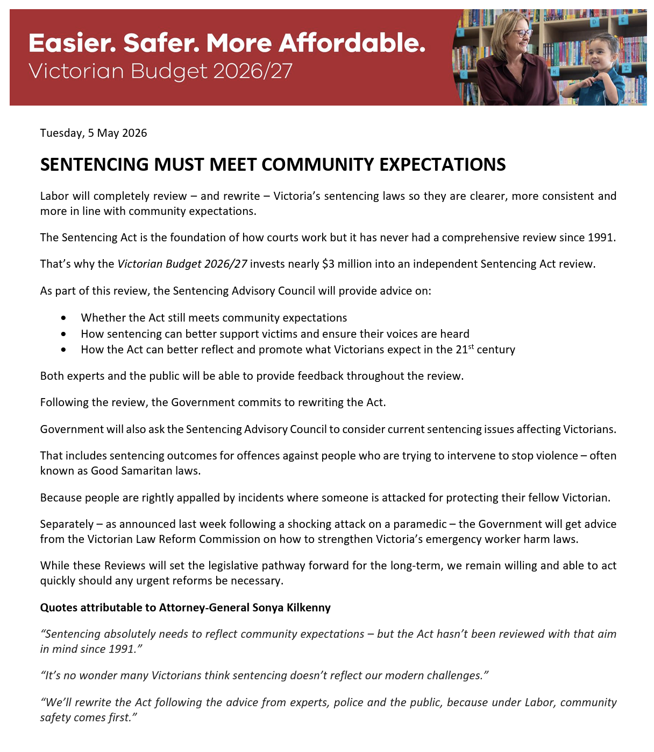

Slide 29
Questions?
Let’s keep the conversation going …
Email me at paige.darby@monash.edu

