Slide 1

Beyond the walls, but still under watch:
the paradox of electronic monitoring and prison overcrowding in Brazil
Prof. André Mendes, FGV Rio Law
andre.mendes@fgv.br
2026 ISRCL International Conference
THINKING BEYOND THE BARS: REIMAGINING BAIL, SENTENCING, AND IMPRISONMENT
Montréal, Quebec | July 16

Slide 2
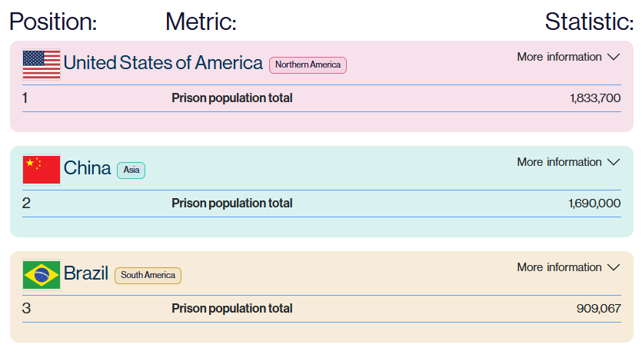

Context and Problem: mass incarceration
Brazil holds the world’s third-largest prison population.
Source: World Prison Brief, Institute for Crime & Justice Policy Research.

Slide 3
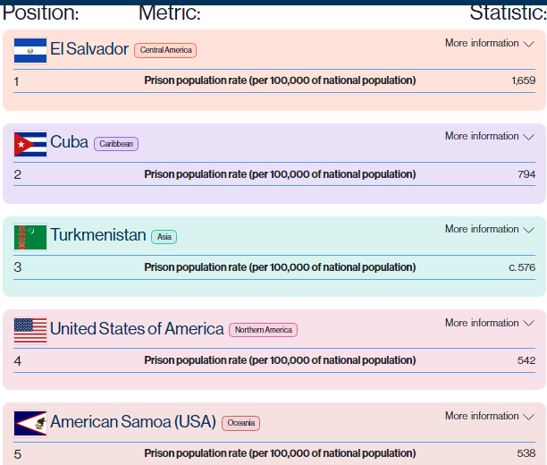
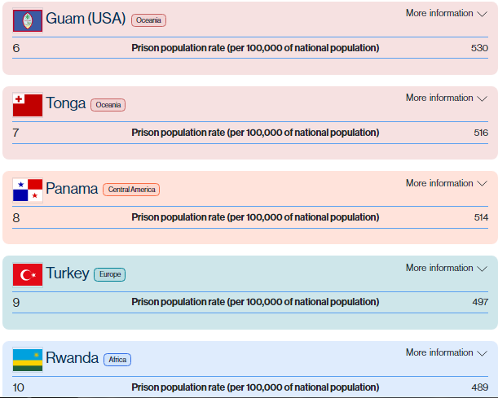
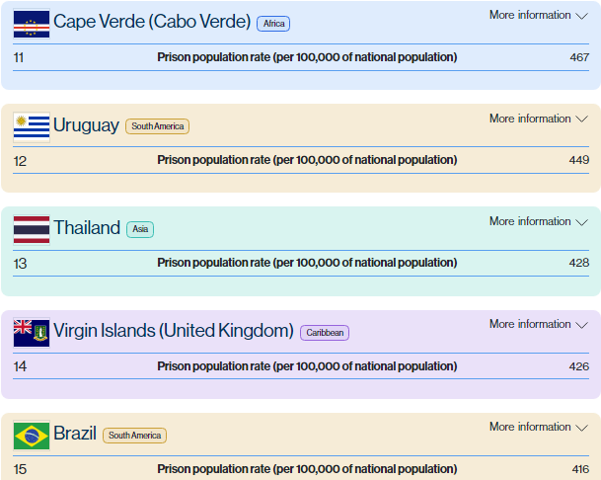

Context and Problem: mass incarceration
Brazil ranks 15th globally in its imprisonment rate per 100,000 population
Source: World Prison Brief, Institute for Crime & Justice Policy Research.

Slide 4
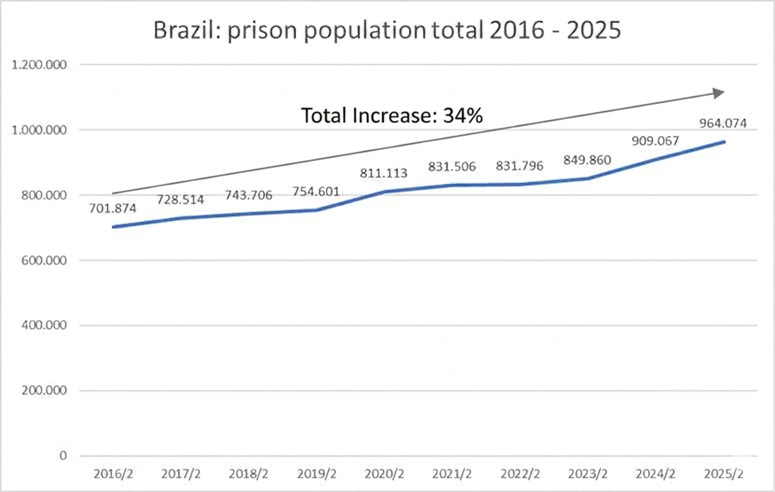
Context and Problem: mass incarceration
Brazil´s prison population increased consistently by 34% between 2016 and 2025, reaching over 964.074 individuals.
Includes:
prison facilities = 730,933
house arrest with eletronic monitoring = 129,810
house arrest without eletronic monitoring = 103.271
Source: SENAPPEN - National Secretariat for Penal Policies

Slide 5
Context and Problem
The system operates at 144% capacity.
Source: SENAPPEN - National Secretariat for Penal Policies

Slide 6
Context and Problem
Deficit of 222,034 prison beds
222,034
Source: SENAPPEN - National Secretariat for Penal Policies

Slide 7



Context and Problem
Besides the deficit of 222,034 prison beds, there is 276,265 arrest warrants to be executed
Source: National Database of Criminal Measures and Prisons (BNMP) - National Council of Justice (CNJ)

Slide 8
Context and Problem
The real deficit would be = 498,299 prison beds
Current capacity is 505.267...
Build a whole new system…
Probably:
Not rational
It would get overcrowded again
Excessively costly: how much?

Slide 9
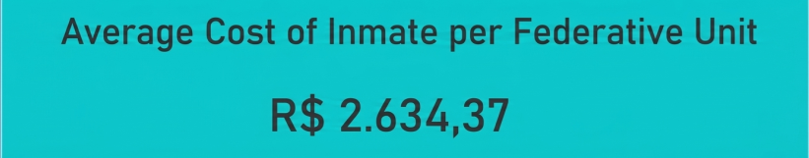

Context and Problem
2025
CAD 726,49
Source: SENAPPEN - National Secretariat for Penal Policies
505.267 prison beds =
BRL 1,33 billion per month
CAD 366,9 million per month

Slide 10
Research Question
Premise: eletronic monitoring as an alternative measure to face prison overcrowding
Does electronic monitoring reduce the prison population in Brazil?
The hypothesis is that electronic monitoring does not change the mass incarceration trend; instead, it serves as a low-cost palliative measure that fails to challenge traditional imprisonment logic.
BRL 301,25 per month*
CAD 83,12 per month
*Source: Management model for the electronic monitoring of individuals. National Council of Justice (CNJ). 2020.

Slide 11
Eletronic monitoring framework in Brazilian criminal justice system:
Correctional process (Post-Conviction): during the sentence serving, house arrest or parole. (Most common)
The Pre-Trial / Procedural Phase (Pre-Conviction): alternative to pre-trial detention (Brazilian Criminal Procedure Code, art. 319, IX.)
Domestic and Gender-Based Violence Interventions: Implemented to monitor perpetrators subject to Urgent Protective Orders

Slide 12
Advantages (The Pros)
Mitigates carceral saturation.
Fiscal efficiency: cost of supervising an individual under electronic monitoring represents a mere fraction of the capital expenditure required to maintain a traditional carceral bed.
Preservation of social bonds: the supervised individual retains critical ties to their family and community, thereby minimizing the institutional trauma and psychological erosion of carceral isolation.
Continuity of employment and education.
Avoid prison criminogenic effect: organized crime recruits inmates

Slide 13
Disadvantages (The Cons)
Social stigmatization: monitoring device institutionalizes social marginalization and creates barriers to labor market entry.
The "Net-Widening" Effect: Judicial authorities frequently impose electronic surveillance on low-level offenders who would otherwise qualify for non-custodial sanctions (such as fines or community service), thereby expanding state control without achieving an actual reduction in the core prison population.
Punishment extends to the family: The domestic sphere is effectively transformed into an extension of the state carceral apparatus.
Public perception of impunity: certain segments of civil society and mainstream media criticize the measure, portraiting it as a systemic failure of punitive accountability or a lack of meaningful retribution.

Slide 14
Eletronic monitoring is increasing, so is overcrowding. Why?
While electronic monitoring is theoretically framed as a "decompressing tool“, mass incarceration persists without a structural shift in criminal policy.
EVIDENCES:
Escalating imprisonment rates: a steady expansion of the carceral population despite technological alternatives.
Legislative trends: the 'toughening' of criminal statutes, characterized by increasing mandatory minimum punishment —a sign of penal populism.
A deficit in legisprudence: A lack of robust 'legisprudence' studies in Brazil, which should ideally provide a rational, justified framework for legislative choices, ensuring they are not merely reactive or populist.

Slide 15
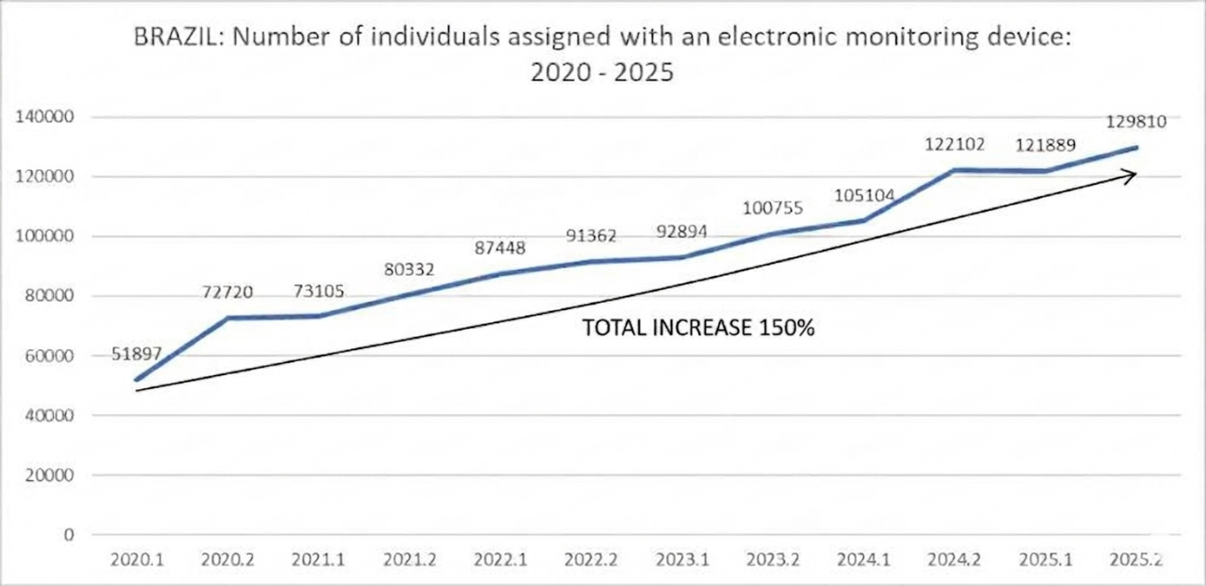
The use of electronic monitoring grew by a staggering 150% from 2020 to 2025.
Source: SENAPPEN - National Secretariat for Penal Policies

Slide 16
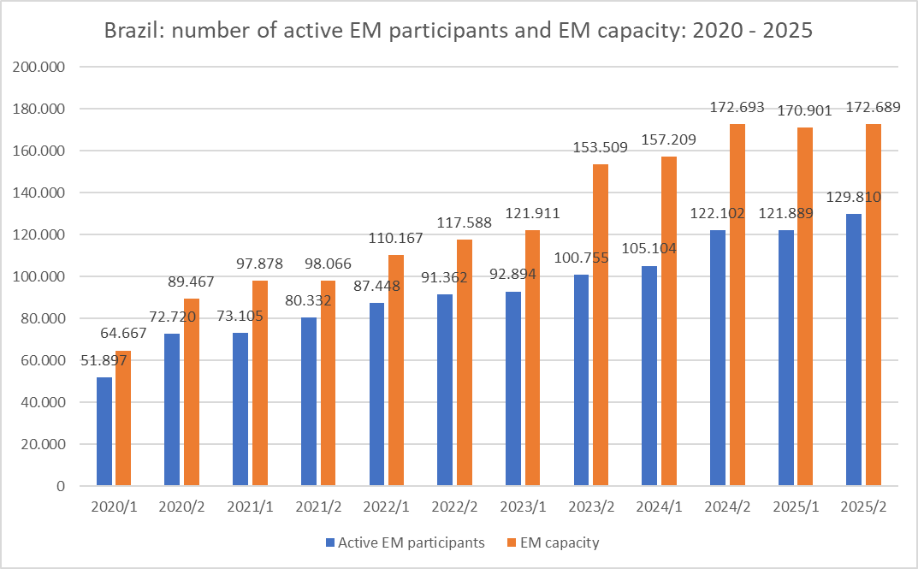
Findings reveal a consistent state strategy of using electronic monitoring to manage overcrowding. “Reimagining" imprisonment in Brazil has become synonymous with "technological expansion."
The data suggests that EM is being used to manage the overflow of a broken system at a lower fiscal cost, without addressing the underlying causes of mass incarceration or reducing crime rates.

Slide 18
169%

Slide 19
Conclusion and contribution
This presentation challenges the perceived success of electronic monitoring. It argues that current policies:
fail to contain mass incarceration,
prioritize cost-reduction over human rights integrity in overcrowded facilities, and
suggest that technology can inadvertently extend the carceral net instead of dismantling it.

Slide 20
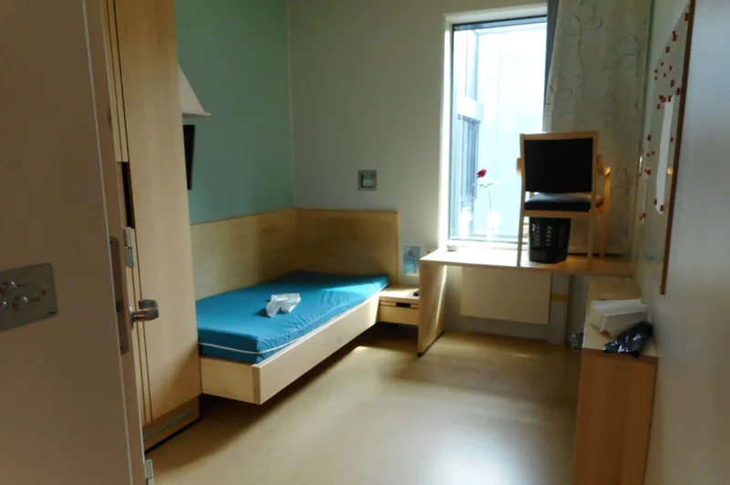
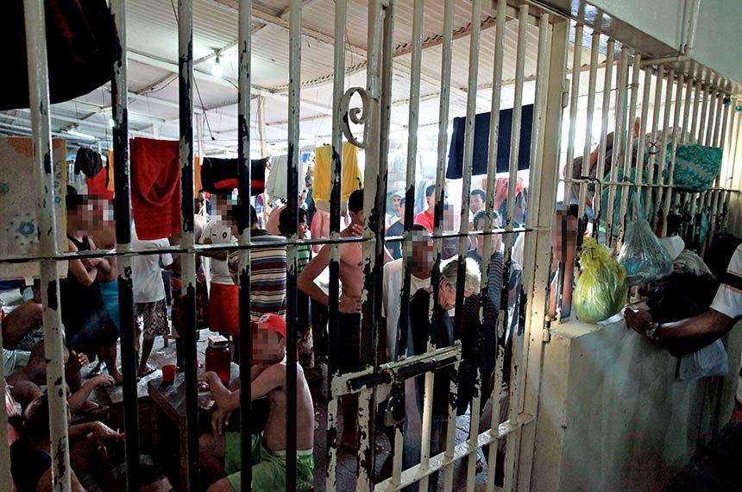
Source: https://www.bbc.com/news/stories-48885846
Source: https://www12.senado.leg.br/noticias/materias/2018/10/03/senado-analisa-projetos-que-tratam-das-condicoes-dos-presidios-brasileiros
It is not possible to rehabilitate through degradation

Slide 21
Thank you!
Prof. André Mendes, FGV Rio Law
andre.mendes@fgv.br

