Slide 1
Sentencing and Remand:
The Scottish Perspective
Lady Drummond
Sheriff Adrian Cottam
Sheriff Jo McDonald

Slide 2
Bail, sentencing and penal reform
Scottish Government consultation
Extending and increasing presumption against short sentences
Strengthening the bail test
Expanding and enhancing community sentencing options
Expanding eligibility for automatic early release
Reintroducing conditional release at 2/3 point for certain long-term prisoners

Slide 3
Sentencing Council Research
Pilot study into the operation of the presumption against short sentences of 12 months or less
Public perceptions of sentencing:
    - 2019 national surveys
    - 2025 national survey
Judicial perspectives:
    - community disposals
    - mental health and sentencing

Slide 4
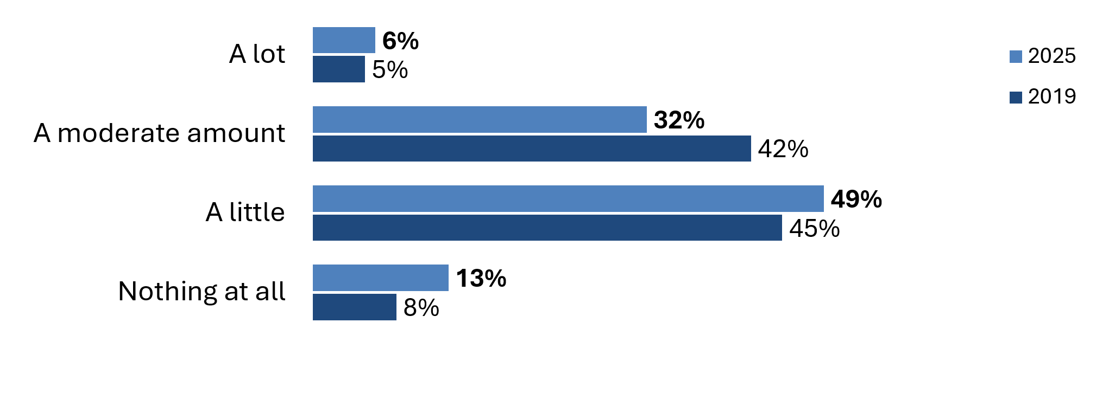
Public perceptions - knowledge
Q: In general, how much, if anything, do you feel you know about the sentences given to people convicted of crimes in Scotland?
Base: All respondents – 2025 (1,001); 2019 (1,001)

Slide 5
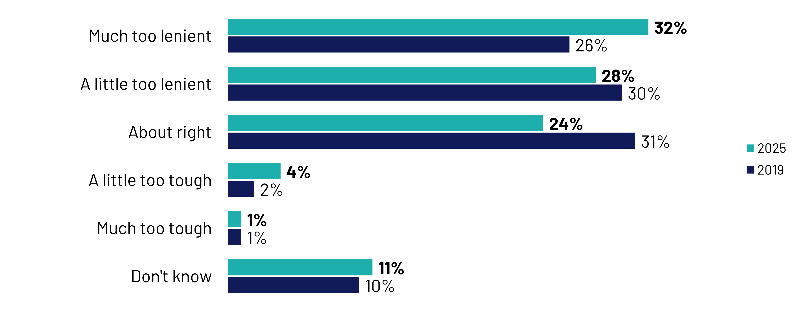
Public perceptions - leniency
Q: In general, would you say that sentences given by the courts in Scotland tend to be …

Slide 6
Public perceptions – community sentencing
Q. Can you say whether you think [this] can be part of a community sentence or not, or if you are not sure? (2026 survey)

Slide 7
Public perceptions – effectiveness
2019 – mixed views of community sentences
2026 – clearer distinctions
  Rehabilitation
    56%: community sentences more effective
    43%: prison sentences more effective
  Public protection
    78%: prison sentences more effective
    41%: community sentences more effective

Slide 8
Public perceptions – demographics (1)
Age differences
  Under 35s
  Least likely to say they knew a lot or a moderate amount about sentencing (30%) compared with those aged 35-64 (38%) and 65+ (47%)
  Less likely to see sentencing as too lenient
  BUT: more open to media influence?
  More likely to prioritise rehabilitation: 42% of 18-34s v. 32% of those 35+
  BUT: more likely to think that short prison sentences more effective than community sentences: 52% of 18-34s v. 41% of those 35+

Slide 9
Public perceptions – demographics (2)
Education differences
Graduates
  More likely to prioritise rehabilitation (47% vs. 27% of non-graduates)
  Less likely to favour short sentences (33% vs. 51% of non-graduates)
  More positive about community sentences overall

Slide 10
Judicial perspectives
Judicial perspectives of community-based disposals, Issues paper (October 2021)
Judicial perspectives of mental health and sentencing, Issues paper (December 2024)

Slide 11
Changing Perceptions of the Scottish Judiciary
A new test for Bail
2.Early release and credit for a curfew
3. Changing our thinking on the purpose of a sentence

Slide 12
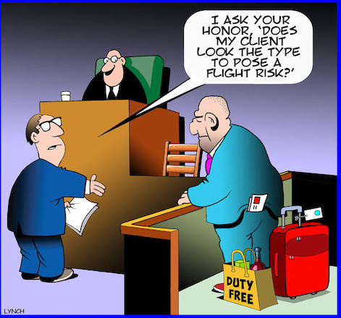
The New Bail Test (Bail and Release from Custody (Scotland) Act 2023)
Notes:
For many years there was a perception that certain cohorts of offenders were remanded primarily due to frustration on the part of the sheriff. Repeated failures ot appear or failures to co-operate with court timetables led to the oft heard “the only way ot get you to court is to remand you”. Whilst hopefully not completely true and of course many were remanded due to the significant nature of offending or their lengthy records, it has to be accepted that research shows a large majority of those accused in summary proceedings never actually get a custodial sentence at the end of the case. I have heard sheriffs saying “a remand will give the shop keepers of Edinburgh a break for a few weeks” or “it will give you a chance to sober up”.
The prison population “crisis” as mentioned by Lady Drummond led to a fresh look by the Government - looking at risk, both to safety and of actual flight from the country.

Slide 13
The New Bail Test
Bail is to be granted to an accused person unless the court determines that there is good reason for refusing bail.
The court may determine that there is good reason for refusing bail only if it considers that—
(a) at least one of the grounds specified in section 23C(1) applies,
and
(b) having regard to the public interest, and having considered ….bail conditions in accordance with subsection (2), it is necessary to refuse bail.
Notes:
The 2023 Act amended our well worn bail provisions in the 1995 Act. The new provisions reiterate the presumption that bail should be granted. This presumption is only rebutted if there is a good reason to refuse bail and it is now a clear two stage test - 1. establishing a ground to refuse and 2. even if a ground has been established a public interest necessity test
The policy intention appears to be that the operation of the new bail test will allow for a greater appreciation in decision-making that those who pose limited or no risks to public safety or to the delivery of justice, but who may need effective support and supervision, can appropriately remain in the community during a criminal court process. The aim is to ensure risks relating to an individual breaching bail conditions are addressed through support and supervision being provided, instead of their being remanded in custody – so removing the frustration, but removing those who are unlikely to get a sentence being remanded

Slide 14
The New Bail Test – Part 2
Once a ground has been established, a good reason for refusing bail can only be established if:
having regard to the public interest, and having considered the imposition of bail conditions in accordance with subsection (2), it is necessary to refuse bail—
        (i) in the interests of public safety, including the protection of the complainer from a risk of harm, or
        (ii) to prevent a significant risk of prejudice to the interests of justice.”
Notes:
The grounds on which a good reason can be found has not changed, so I will not cover them here in detail – they rely on looking of risks of reoffending, breaching orders etc. However the necessity test means the court must think, even with that record, even with a catalogue of say alleged shoplifting or drugs offeindg, how does that impact public safety (not public or our annoyance) or a risk to interests of justice – such as destroying evidence
So at the JI we are asking colleagues to be addressed on , and consider, what do the grounds actually mean –
4.32 Public safety may well be compromised by a repeat violent offender who acts indiscriminately, perhaps towards shopkeepers shop workers or emergency staff. Similarly by A similar interpretation of the section may apply to an accused who targets an individual in a domestic relationship.
4.33 The However, the emphasis on public safety however may potentially rule out the use of remand in cases alleging, for example, in shoplifting, possession of drugs or low level repeat annoying crime, no matter the record
DISCUSSION
What difference do you think this will make
What type of offenders / offences may be impacted
Use paper as discussion if necessary

Slide 15
The New Bail Test – Special Conditions
Section 23B(2) remains unchanged.
“consider the extent to which the public interest could, if bail were granted, be safeguarded by the imposition of bail conditions”.
Section 24(2AA)(iii)
Court shall state “reasons for considering….that either it would not be appropriate to impose on the accused bail conditions subject to a requirement to submit to [electronic] monitoring or that doing so would not adequately safeguard the interests of public safety or justice”
Notes:
And then, in what will hopefully become clear in a moment as a seamless link to the next section of this talk, before satisfying ourselves about the necessity test, we must “consider the extent to which the public interest could, if bail were granted, be safeguarded by the imposition of bail conditions”.
Often special conditions to stay away from a person or locus may well provide the necessary safety. A curfew may assist in avoiding, amongst other things, repeat night-time offending or provide an additional security for public safety.
7.3 It is important to note that special conditions are not to be used where they could simply be viewed as “early punishment” or where they are unnecessary to address the question of safeguarding public safety/interests of justice. But an electronically monitored curfew should always be considered when otherwise the necessity test has been met. And in an increasing drive for accounatbality and telling the public what we are doing we need to give reasons

Slide 16
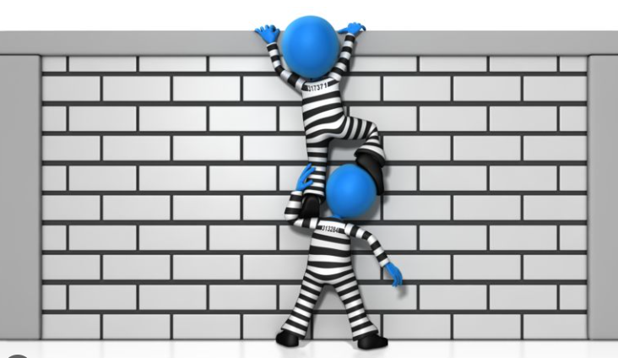
Sentencing and Early Release
Notes:
We have therefore an eye on electronic monitoring, even in serious cases, before a decision is made. This then provides a context for another element of reimaging sentence, and our Government’s approach to cutting the prison population – which you have heard which is higher than ever and having a huge knock on effect not only for prison conditions, but on the chances of rehabilitation.
Two recent changes are
to in effect give credit to accused who are on an electronic curfew, and treat each day where their movement is restricted by having to be at home for 9 hours or more each day as equivalent to a half day in jail, - that means every two days on curfew allows one day of an offenders eventual prison sentence, if they get one, to be treated as already served before they even get in the door;
2 to allow automatic early release after a person serves 30% of their sentence (not long term prisoners or anyone convicted of sexual or domestic abuse offences)
So to illustrate I have two arithmetic tests for you from the Scottish courts – these are examples we are using to try to get colleagues to reimagine what the point and purpose is – and perhaps how to explain to the public what we are doing and why.

Slide 17
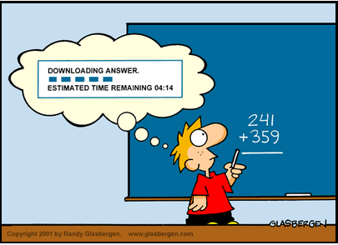
Sentencing and Early Release
Plea at a First diet to multiple House Breakings
Sheriff decides headline sentence due to record is 4 years (1460 days)
Sheriff allows a 25% reduction for plea avoiding trial
On electronic curfew for 13 months (394 days)
How many days will the accused serve?
Notes:
Here is a regular type case – an accused pleads
I;ve given you a starter for ten with the what the sheriff thinks the crime is actually owrth, having looked at record, personal circusmtanes, etc
I am sure plenty of other jurisidtions allow a reduction in sentence for the utilitarian value of plea, so here again I have selected a relativeky common va,lue (how much and when is a whole other discussion!

Slide 18

Four Year Headline – 4 years - 1461 days
Give you a minute..
But Multiple Choice (within 10 days) for
days offender will serve:
A. 548 days
B. 270 days
C. 132 days
D. 99 days
Notes:
How many days with they actually be in prison [put figures back up from previous slide] vote now hands up

Slide 19
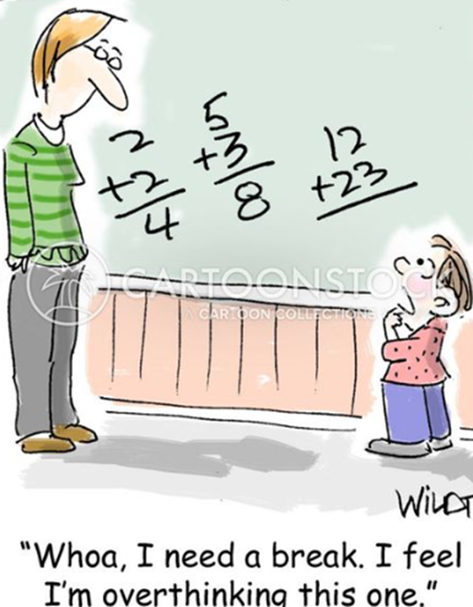
Sentencing and Early Release
4 years sentence =1461 days
25% “discount” = 365 days
Sentence imposed = 3 years = 1096 days
Bail period =394 days
Relevant period = 197 (394 /2) days to be treated
as already served
Court Imposes 1096 days imprisonment and directs
that 197 days be treated as time already served
Sentence to be served= 30% of 1096 = 329
Days in custody 329 – 197 = 132 days
Notes:
A sentencing/arithmetic test :
For those who calculated and came up with answer B (270days) we have checked whether the days served (due to EMO) would be deducted first and then 30% rule applied. SPS have, in confidence for the purposes of training and judicial awareness only, confirmed no, the mechanism is as we see on the screen
For a bonus point, at point would this offender, whose offences and record deserved a 4 year sentence, be eligible for home detention curfew?
It is available to be applied for after serving15% of the full sentence- so 1096 x 15 % = 165 days – they have in fact already served 197 days… so they have already reached the point where 15% of their sentence is served so the prisoner would in fact be eligible for HDC immediately, as you can be on a HDC for up to 210 days
We are asking sheriffs to think - impact of sentence is disproportionate to what you thought it might be? Is a CPO more punitive or fit the purposes better? No rehabilitation at all – easier than a CPO? But – efficacy of another period of ROLO???

Slide 20
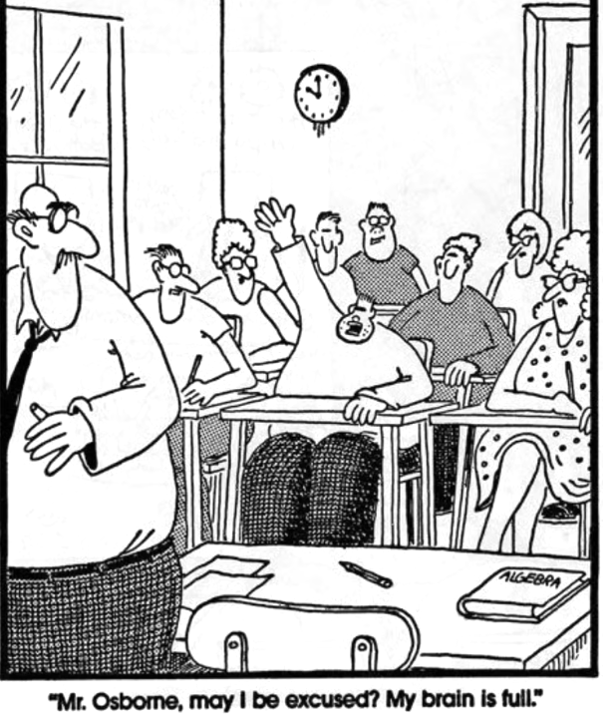
Sentencing and Early Release
Summary Sentence for s.38, threatening behaviour
10 months is headline selected (330 days)
Plea at continued intermediate diet so decides
discount of 20%
Agent advises on curfew for approx. 22 weeks
(160 days)
How long in prison?
Notes:
This second one fits in perfectly with PASS and how we are really having to reimagine what is the point of prison – is it easier to get a sentence than do a community based disposal or turn up in front of Jo every 4 weeks in the women’s offenders court – again a similar exercise, looking at record the public would say let’s get this guy locked up

Slide 21
10 month headline (330 days)
Give you a minute..
But Multiple Choice (within 5 days):
A. 129 days
B. 165 days
C. 59 days
D. 0 days
Notes:
How many days with they actually be in prison [put figures back up from previous slide]

Slide 22
Sentencing and Early Release
Convert to days 10 x 30 = 330
20% of 330 = 66 days
Discounted sentence (330-66) = 264 days
Days on bail (bail period)= 160
Relevant Period 160 / 2
80 days to be treated as served
“Court Imposes 264 days imprisonment and directs
that 80 days be treated as time already served”
Sentence to be served= 30% of 264= 79
Days in custody 79 – 80 =……….
Notes:
And that ties together – a demand on our decision making to think about risk, to use electronic montiriing to miniommise pre-trial risk, keeping people away from placed ot people - but ends potentially in any sentence of imprisonment being ineffective. What can we do – a longer restriction, or actually try and try an try statutory intervention to try to change behaviour – all means we need to re-educate ourselves abot deterrence, public perception and what the purpose of our sentence should actually be.

Slide 23
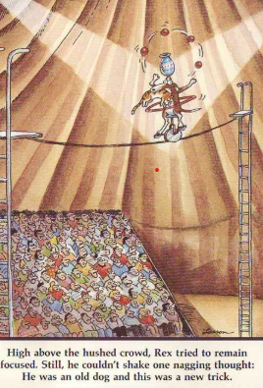
New Ways
Notes:
And this just allows me to use My favourite cartoon – for those can’t read it
And hand you over to Jo with a real example where seeing past jail and concentrating on the offender has allowed the Scottish judiciary to rethink sentnencing – JO:

Slide 24
Structured Deferred Sentences
Sheriff Jo McDonald
Glasgow Sheriff Court

